Slide 1
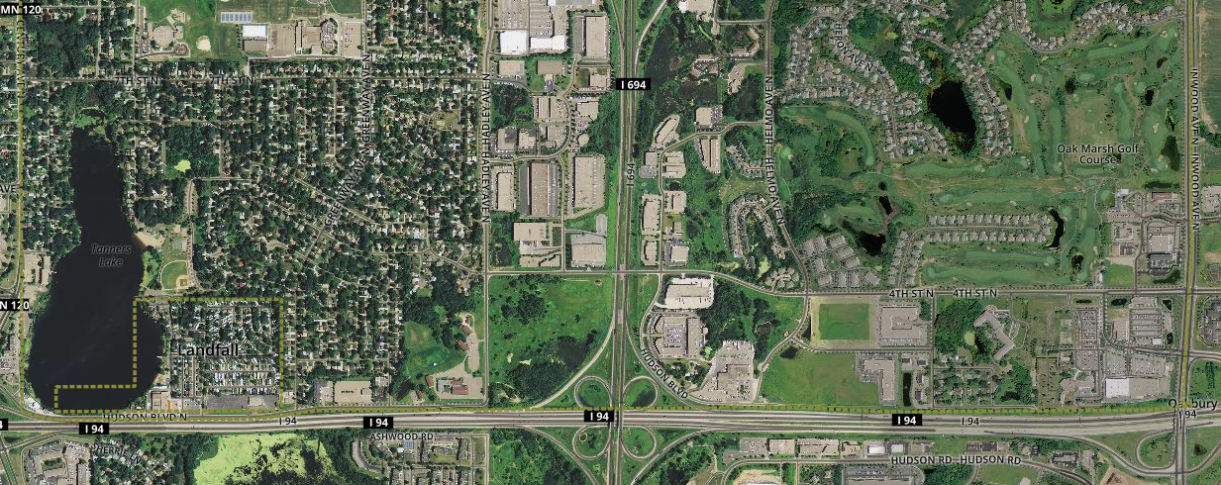
GOLDLINE OAKDALE ALIGNMENT

Slide 2
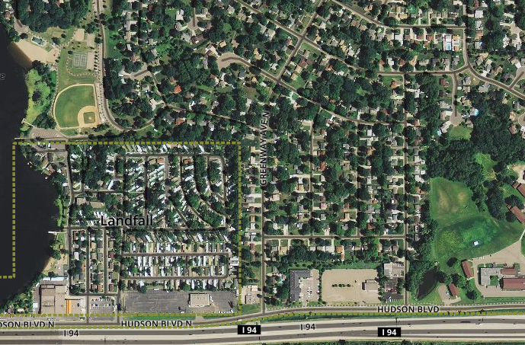
GREENWAY STOP

Slide 3
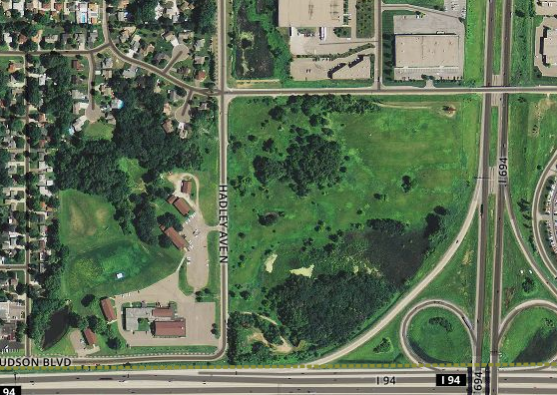
DEVELOPMENT/REDEVELOPMENT AREA

Slide 4
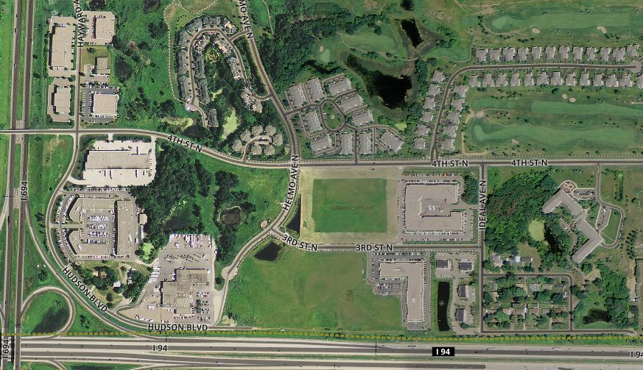
HELMO STOP

