Slide 1
Recommendation of Land Use Advisory Committee on Geographic Planning Areas
August 28, 2013
Committee of the Whole

Slide 2
Why planning areas matter
Use planning areas to effectively plan and implement policies at the local level
Apply different policies tailored for different areas
Recognize context for applying different policies
Make different expectations clear for different communities
Notes:
Through geographic planning areas, the comprehensive development guide sets expectations for different groups of communities on how to implement regional policies at the local level
Expectations that are different based on planning area include, but are not limited to:
Land use and density expectations – for example:
The RDF has a goal to “Work with communities to accommodate growth in a flexible, connected, and efficient manner” directing communities to “Plan for development at appropriate densities,” in addition to other land use strategies.
The RDF then provides specific minimum sewered densities, and maximum unsewered densities, specific to each geographic planning area. For example, Diversified Rural areas are not to exceed densities of 1 unit per 10 acres, Agricultural areas no greater than 1 du/40 acres, and Developing with 3 du/ac.
The RDF directs Developing communities to “consider the need for additional serviceable land for growth beyond 2030,” and to “plan for necessary infrastructure improvements including, as appropriate, executing orderly annexation agreements.
Under the same goal, the RDF directs Diversified Rural areas to “plan development patterns that will protect natural resources,” to “preserve areas where post-2030 growth can be provided with cost-effective and efficient urban infrastructure,” and to “accommodate growth without requiring the provision of regional urban services.”
How to address goal of preservation of natural resources for future generations – some of those are able to be protected through acquisition (rural areas), while others may be in need of restoration or management (more urban areas). For example:
The RDF directs Developed and Developing communities to “permit projects designed to reclaim contaminated lands and restore natural resources where appropriate,” and to “implement best management practices to control and treat stormwater as redevelopment opportunities arise.”
The RDF directs Diversified Rural areas to “conserve, maintain, and restore natural resources identified in regional and local natural resource inventories” and to “integrate natural resource conservation strategies into development plans.”

Slide 3
Overview
Objectives
Time frame for planning areas
Recap of COW meeting on January 30
Role of planning areas
Land Use Advisory Committee (LUAC)
LUAC’s recommendation
Discussion

Slide 4
Objectives
Confirm that the Council will develop new planning areas for Thrive MSP 2040
Discuss Land Use Advisory Committee’s recommendation & affirm general concepts
Provide guidance for refining planning areas as policy discussions continue

Slide 5
Time frame for planning areas
LUAC Jan. 2013
Planning areas & input for COW
LUAC May 2013
Job and activity centers & data analysis
COW Jan. 2013
Planning areas & LUAC’s input
COW Aug. 2013
LUAC’s recommen-dation on planning areas
COW Oct. 2013
Refine planning areas
LUAC July 2013
Recommen-dation to COW on planning areas

Slide 6
Recap of COW on January 30
Importance of geographic planning areas
History of planning areas
Other geographies used for implementation
Role of Land Use Advisory Committee
Input from Land Use Advisory Committee
Main messages and themes on planning areas

Slide 7
LUAC’s role
As requested by the Council, LUAC gives advice and assistance on:
metropolitan land use (Metropolitan Land Planning Act);
comprehensive planning (system statement hearings); and
matters of metropolitan significance
Half of members are locally elected officials

Slide 8
LUAC members (vacancies in two Council Districts)
Jon Commers, Chair
Ginny Black, elected official (District 1)
Tami Diehm, elected official (District 2)
Kim Kang (District 3)
Greg Boe, elected official (Carver County, District 4)
Jon Ulrich, elected official (Scott County, District 4)
Bill Neuendorf (District 5)
Kathi Hemken, elected official (District 6)
Andrew Hestness (District 7)
Chip Halbach (District 8)
Amy Ihlan (District 10)
Phil Klein, elected official (District 11)
Elizabeth Wefel (District 14)
Kristina Smitten (District 12)
Elizabeth Kautz, elected official (District 15)
Bill Droste, elected official (District 16)

Slide 9
Why change planning areas?
Reflect changes in conditions and priorities since the Regional Development Framework
Redefine “Developed” and “Developing” areas for more effective policy implementation
Recognize commonalities that tie communities together
Notes:
1. Reflect changes:
Wastewater treatment system largely built out
Less pressure to grow outward since recession
Recently raised concerns over water supply
Growing demand for access to transit, along with significant capital investment in fixed transitways
2. Redefine developed and developing areas:
Number and diversity of communities not conducive to effective policy implementation
Redevelopment happening across region, not just in developed area
3. Recognize commonalities that tie communities together
Water supply
Transit and transportation corridors

Slide 10
Current Geographic Planning Areas

Slide 11
LUAC’s recommendation
Conceptual in nature
Does not specify definitions, policies, boundaries, or names for planning areas
Based on:
input from LUAC and the COW;
Metropolitan Council’s statutory authority; and
staff research and review

Slide 12
Recommendation includes
Characteristics at the community level
Keeps characteristics of current planning areas
Adds intersection density and age of housing
Features that transcend community borders
Existing job & activity centers
Transportation corridors
Potential for redevelopment, reuse and infill
Groundwater recharge potential

Slide 13
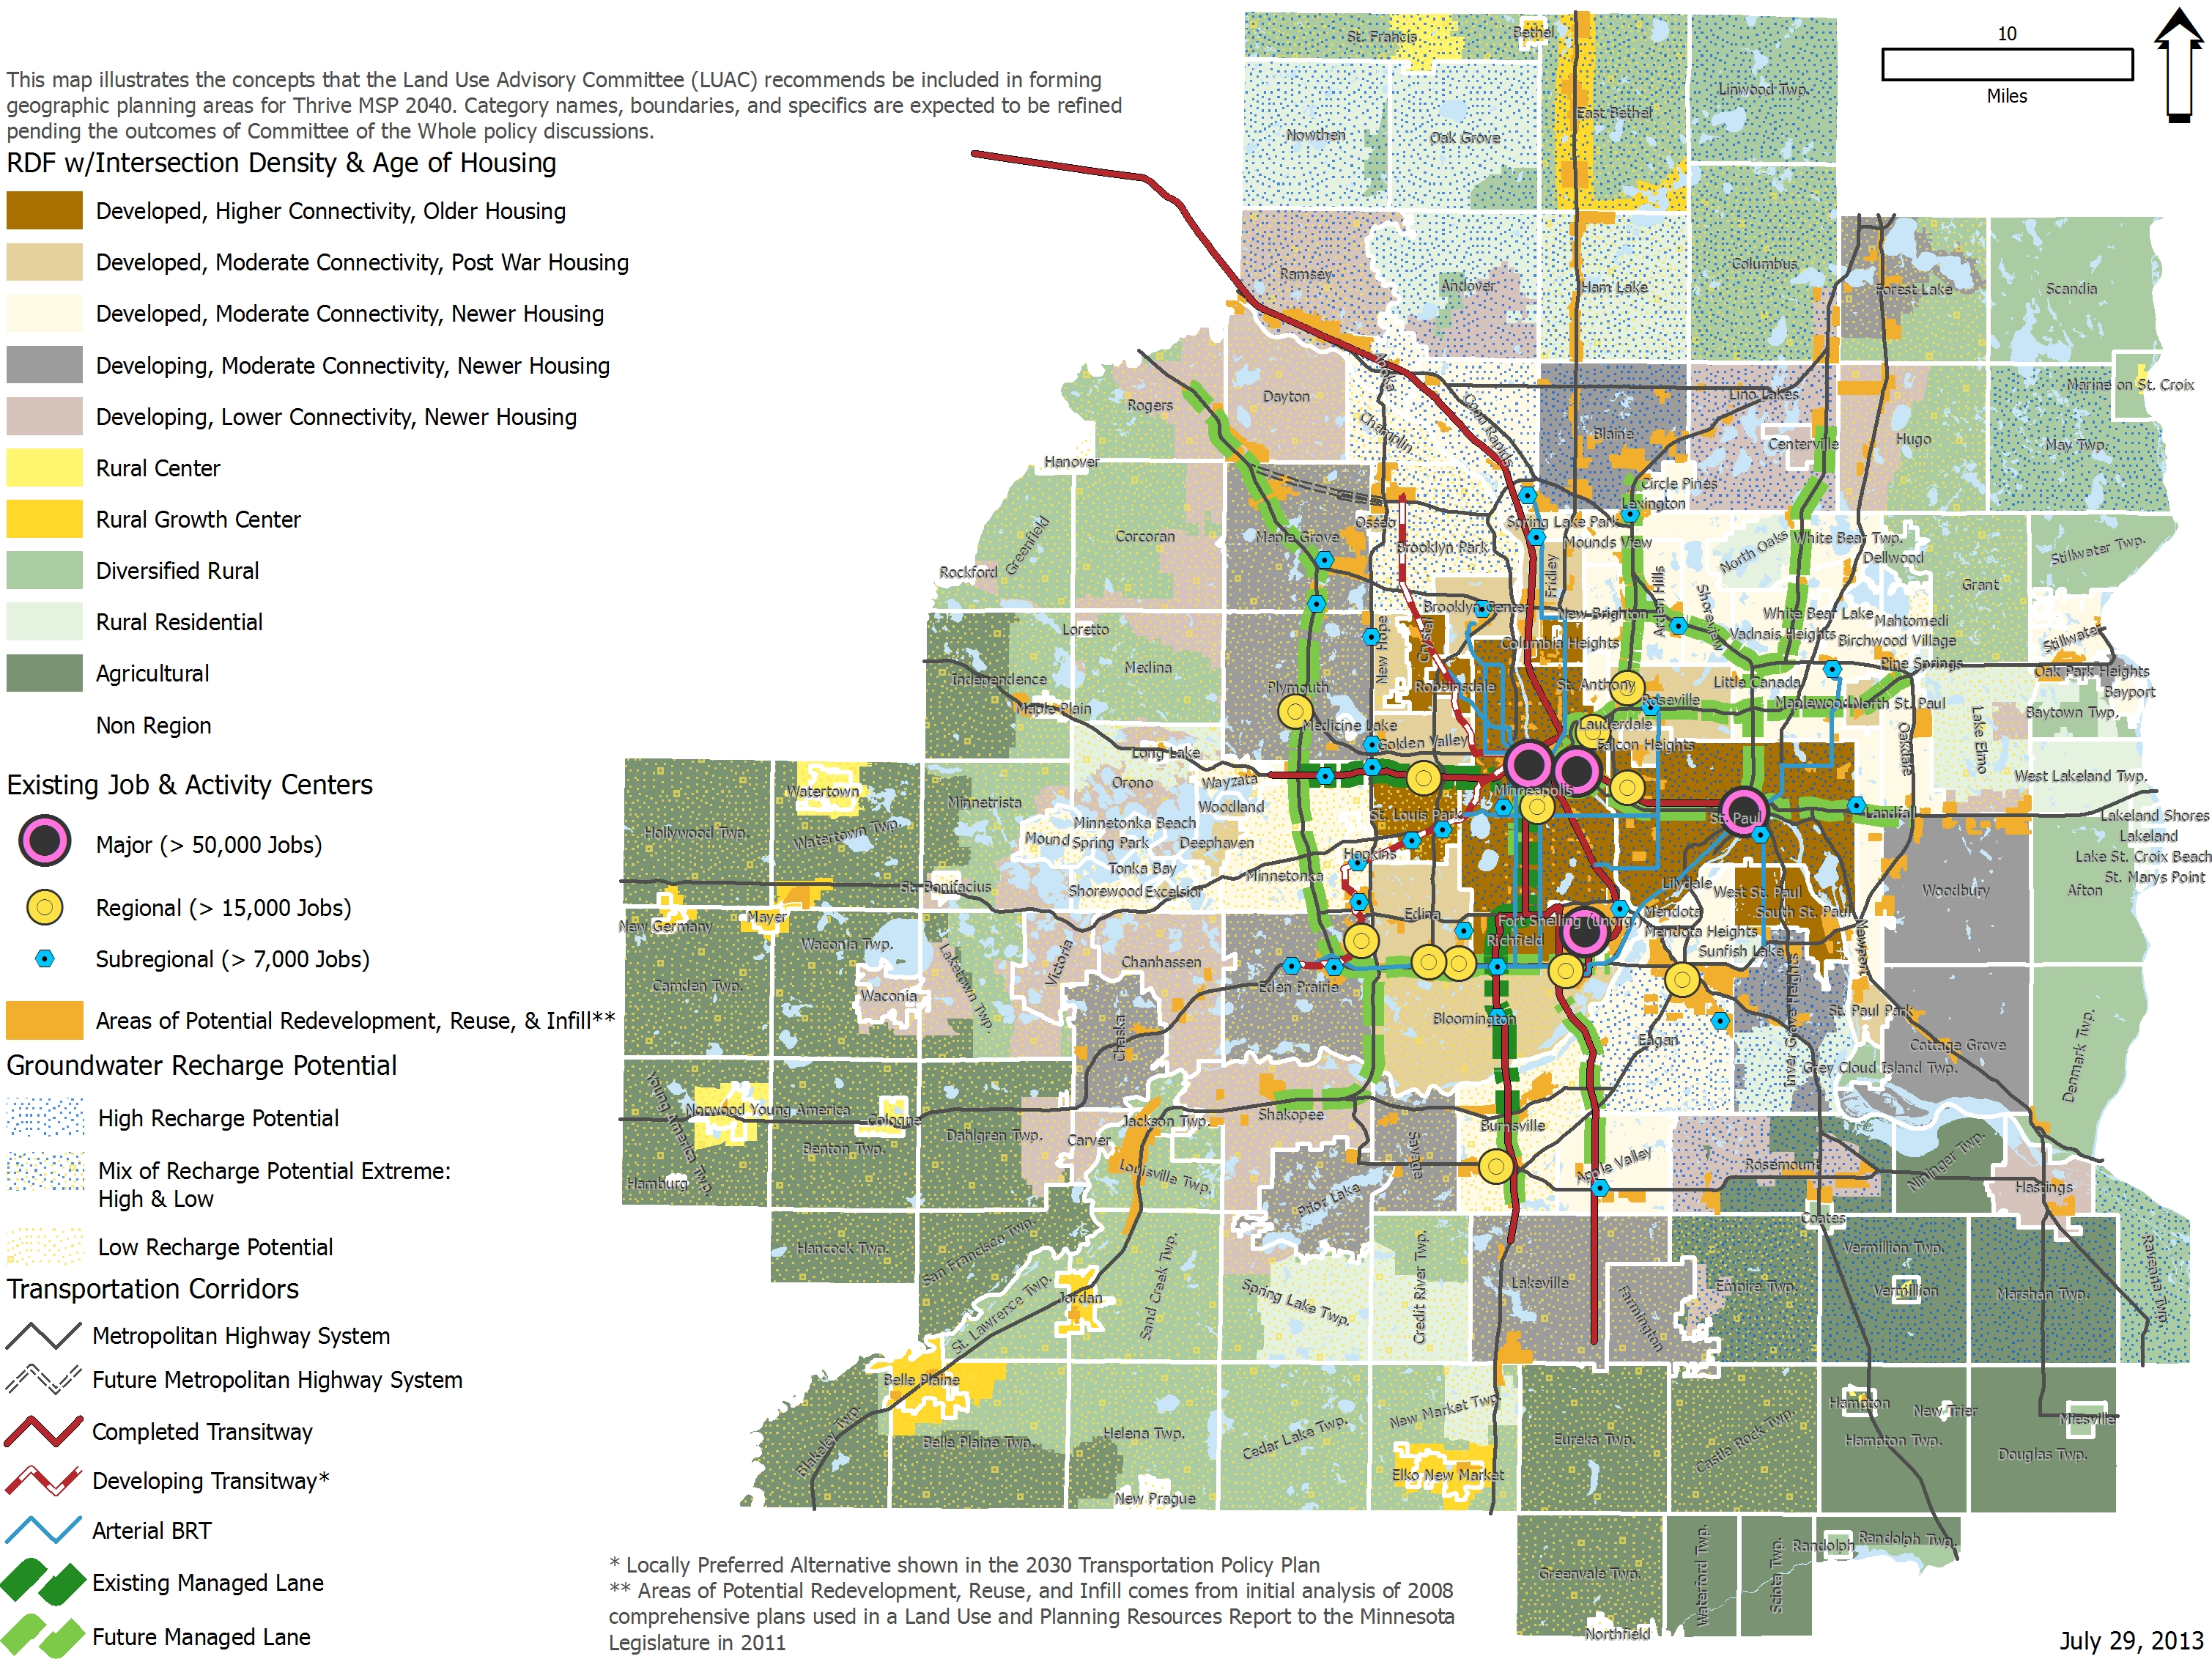
LUAC Recommendation

Slide 14
Community-level characteristics
Characteristics retained
Long-Term Wastewater Treatment Service Area
Metropolitan Urban Service Area (MUSA)
Percentage of developable land committed to urban uses
Used more than 85% developed as threshold to define developed area in Regional Development Framework

Slide 15
Community-level characteristics
Information added
Intersection density
Addresses connectivity, accessibility and walkability, urban form and character of development
Age of housing
Serves as proxy for age of infrastructure, maintenance needs and general development patterns
Notes:
Why intersection density and age of housing matter:
Represent the character of initial or current development that sets the pattern for future land uses
These also seemed to be effective measures of grouping like communities – based on their stage of urban development
Intersection density:
Great interest in expanding access to transit – role of connectivity to get to transit
This type of data also helps these “base” designations of planning areas relate to our systems: in this case, transit market areas
Age of housing:
Interest in grouping communities with similar issues, such as aging infrastructure
Maintenance costs a big issue for communities

Slide 16
Features that transcend borders
Existing job & activity centers
Shows major, regional and sub-regional centers
Transportation corridors
Shows corridors adopted in the Transportation Policy Plan (existing, have locally-preferred alternative or are committed to)

Slide 17
Features that transcend borders
Potential for redevelopment, reuse and infill
Shows planned 2030 land use for commercial-industrial, institutional or mixed-use development within ½ mile of transitway and within ½ mile of highway corridor
Groundwater recharge potential
Shows areas of high, low, mixed and moderate potential for water recharge

Slide 18
Rationales for recommendation
Emphasize environmental sustainability
Enhance economic competitiveness
Reflect character of communities and infrastructure
Maximize efficient use of infrastructure
Provide efficient transportation
Show areas of development and redevelopment
Recommend concepts important for whole region
Support best option for planning

Slide 19
LUAC’s different viewpoints
Some LUAC members:
preferred another option for planning areas;
expressed concerns about reflecting water supply in planning areas;
valued other concepts; and
How do socio-economic conditions, such a racially concentrated areas of poverty (RCAPs), connect?
shared ideas for additional analysis

Slide 20
Discussion
Confirm that will develop new planning areas for Thrive MSP 2040
Affirm general concepts in LUAC’s recommendation
Provide guidance for refining planning areas

Slide 21
Recommendation of Land Use Advisory Committee on Geographic Planning Areas
Staff contacts:
Lisa Barajas, 651-602-1895
Lisa.Barajas@metc.state.mn.us
Debra Detrick, 651-602-1327
Debra.Detrick@metc.state.mn.us

