Slide 1
Community-Centered Engagement
Equity Advisory Committee
May 21, 2024
Michelle Fure

Slide 2
Background on public engagement | 2
Imbedding engagement in regional development guide | 6
Recommended actions and commitments | 9
Community engagement discussion | 10

Slide 3
Background – Public Engagement Plan
From principles to practice
Thrive MSP 2040 committed to engaging a full cross-section of the community in decision-making.
Shifting to a more relational engagement approach
Acknowledging and moving toward compensation for community expertise
Process emerged from equity-related agenda of Met Council chair and community advocates
Co-created in partnership with community
Community leaders in partnership with Met Council
Community-led engagement to refine Public Engagement Plan

Slide 4
Principles for engagement
Equity
Respect
Transparency
Relevance
Accountability
Collaboration
Inclusion
Cultural competence

Slide 5
What changed since Thrive MSP 2040
Changes in practice, lessons from community
Practices that included people impacted by processes in the structure and planned outcomes of engagement
Compensation
Internal business processes
Tribal relations policy
Learning from community and being explicit about commitments to repair past harms

Slide 6
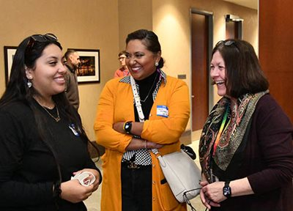
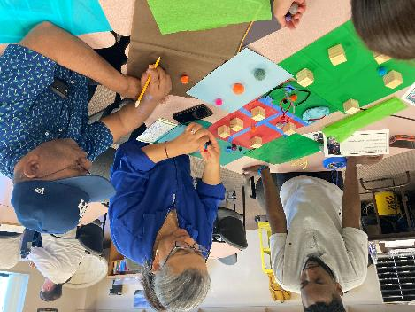

Slide 7
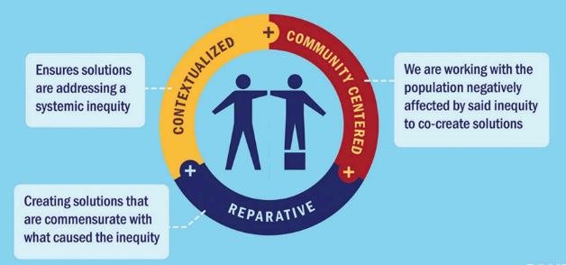
Part of the Equity Framework
Equity Framework for the 2050 Regional Development Guide
Working with populations to co-create solutions
Leading with community voices
Community expertise guides work and we foster participatory decision-making processes
Transparent
Proactive
Addresses historical context
Innovation and imagination in connecting community voices to developed policy
Notes:
The good news is we’ve been prioritizing community in our engagement practices in the past decade – but especially as we have developed the policy in the 2050 Regional Development guide.

Slide 8
Imagine 2050 engagement framework
Imagine 2050 progresses previous engagement by:
Centering community voices
Partnering with community as co-creators
Shared agenda-setting
Investing in community capacity building
Assets in community
Value of community voices
Prioritizing overburdened communities in engagement

Slide 9
Engagement spectrum
Less impact
More impact
 | Inform | Consult | Involve | Collaborate | Co-create/ Co-lead
Impact | One-way communication | Provide access | Provide access, respond | Partner, address inequity, build capacity | Share power, share agenda, change systems
Participation Goal | Inform, educate about problem and potential solutions | Gather feedback and reflect concerns and interests | Work directly with people throughout the process and include concerns, ideas | Partner with constituencies in defining problems, developing alternatives, choosing solutions | Community, constituents have final decision-making power
Promise to community | “We will keep you informed.” | “We will keep you informed, listen to concerns and feedback, demonstrate how feedback influenced decision.” | “We will work with you to ensure concerns and desires are reflected in the alternatives developed and demonstrate how feedback influenced the decision.” | “We will seek your advice and innovation, include your advice, and recommendations in decisions to the greatest extent possible.” | “We will set the agenda together and decide together. We will implement those shared decisions.”
Sample activities | Fact sheets Web sites Email newsletters Open houses | Public comment Surveys Public meetings | Workshops Working/advisory groups Deliberative polling | Shape strategies Influence agenda setting | Direct agenda setting Direct decision-making Establish expectations

Slide 10
Imagine 2050 engagement framework
Commitments
Policy
Actions
Build trust
Relational
Go beyond project engagement
Co-creation
Transparency
Dedicating financial resources
Measure effectiveness
Advisory committee recruitment
Compensate community members for time and expertise
Intentionally plan with communities, where and when it’s most effective for community participation
Engage to tangible impact decisions
Partner with community, prioritize overburdened communities
Address prohibitions for compensation
Highlight best practices in government engagement
Establish expectations for engagement budgeting
Identify expectations for co-creation
Create an assessment tool
Engage community in defining measures, expectations

Slide 11
Engaging on the framework
What does transparency look/feel like?
What does accountability look/feel like?
What does it mean to truly center community voices in our processes?
Qualitative and quantitative measures
Budgeting practices
Engagement principles
Our ask today:
How can we partner with the EAC to gather feedback on these items?
What can we do to support EAC’s work, Met Council decision-making processes?

Slide 12
Thank you!
Michelle Fure
Public Involvement & Communications Manager
michelle.fure@metc.state.mn.us

