Slide 1
1Q13 Investment Results for the Management Committee, 05-22-13

Slide 2
Gross Domestic Product
Source: US Bureau of Economic Analysis
Notes:
Economic Data
- GDP better than 2Q07 at 3.9 ( Advance estimates) – due to increased PCE, exports and federal spending
- Weakness in the Housing sector –
- Existing home sales plunged 8.0% in September
- Housing starts dropped 10.2%
- Pending Hm sales declined 21.5%
- Home prices fell 4.4% in August
- Inflation – core remained benign
- CPI and core CPI for Sept came at 2.8% and 2.1% respectively
- ISM Manufacturing and non-manufacturing both above 50, A # above 50 indicates economic expansion
- Productivity – is the key ingredient for rising living standards
It allows employers to pay workers higher wages which are financed by the increased output, which means employers don’t have to resort to raising the price of their products which can lead to inflation.
- Unemployment came at 4.7% in October, no change from prior month

Slide 3
US Equity Market and Housing Recovery

Slide 4
Inflation Expectations
Source: Bianco Research

Slide 5
Total Return, ST Port 1Q13
+6 bps above Index (24 bps if annualized)
+30 bps/year ave. over index for last 14.25 yrs
Source: Metropolitan Council, Crane Data.

Slide 6
Short Term Yields
Rates | 03-31-13 | 05-17-13
30-Day Commercial Paper | 0.10% | 0.09%
Federated Prime Fund | 0.09% | 0.07%
Goldman Sachs Prime Fund | 0.08 % | 0.06%
US Bank ECR | 0.22% | 0.22%
Source: Metropolitan Council, Goldman Sachs MMF Portal
Notes:
Short and Long-term Porfolio 100% in fixed income investments
- Prices for FI securities rise and fall in response to changes in int rates. When rates rise, prices fall
- However, market factors such as the demand for particular FI securites FI securites

Slide 7
Expectations: ST Port
Short rates stay low until FRB reverses course.
Search for alternative investments to replace Prime MMF asset class
Continue to invest in short munis, commercial paper and Government MMFs.

Slide 8
Total Return, LT Port 1Q13
+25 bps above index
+23 bps/yr ave over index for last 14.25 yrs
Source: Metropolitan Council, Bloomberg
Notes:
Short and Long-term Porfolio 100% in fixed income investments
- Prices for FI securities rise and fall in response to changes in int rates. When rates rise, prices fall
- However, market factors such as the demand for particular FI securites FI securites

Slide 9
L-T Port Asset Allocation 1Q13 vs. 4Q12
Source: Metropolitan Council
Notes:
Short and Long-term Porfolio 100% in fixed income investments
- Prices for FI securities rise and fall in response to changes in int rates. When rates rise, prices fall
- However, market factors such as the demand for particular FI securites FI securites

Slide 10
Future Economic Environment
LT rates have inched up a bit and may continue to rise but will be constrained by the economy’s low growth expectations.
Inflation concerns: Watch capacity utilization, unemployment reductions, growth in average hourly wages, influences of international markets; and, commodity inflation.

Slide 11
Investment Plans for Long-term Portfolio
Deploy cash into callable agencies.
Invest in good quality municipal bonds, G.O bonds rated “A” or better and revenue bonds rated “AA” or better.
As rates rise, invest in some mortgage backed securities.

Slide 12
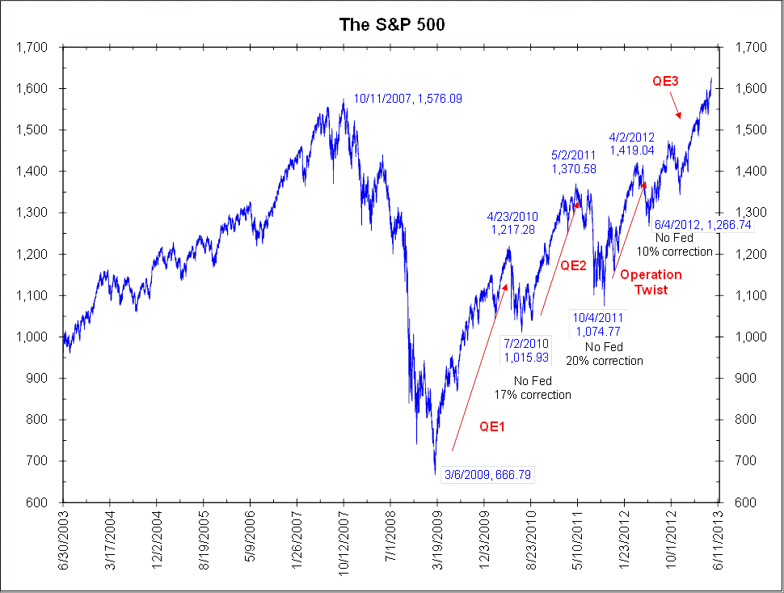
S&P 500 Index
Source: Bianco Research

Slide 13
OPEB 1Q13 Port Results
S&P 500 Index @ 10.61%; OPEB @ 10.55%
1Q13 unrealized gain is $ 13.3MM
Value: 12-31-12: $ 131.00MM 03-31-13: $ 145.80MM 05-17-13: $ 156.04MM
100% allocation to equities

Slide 14
Expectations: OPEB
Don’t fight the Fed!
Stay primarily invested in equities in 2013.
Cash and long bonds have low yields; long bonds have price risk if rates rise.

Slide 15
Heating Oil Forward Pricing Curve
Source: Bloomberg

Slide 16
Monthly Hedged Ratios, Heating Oil Fut. Contracts
Source: Metropolitan Council

Slide 17
Diesel Hedging-- Budget vs. Actual
Source: Metropolitan Council

Slide 18
Expectations: HO (diesel)
Supply and demand factors that impact diesel prices include –
Geopolitical risks with Iran and North Korea.
Lower economic expectations from China
Euro zone recession
Weaker than expected US economic growth
Some price decline is expected later in 2013
Continue practice of rolling futures contracts.

Slide 19
QUESTIONS?

