Slide 1
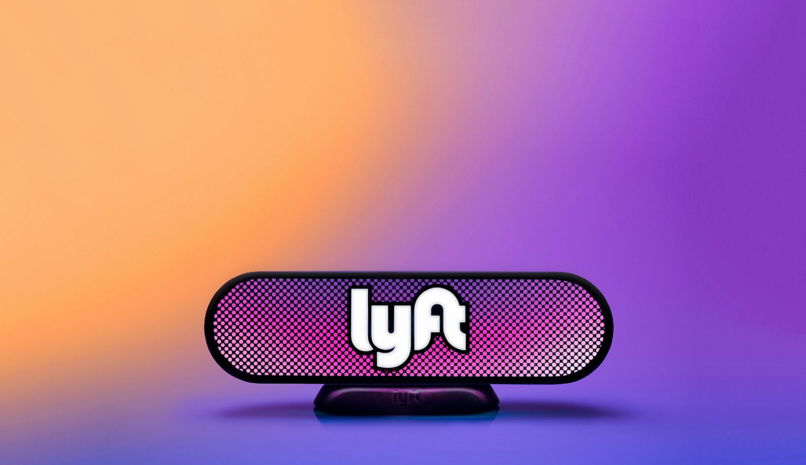
Lyft
+ Metro Mobility
DAVID KATCHER
MIDWEST GENERAL MANAGER 9/21/17

Slide 2
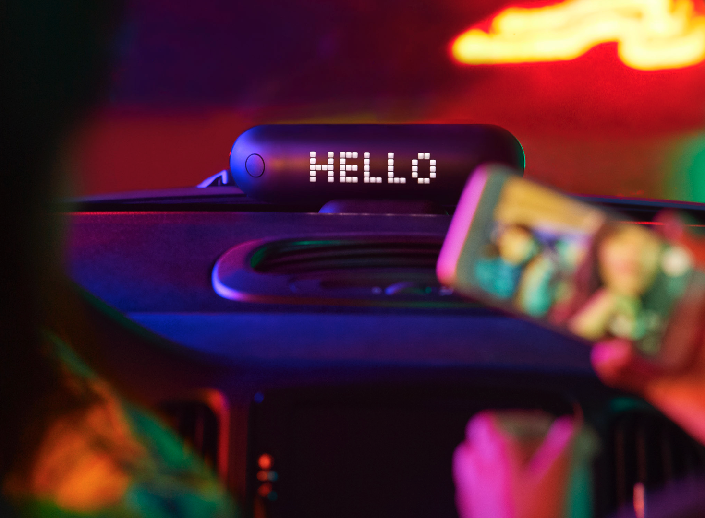
Agenda
AGENDA
Our Mission and Model
Lyft + Transit
Data Sharing
Driver Requirements
Next Steps

Slide 3
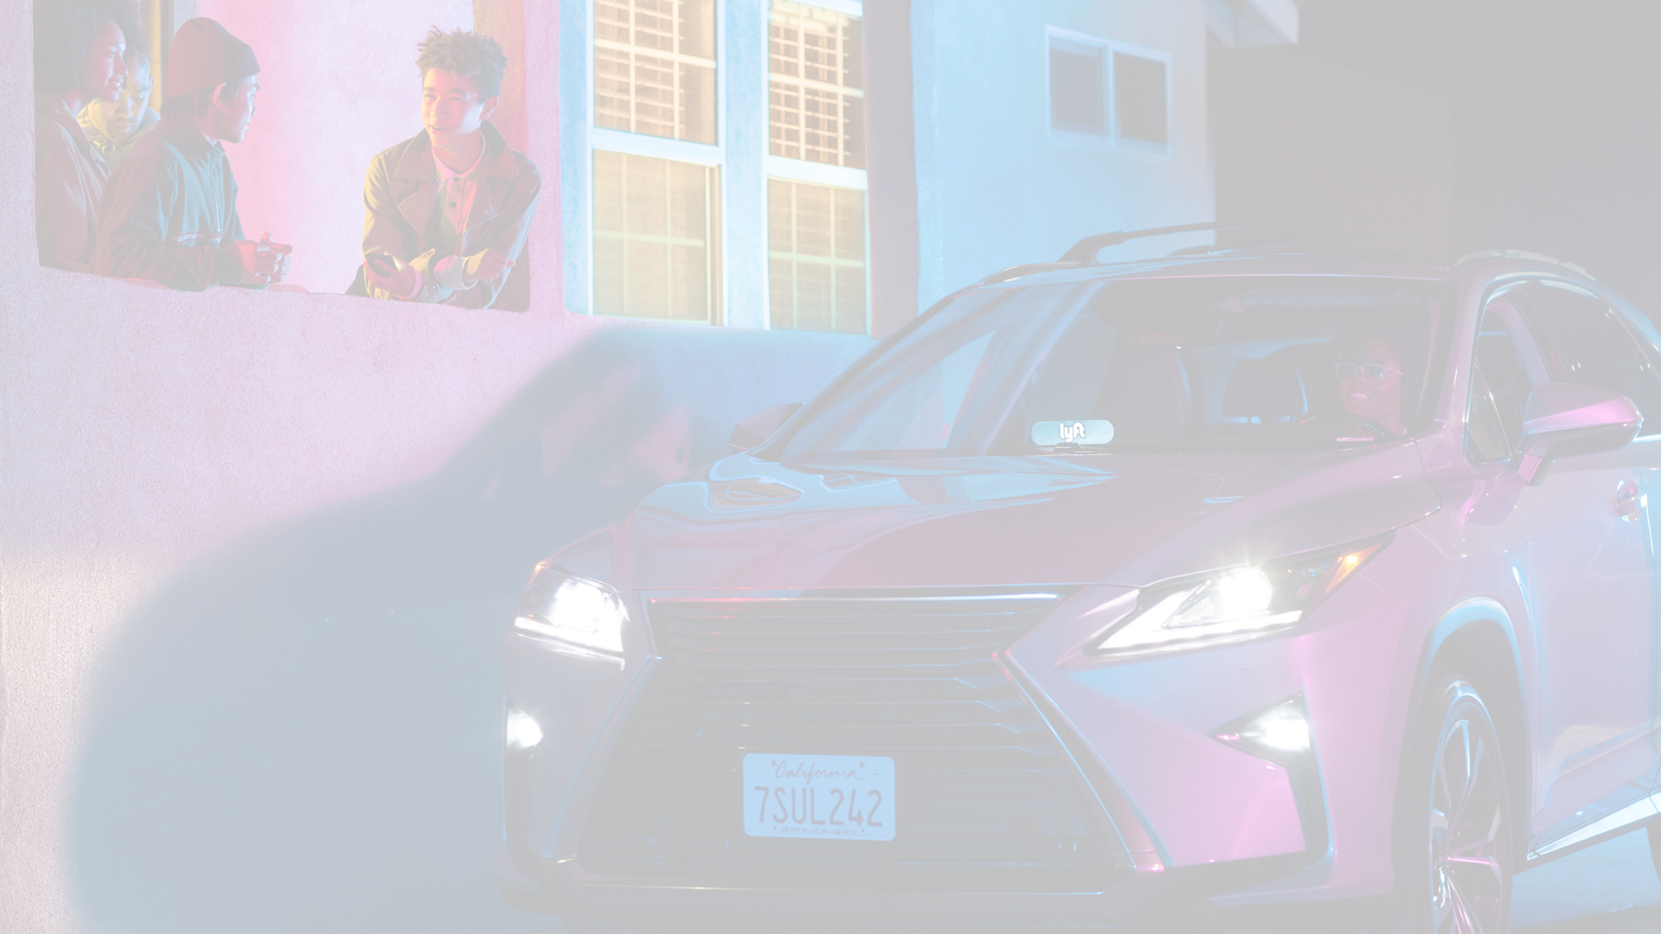
The Lyft Mission
THE LYFT MISSION

Slide 4
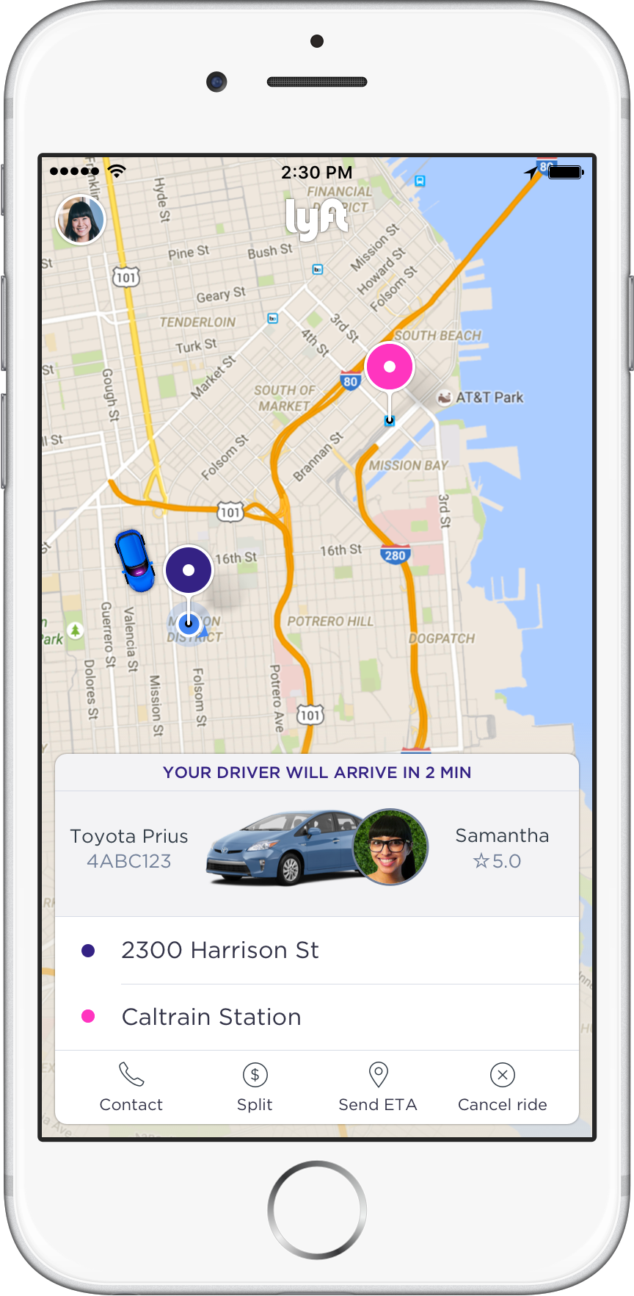
Mission and Model
MISSION AND MODEL
Notes:
In 2012, our founders launched Lyft, a peer-to-peer ridesharing app to help reconnect communities through better transportation. Using Lyft, people will able to connect and fills empty seats in passenger vehicles already on the road by matching drivers and riders via a smartphone application.

Slide 5
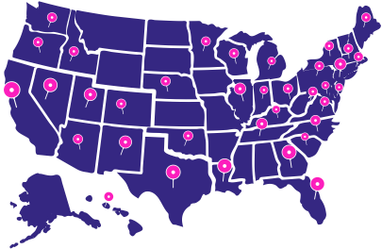
Where we are today
WHERE WE ARE TODAY
350+
$1.5B+
Earned by Lyft Drivers
(Including Tips)
Cities in the U.S.
12 MILLION
700K
Active Passengers
Drivers

Slide 6
Lyft and Transit
LYFT AND TRANSIT

Slide 7
Partnership Models
Partnership Models

Slide 8
Our existing partners
Our Existing Partners
Notes:
While I have focused on a few of our commuting related partnerships today, Lyft’s partnerships with transit agencies are growing every week. In addition to the services I discussed today we are also working on suburban on-demand services, paratransit, and late-night rides.

Slide 9
Partnership validation
Validation For Transit – TNC Partnerships
Federal Transit Administration
Mobility On Demand Sandbox grant program launched.
American Public Transit Association (APTA)
Study outlining how TNCs can help transit
Brookings Institution
Policy paper supporting TNC-paratransit partnerships
Center for American Progress
Endorses federal TNC subsidies for low-income riders

Slide 10
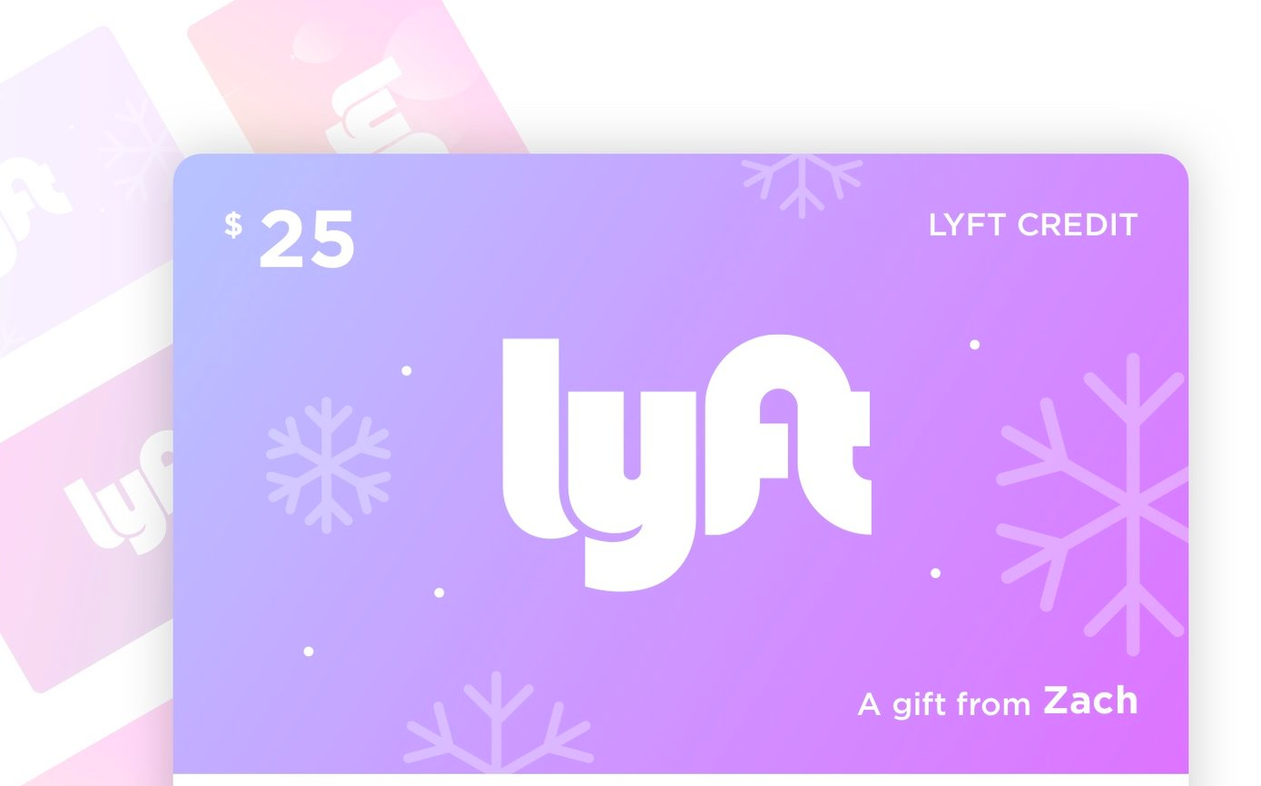
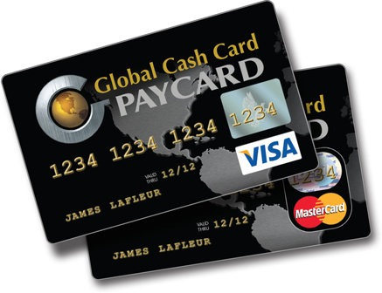
Serving Unbanked
Serving Unbanked Passengers
Need to provide a solution for unbanked passengers.
Lyft has developed a solution to meet this need:
You can sign-up for Lyft without a Credit Card
Currently a good % of nationwide trips are on Prepaid cards.
Cards can be purchased at any supermarket, convenience store or via Lyft.
Collaborate on unbanked fare offering
Can offer Lyft or general Prepaid cash cards at ticket purchasing locations.
In person paperless ticket (code) purchases.
Notes:
As transit agencies and as Lyft we believe that an option for payment needs to be provided for unbanked passengers to access transportation services. It is a question of equity of access. Lyft has modified its service offering to meet this critical Title VI need.

Slide 11
Data
DATA AND PRIVACY

Slide 12
Data Sharing
Data Sharing
National Transit Database
Partners receive partnership performance data in line with National Transit Database reporting
On-going discussion about data sharing with regards to:
Personally identifiable information (PII)
Consumer Privacy + FOIA
Competition

Slide 13
Driver Safety
DRIVER TRAINING AND SAFETY

Slide 14
Lyft does comprehensive driver screening. The chart shows that we do a social security verification, a national criminal background check, federal, county and us sex offender check, and a 19 point vehicle inspection.
Safe, Reliable Options For Everyone
Safety? Check.
Social Security # Verification
Enhanced nationwide criminal search
County court records
Federal criminal court records
U.S. Department of Justice sex offender registry
Driving record check completed by ADR
Background checks
19-point vehicle inspection
DMV & Background Checks
97%
Critical Response Line
Vehicle Inspections
of passengers feel safe with Lyft
$1M Insurance Protection
43%
Two-way Ratings
Zero Tolerance Drug & Alcohol Policy
of passengers are female

Slide 15
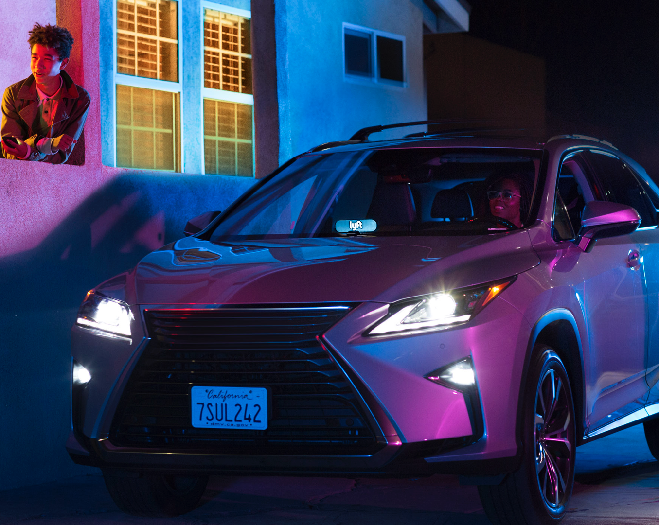
Thanks you. Any questions
THANK YOU
QUESTIONS?
NEXT STEPS

