Slide 1
Uber Technologies
Presentation for Metro Mobility Task Force
SEPTEMBER 2017

Slide 2
Content
1 | Uber Overview
2 | Uber in the Twin Cities
3 | Rideshare Safety
4 | Transit Experience + Models
The content in this presentation is non-binding and subject to further discussion

Slide 3
Uber Overview
The content in this presentation is non-binding and subject to further discussion

Slide 4
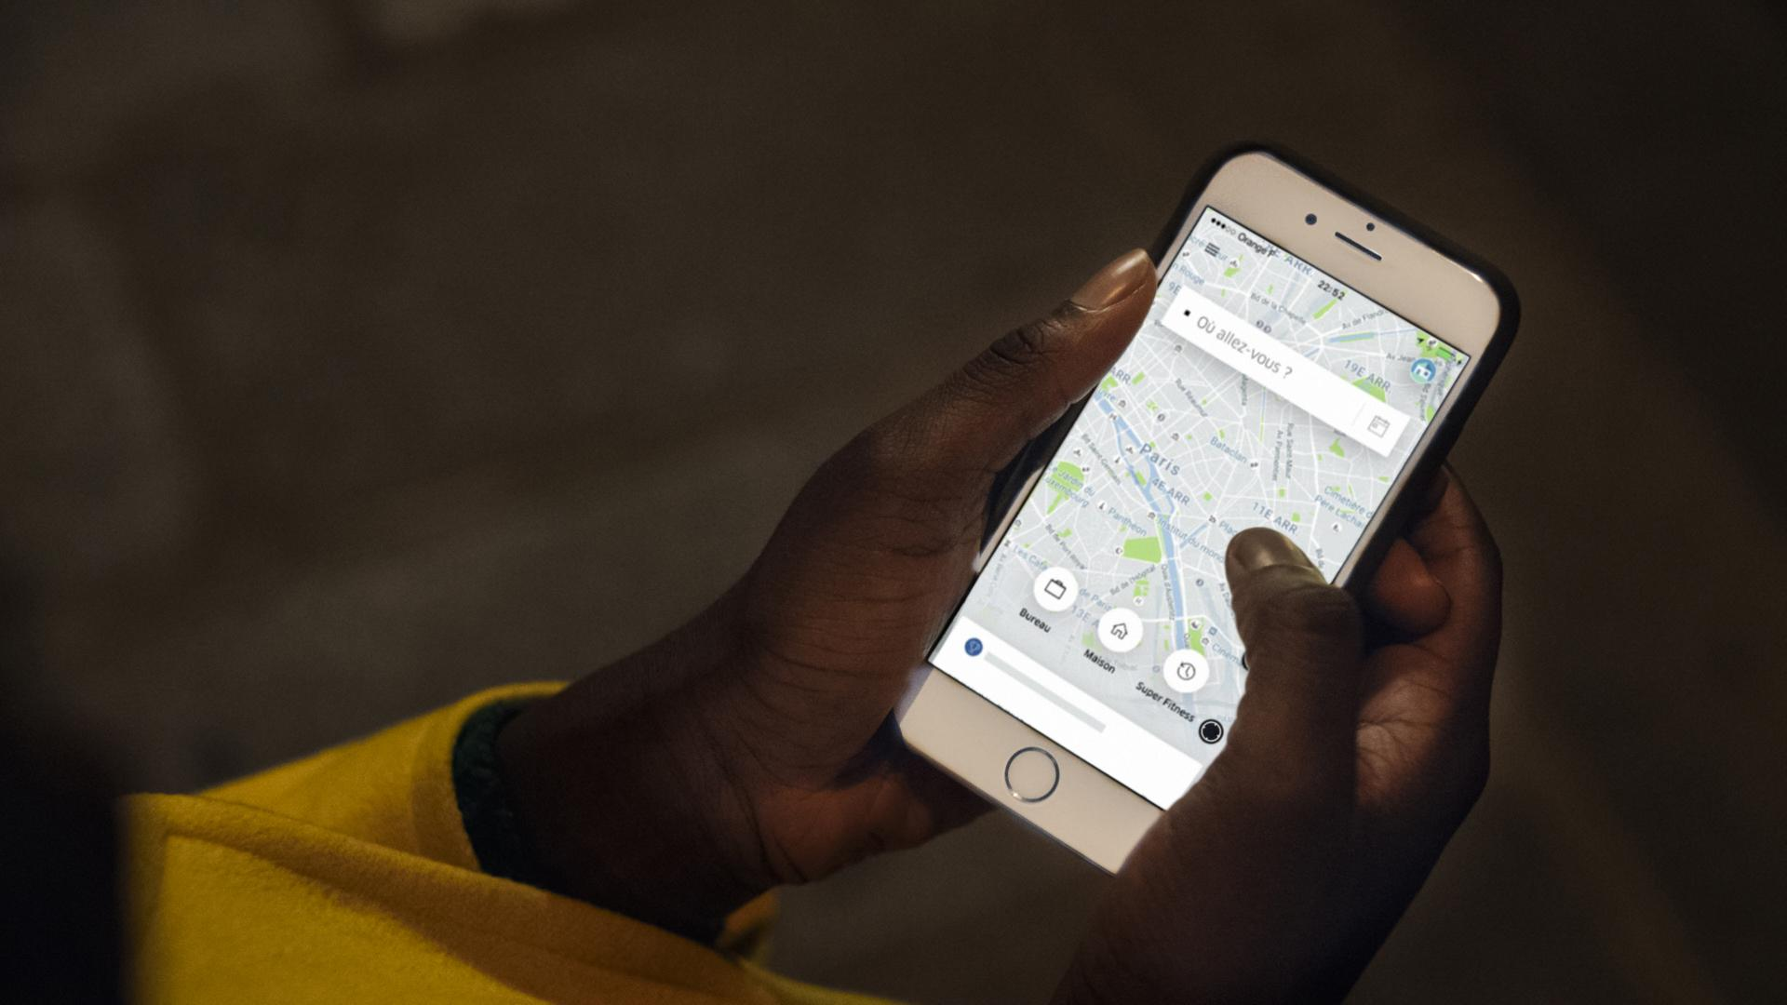
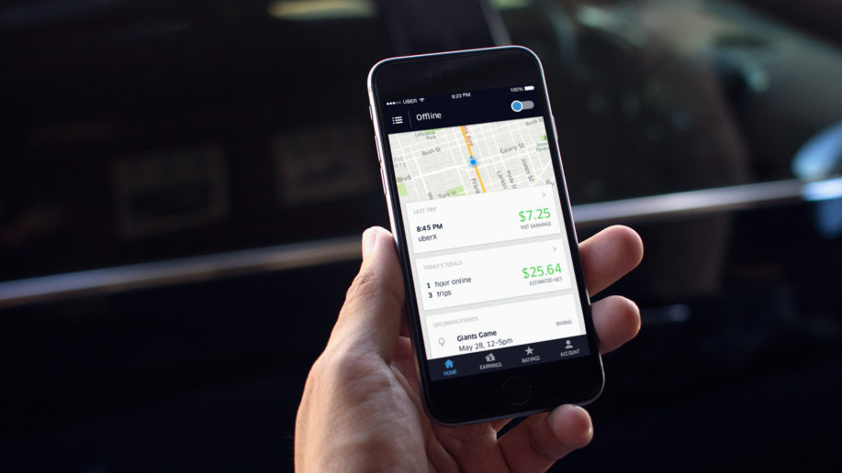
Uber connects riders… with drivers
Uber connects riders...
...with drivers

Slide 5
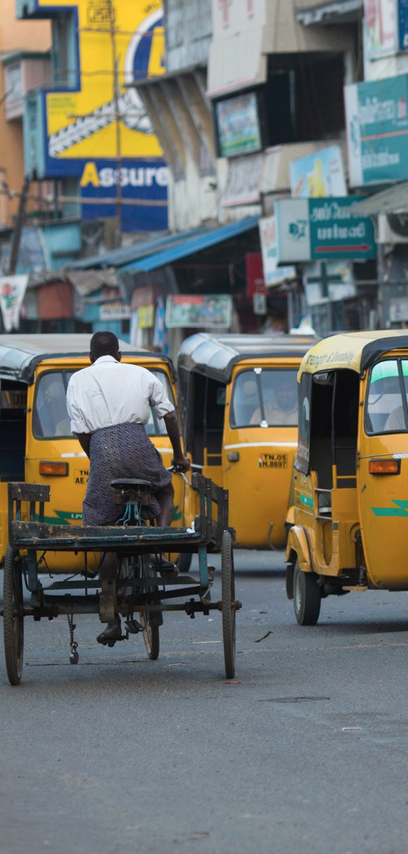
Our Story
600+
77
5B+
Cities
Countries
Rides

Slide 6
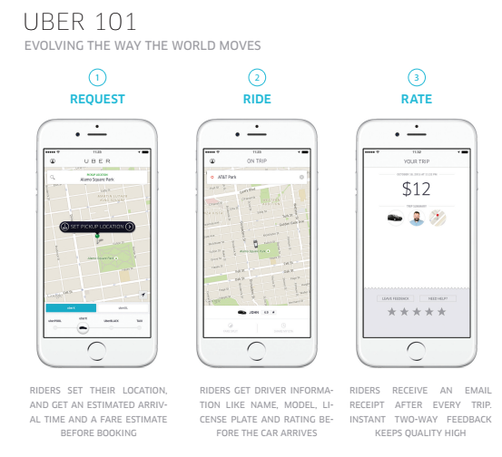
Uber 101: evolving the way the world moves

Slide 7
Uber in the Twin Cities
The content in this presentation is non-binding and subject to further discussion

Slide 8
Uber in Minnesota
Began service in Minnesota in 2012
Operations regulated by Minneapolis, Saint Paul, and MSP Airport
Insurance regulated by State of MN
Driver support office located in Roseville
The content in this presentation is non-binding and subject to further discussion

Slide 9
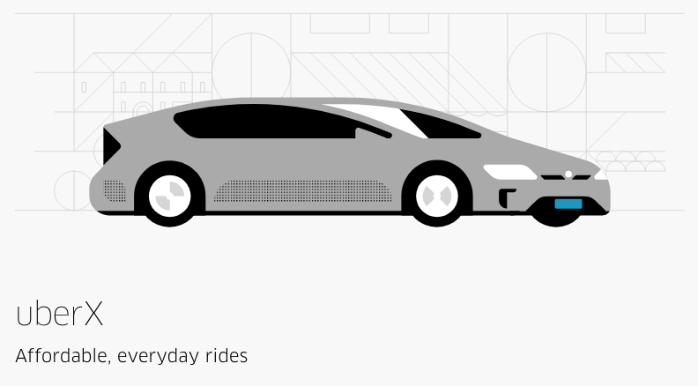
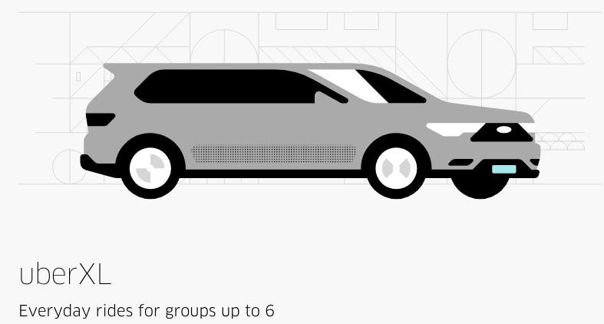
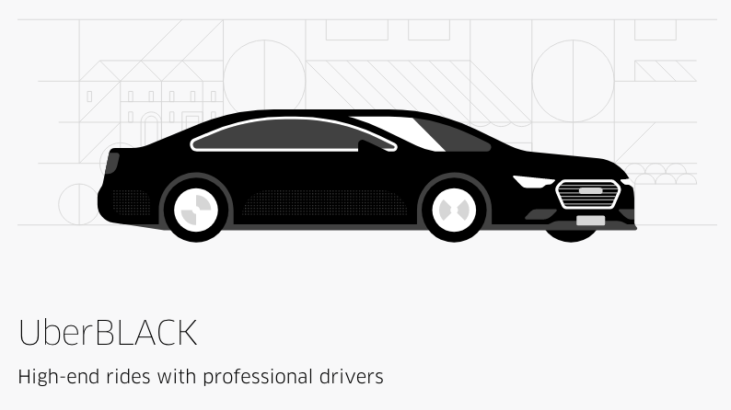
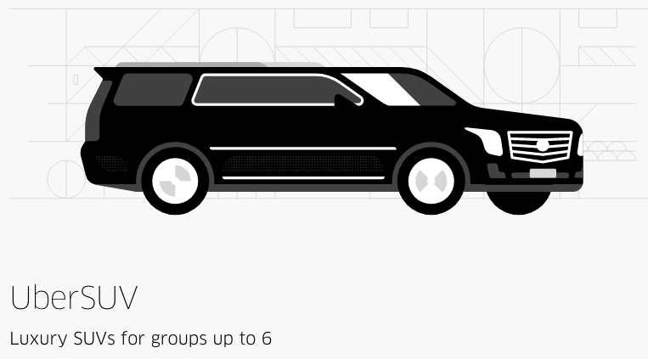
Uber Products
The content in this presentation is non-binding and subject to further discussion

Slide 10
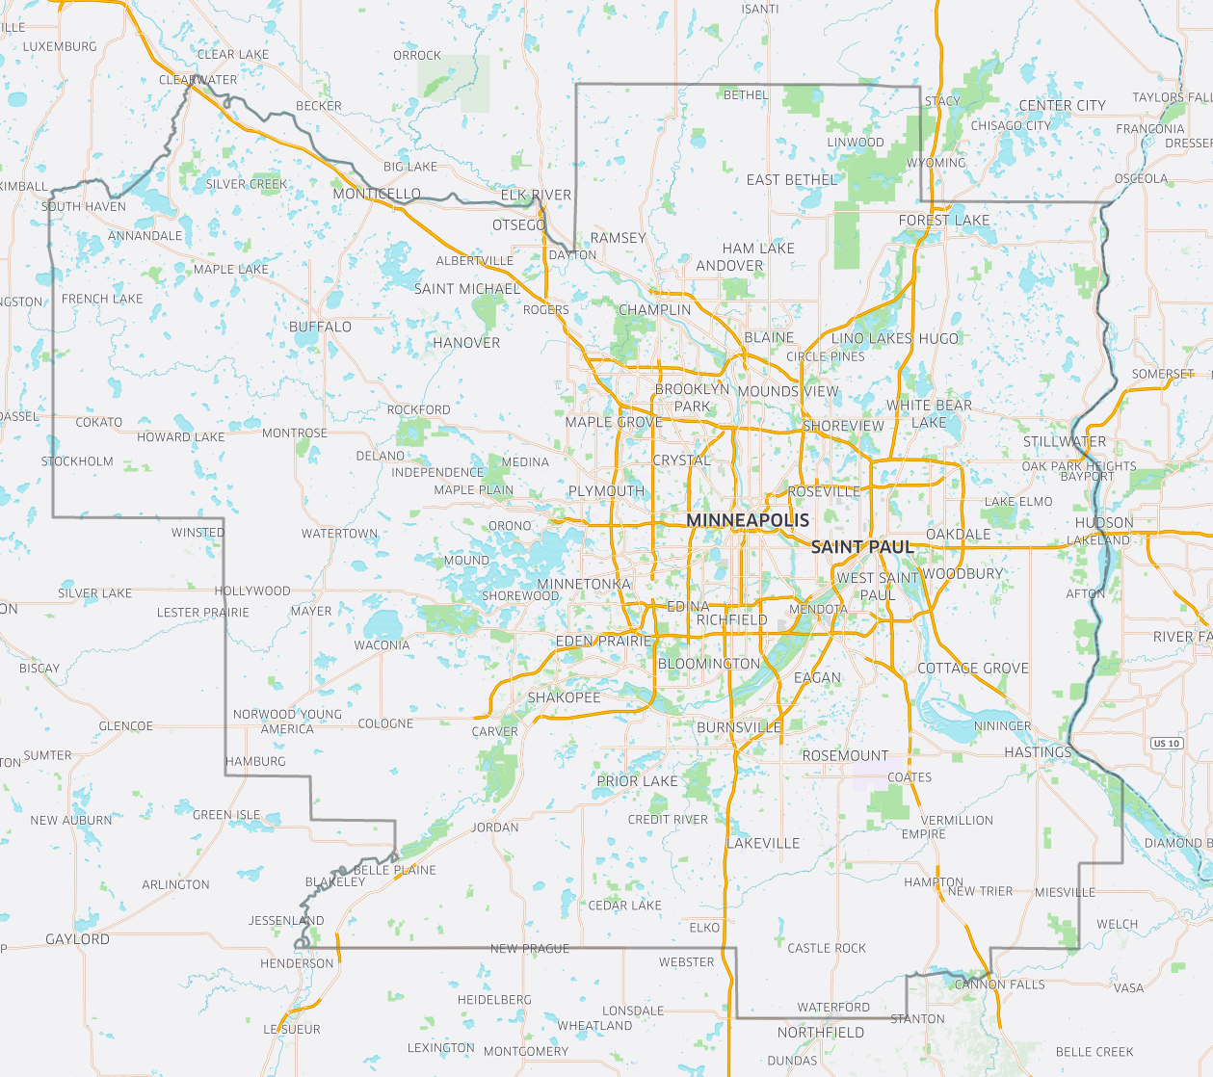
Uber
Service
Area
The content in this presentation is non-binding and subject to further discussion

Slide 11
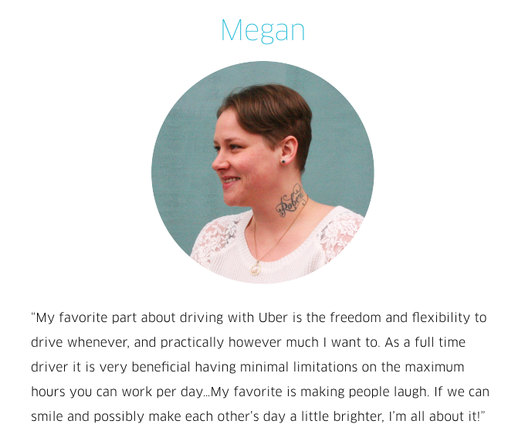
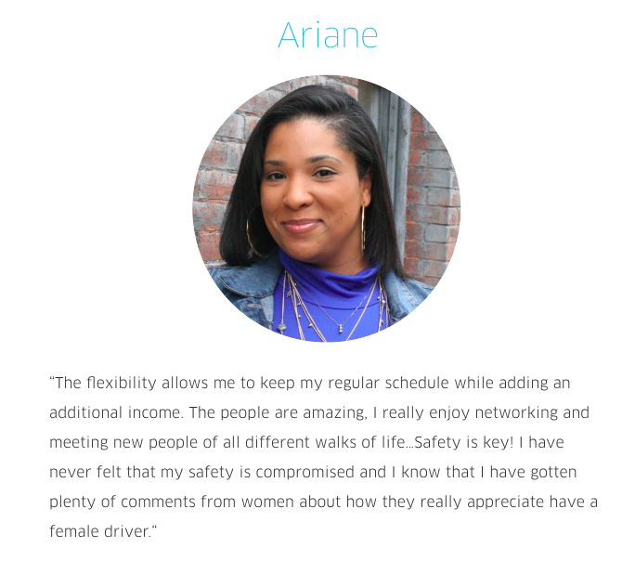
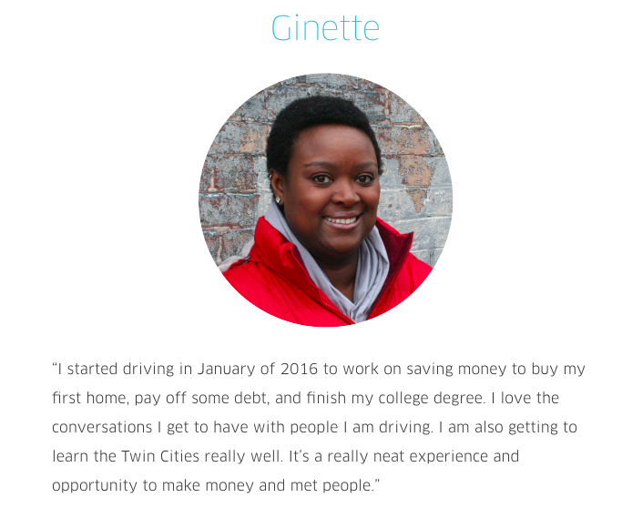
Uber in Minnesota Meet our Drivers
The content in this presentation is non-binding and subject to further discussion

Slide 12
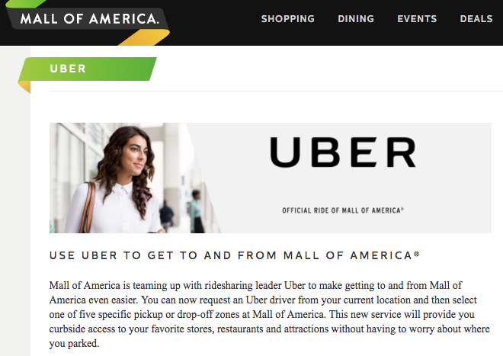
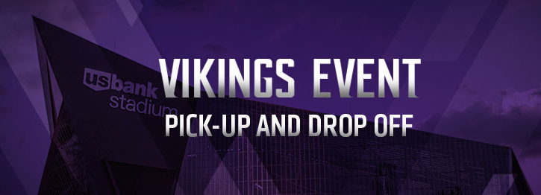
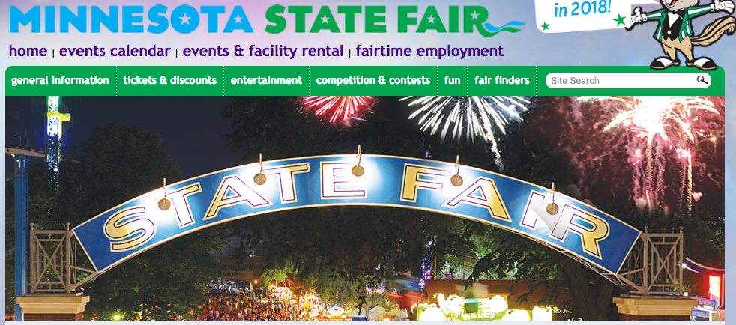
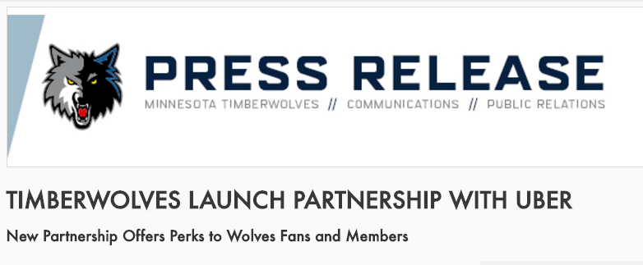
Uber Logistical Partnerships
The content in this presentation is non-binding and subject to further discussion

Slide 13
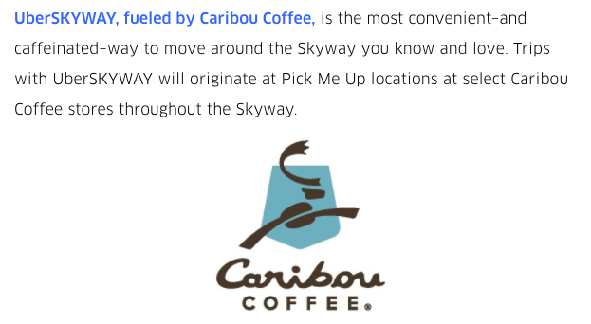
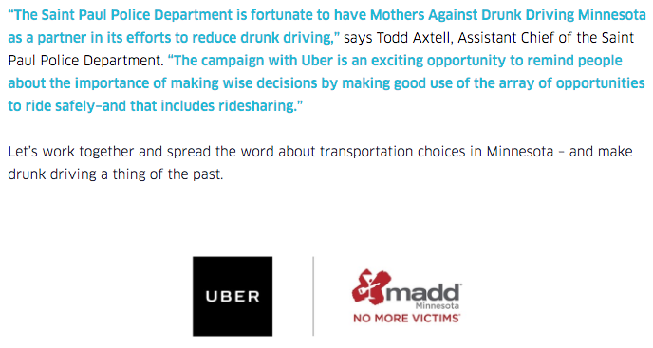
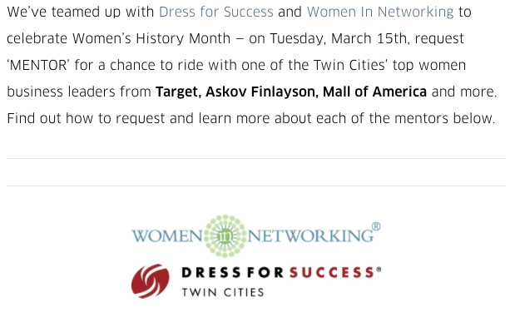
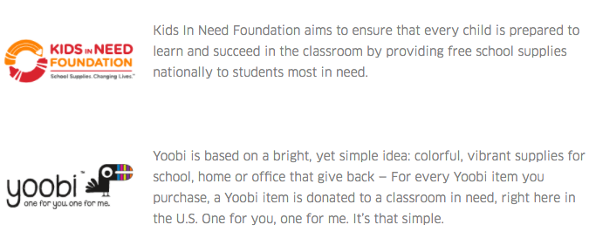
Uber Community Partnerships
The content in this presentation is non-binding and subject to further discussion

Slide 14
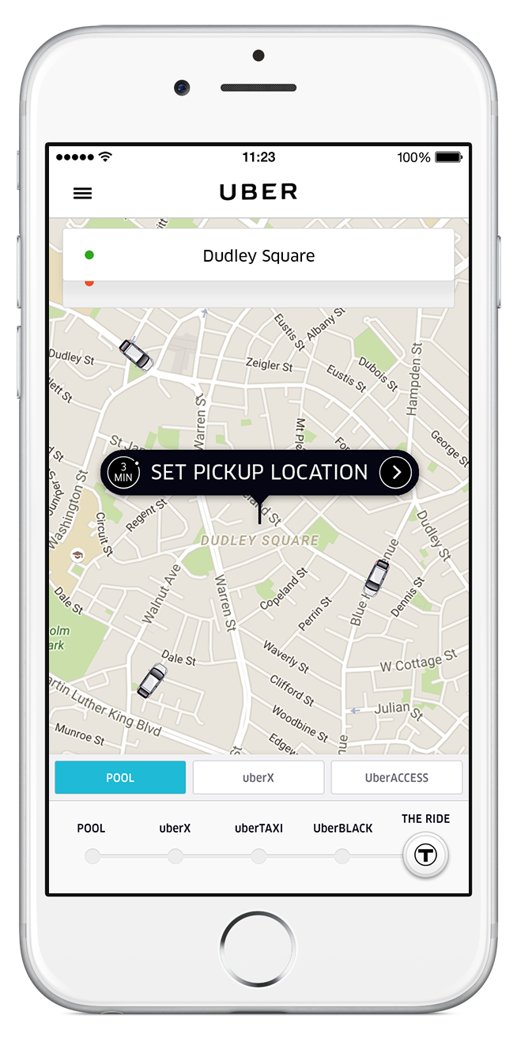
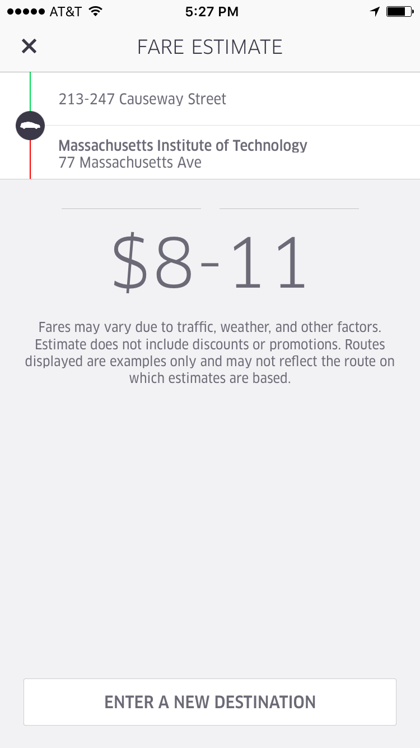
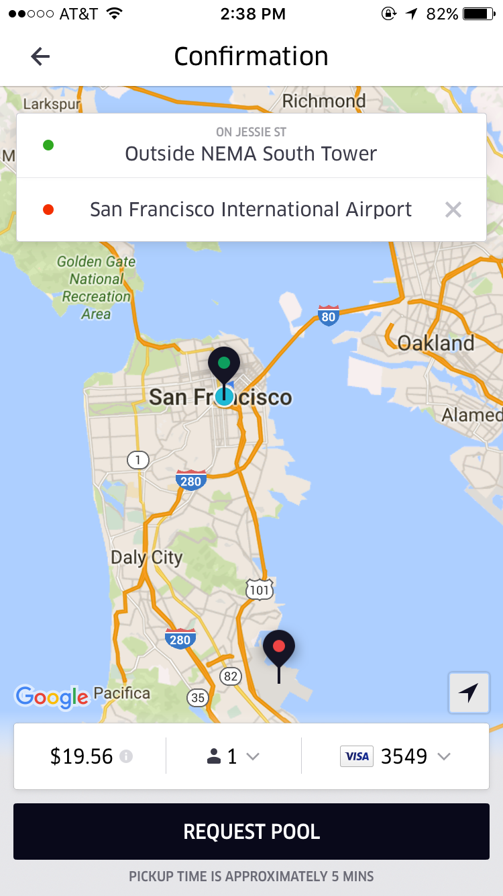
uberX Pricing
Our pricing information is transparent and provided up front before a trip is requested.
Prior to requesting a trip, riders can estimate the cost of a trip online or by utilizing the in-app tool (pictured right).
Uber has a dynamic pricing model for all riders, which allows the service to remain reliable, even in peak times.
If the pick up or drop of location changes after the trip is confirmed, the price will be updated and reflected on the receipt.
To | From | uberX Estimate
MSP Airport | Metropolitan Council Office | $16-$20
University of MN | Mall of America | $16-$22
Minneapolis City Hall | MN State Capitol | $13-$17
Ankoa | Inver Grove Heights | $39-$53
Spring Lake | US Bank Stadium | $25-$34

Slide 15
Rideshare Safety
The content in this presentation is non-binding and subject to further discussion

Slide 16
Technology built for a safe, seamless experience
At Uber, we are committed to safety for riders and drivers
before, during, and after their trips
Our Global Safety Team comprises safety, security, and privacy professionals dedicated to improving our technology for riders and drivers.
In 2015, Uber announced its US Safety Advisory Board comprised of transportation, law enforcement, legal, and domestic violence experts to advise Uber on safety policies.
The content in this presentation is non-binding and subject to further discussion

Slide 17
Safety: Before the trip
Pre-Screening Process
Driver Screening
Driver Education
No Street Hails
Anonymous Driver/Rider Contact Information
Driver Information in the App
Safety: Before the trip
Pre-Screening Process
Driver Screening
Driver Education
No Street Hails
Anonymous Driver/Rider Contact Information
Driver Information in the App

Slide 18
Safety: During the trip
Share your ETA
GPS and Real Time Location Tracking
No Cash
Insurance Coverage
Safety: During the trip
Share your ETA
GPS and Real Time Location Tracking
No Cash
Insurance Coverage

Slide 19
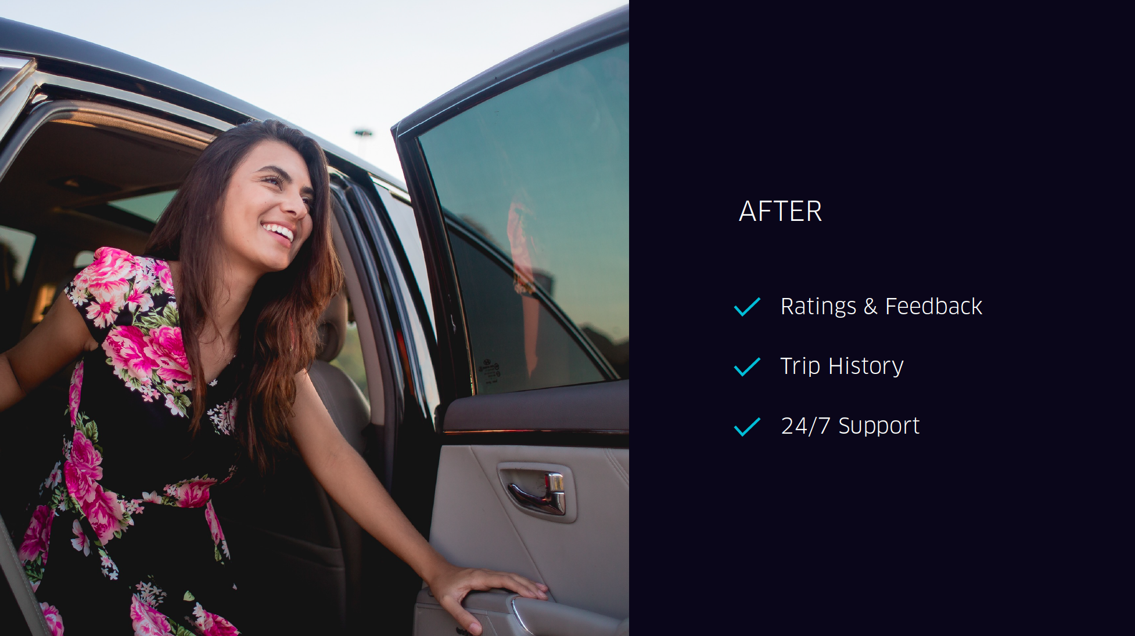
Safety: After the trip
Feedback and Ratings
24/7 Support Rider/Driver
Driver/Rider/Trip Data Collected and Retained
Law Enforcement Liaison Team
Safety: After the trip
Feedback and Ratings
24/7 Support Rider/Driver
Driver/Rider/Trip Data Collected and Retained
Law Enforcement Liaison Team

Slide 20
Transit Experience + Models

Slide 21
Uber is an important complement to public transportation
The American Public Transportation Association (APTA) released an independent study that supports this emerging consensus. Researchers conducted a series of in-depth interviews with transportation officials and riders. Here’s what they found:
The more people use ridesharing services like Uber, the more likely they are to use public transit
Ridesharing complements public transit, enhancing urban mobility
Transit operators believe ridesharing services like Uber are here to stay
Public and private operators can dramatically expand paratransit availability with technology and collaboration
This study can be found here: www.apta.com/resources/hottopics/Pages/Shared-Use-Mobility.aspx
The content in this presentation is non-binding and subject to further discussion

Slide 22
Working with transit agencies across the U.S.
Cities are able to leverage Uber to complement existing transportation
DirectConnect in Pinellas Park | DirectConnect allows riders to use Uber within a specific geographic area to get to or from a select group of designated bus stops, where they can connect into the regular bus system. PSTA subsidizes 50% of the ride, up to $3 per ride.
Evesham Township, NJ | The city of Evesham is paying for all riders taken from select bars and restaurants to homes within the township between 9 PM - 2 AM through June 1, 2016.
TransLoc | TransLoc develops apps for city transit agencies. By integrating the Uber API into the TransLoc multi-modal transit solution, riders can easily combine public transportation with ridesharing to find the most efficient and reliable route from one point to the next. This partnership makes public transportation an option for everyone, not just people living within a quarter of a mile of a train or bus station.
The content in this presentation is non-binding and subject to further discussion

Slide 23
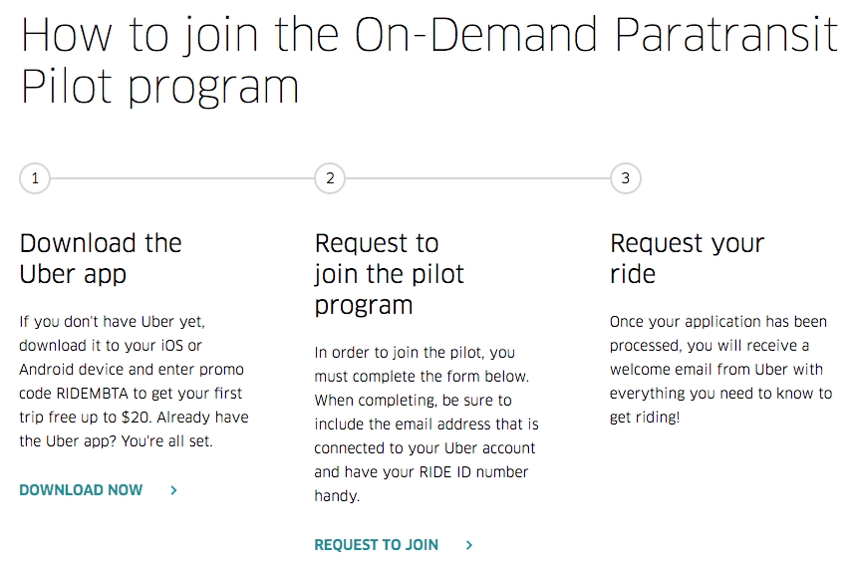
Uber and MBTA Pilot
The content in this presentation is non-binding and subject to further discussion

Slide 24
Uber and MBTA Pilot
Learnings
Sign up
Pricing
Support
The content in this presentation is non-binding and subject to further discussion

Slide 25
Thank you
Proprietary and confidential © 2016 Uber Technologies, Inc. All rights reserved. No part of this document may be
reproduced or utilized in any form or by any means, electronic or mechanical, including photocopying, recording, or by any
information storage or retrieval systems, without permission in writing from Uber. This document is intended only for the
use of the individual or entity to whom it is addressed and contains information that is privileged, confidential or otherwise
exempt from disclosure under applicable law. All recipients of this document are notified that the information contained
herein includes proprietary and confidential information of Uber, and recipient may not make use of, disseminate, or in any
way disclose this document or any of the enclosed information to any person other than employees of addressee to the
extent necessary for consultations with authorized personnel of Uber.

