Slide 1
Pocket Schedule Evaluation
Nathan Bakken | Transit Information Data Coordinator

Slide 2
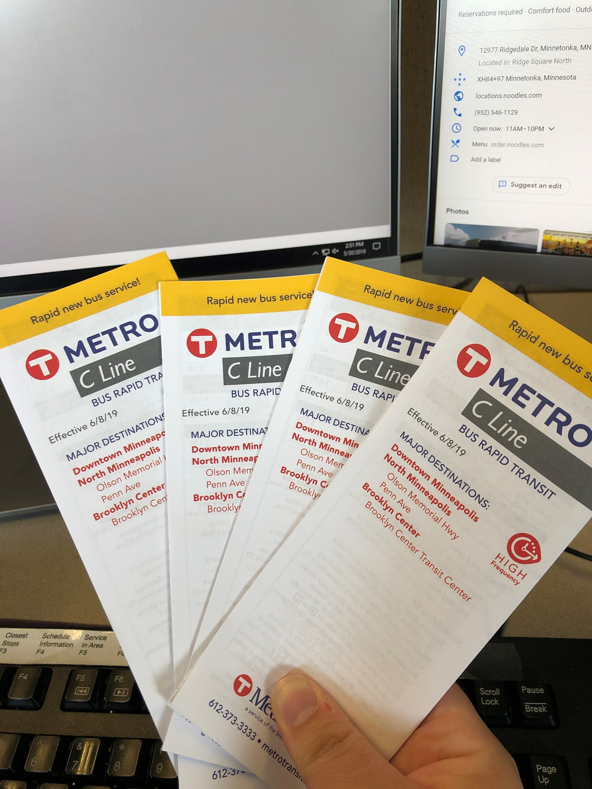
Pocket Schedule Evaluation – What is it?
Evaluate current usage of pocket schedules and make future recommendations for them.
Do we redesign them?
Do we change the content?
Where do we distribute them?
Do we discontinue them?

Slide 3
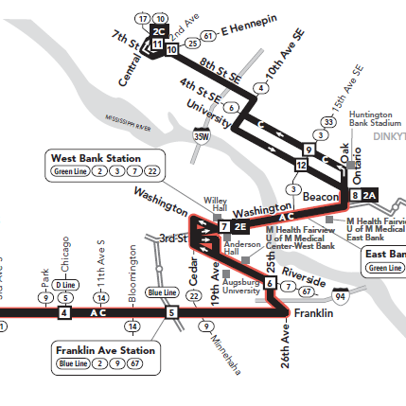
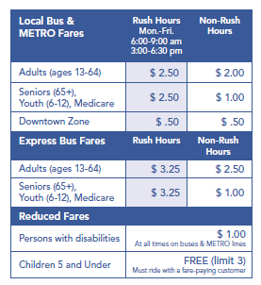
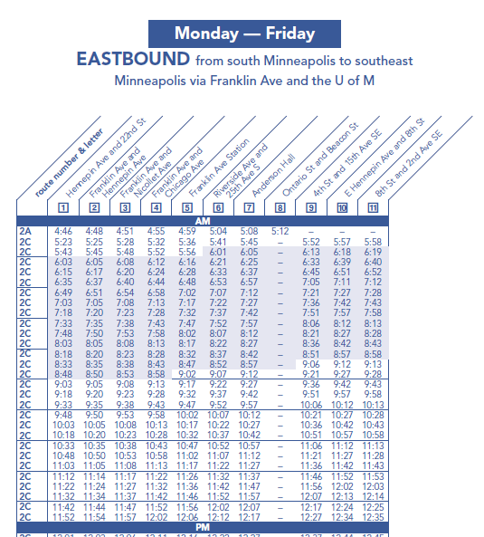
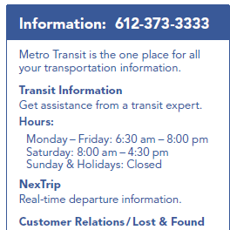
Elements of Pocket Schedules
Maps
Contact Info
Fare Info
Fare Information
Timetables
Contact Information

Slide 4
Limitations of Pocket Schedules
Printed information can get outdated between service changes.
Advancement of technology and online tools.
Printing Contract

Slide 5
How does TAAC want to be involved?
How should we engage the disability community?
Would TAAC like to be apart of a focus group or one-on-one interviews to provide more in-depth feedback about pocket schedules?

Slide 6
Thank You!
Nathan Bakken
nathan.bakken@metrotransit.org
612-349-7414

