Slide 1
TAAC: Stop-Level Signage Evaluation
5 February 2025
Jasna Hadzic-Stanek | Transit Information Sr. Project Administrator

Slide 2
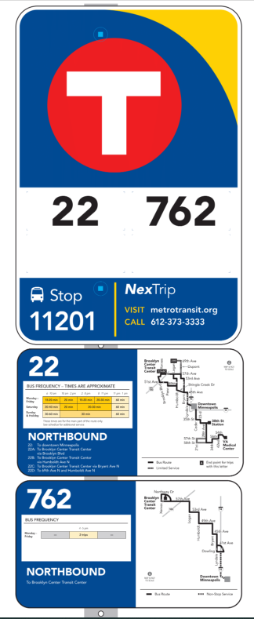
Overview: Signage-Level Evaluation
Last updated in 2017, bus stops with higher ridership and no shelter, were treated to new sign panels that included:
Route number, travel direction and destination(s)
Frequency chart
Simplified route map
Is this information still meeting the customer needs?
Notes:
Last updated in 2017, stops with higher ridership but no shelter, were treated to new sign panels that included detailed route information:
Route number (including branches), travel direction, and destination(s)
Frequency chart
Simplified route map
Challenging to maintain, especially the frequency charts.

Slide 3
Objective: Signage-Level Evaluation
Evaluate and conduct customer engagement and user testing to identify information needs at the stop-level point in the customer journey.
Approach:
Data analysis and current environment/context
User engagement and evaluation
Recommendations and Actions/Decisions
Notes:
Opportunity to revisit our assumptions about what customers want and/or need in stop-level information.
Like Metro Transit Forward recognizes that the agency is at a pivotal point, Transit Information recognizes that external and internal changes over the past couple years present an opportunity to revisit our assumptions about what customers want and/or need in stop-level information.
How do we design testing that gets at the minimum amount of information customers needs at the stop? Travel direction, destination, branches, etc.

Slide 4
Project Timeline
Winter 2025: Existing conditions analysis and project scoping
Spring/Summer 2025: Phase 1 engagement
Focus groups and surveys on what information people want to see/prioritize
Fall 2025: Phase 2 engagement
Present design options
Winter 2025: Develop final recommendations
2026+: Implementation

Slide 5
How does TAAC want to be involved?
How should we best engage with people living with disabilities?
Would TAAC like to be a part of a focus group or one-on-one interviews to provide more in-depth feedback about Stop-Level Signage?

Slide 6
Thank You!
Jasna Hadzic-Stanek
Jasna.Hadzic-Stanek@metrotransit.org
612-349-7178

