Slide 1
Community Engagement
Cindy Sherman
August 17, 2016

Slide 2
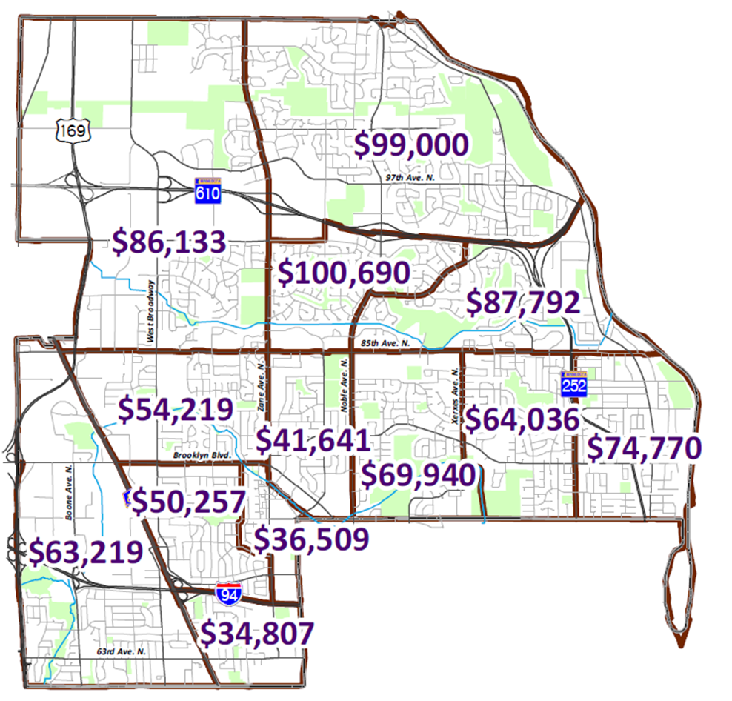

Slide 3
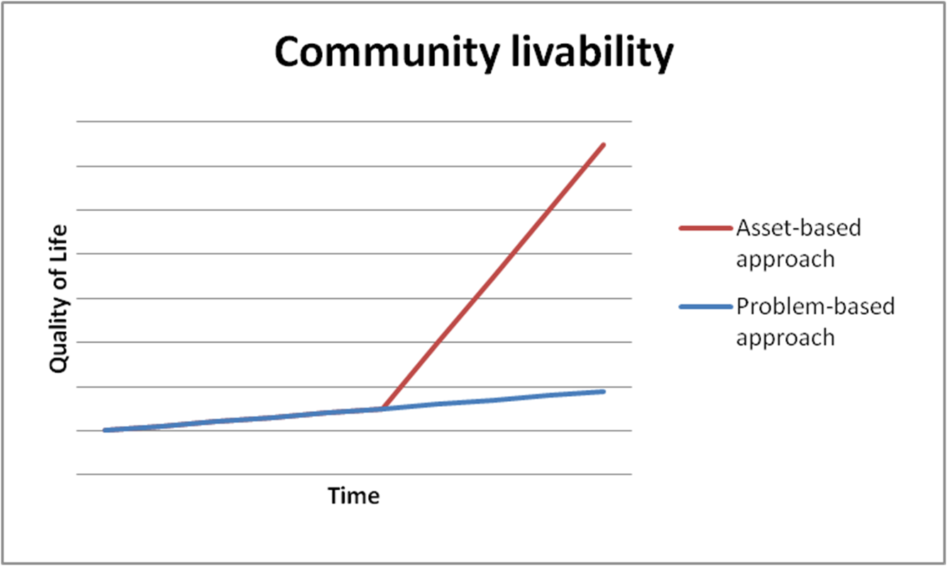

Slide 4
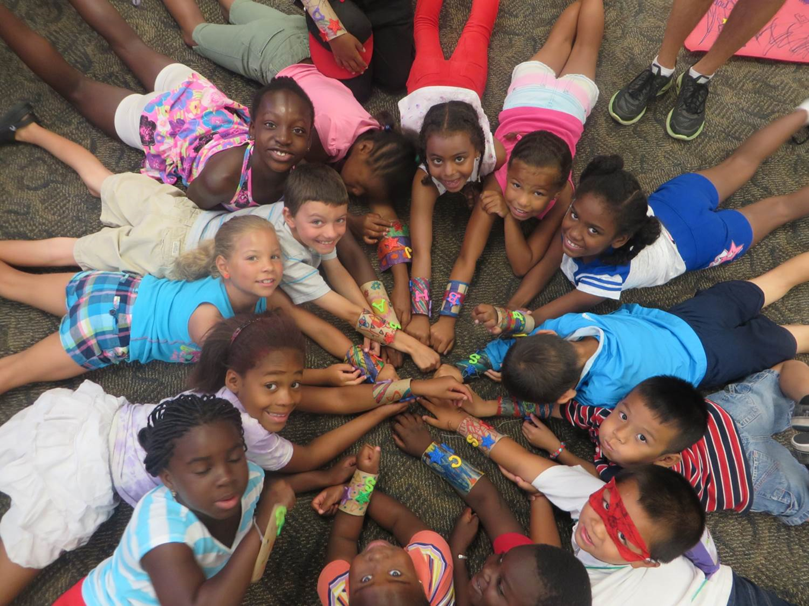
Brooklyn Park, a thriving community inspiring pride where opportunities exists for all

Slide 5
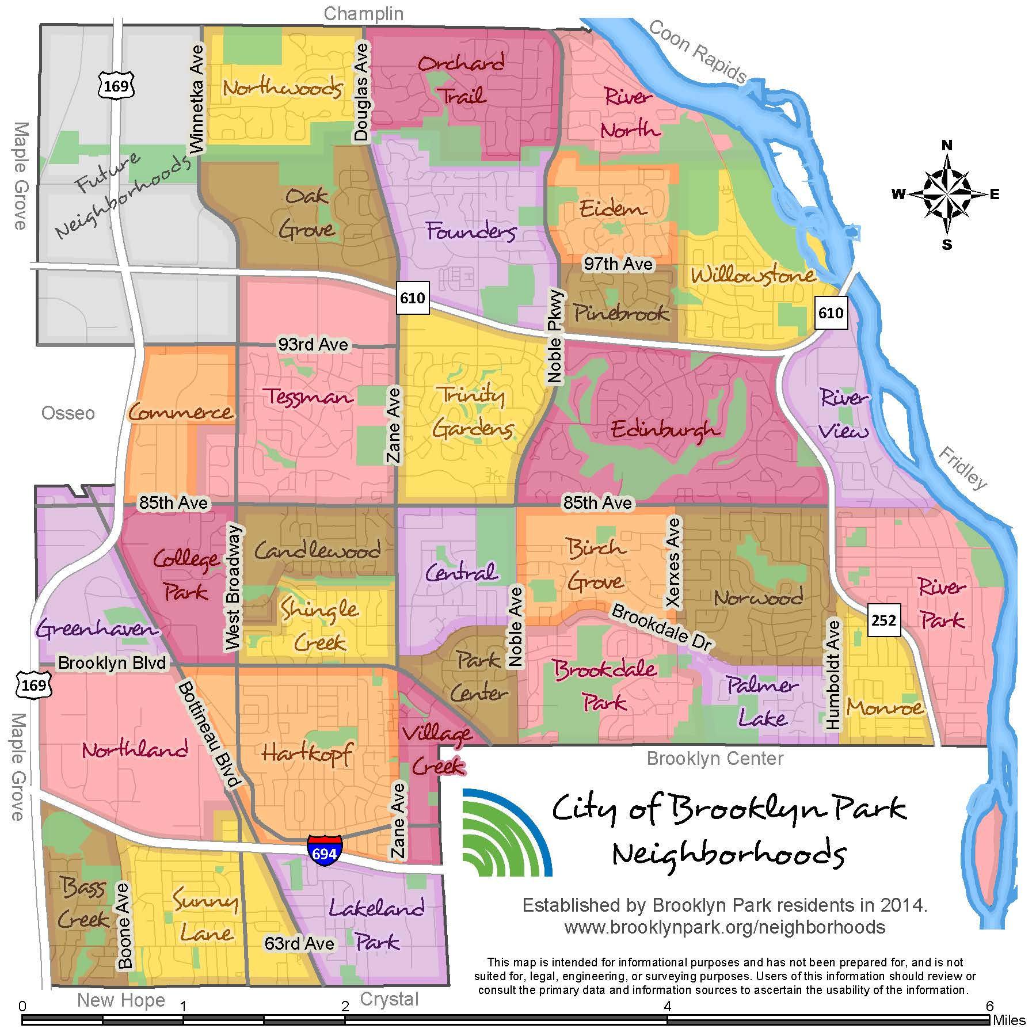

Slide 6
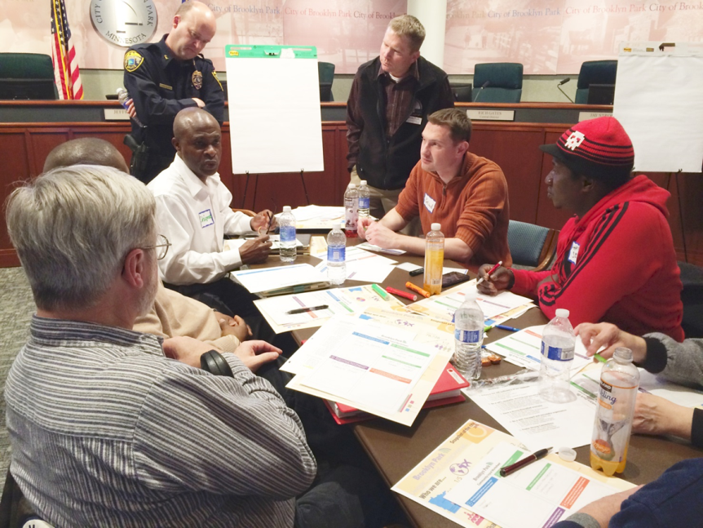
City staff engaged nearly 1000 community stakeholders in a variety of ways between April and June 2016
6 Community Cafés (city wide mailing)
17 community group meetings
Staffed tables at 6 community events
White boards at 9 locations around the city
Online forum
Cafés with 125 staff

Slide 7
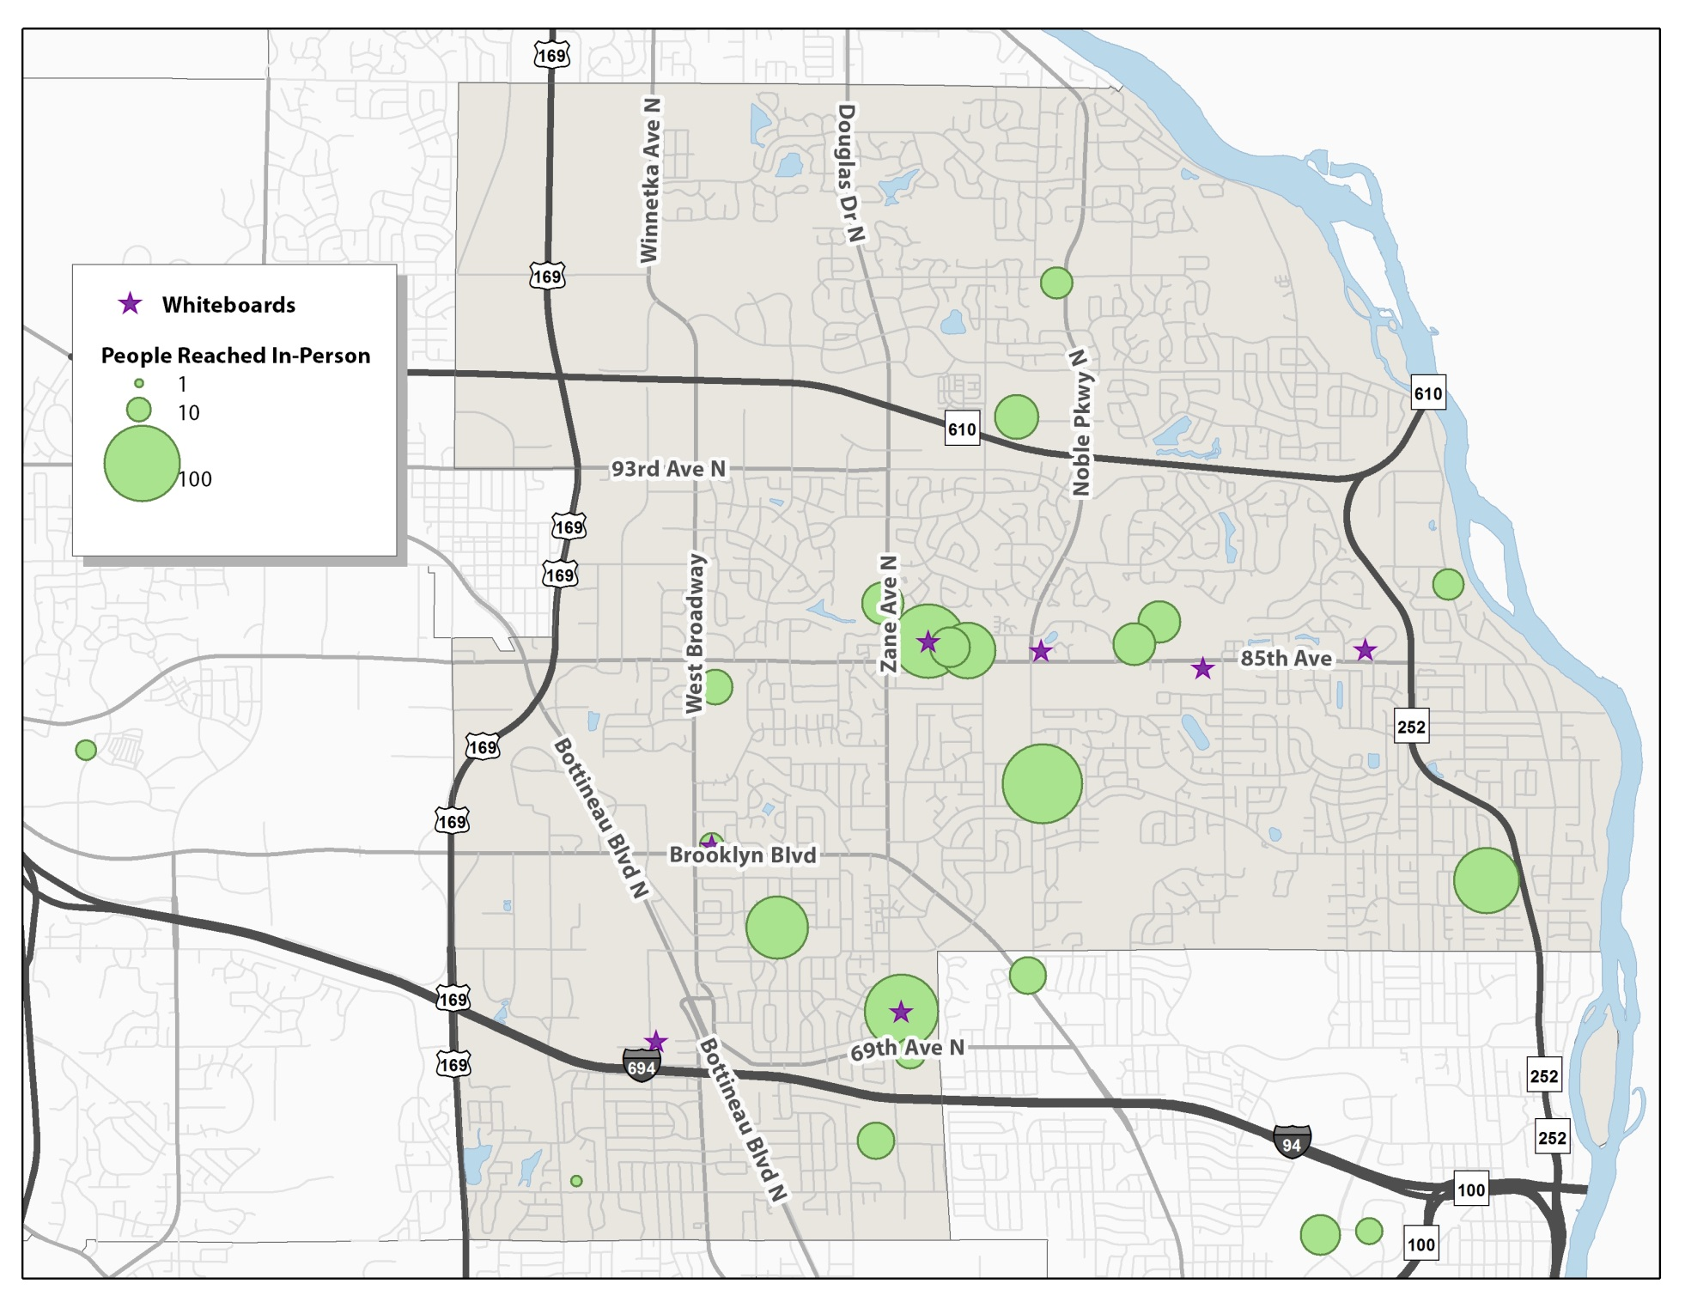

Slide 8
What key words would you use to describe the community of Brooklyn Park today?

Slide 9
What do you love most about Brooklyn Park?

Slide 10
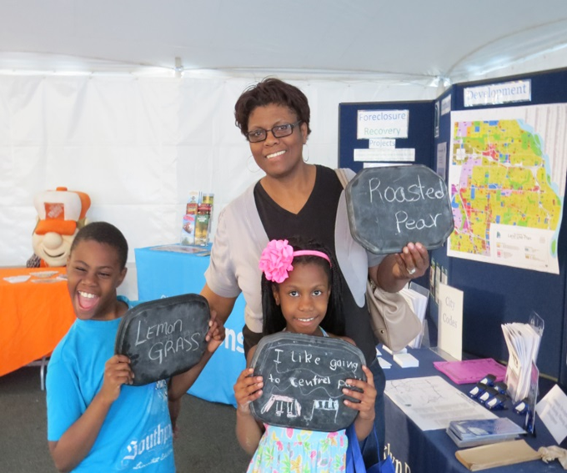
As we look forward to 2025, what do you want to see in Brooklyn Park?
Themes:
Education
Disparities and Equity
Economy
Community Relations
Safety and Crime
Housing
Transportation
Parks and Recreation

Slide 12
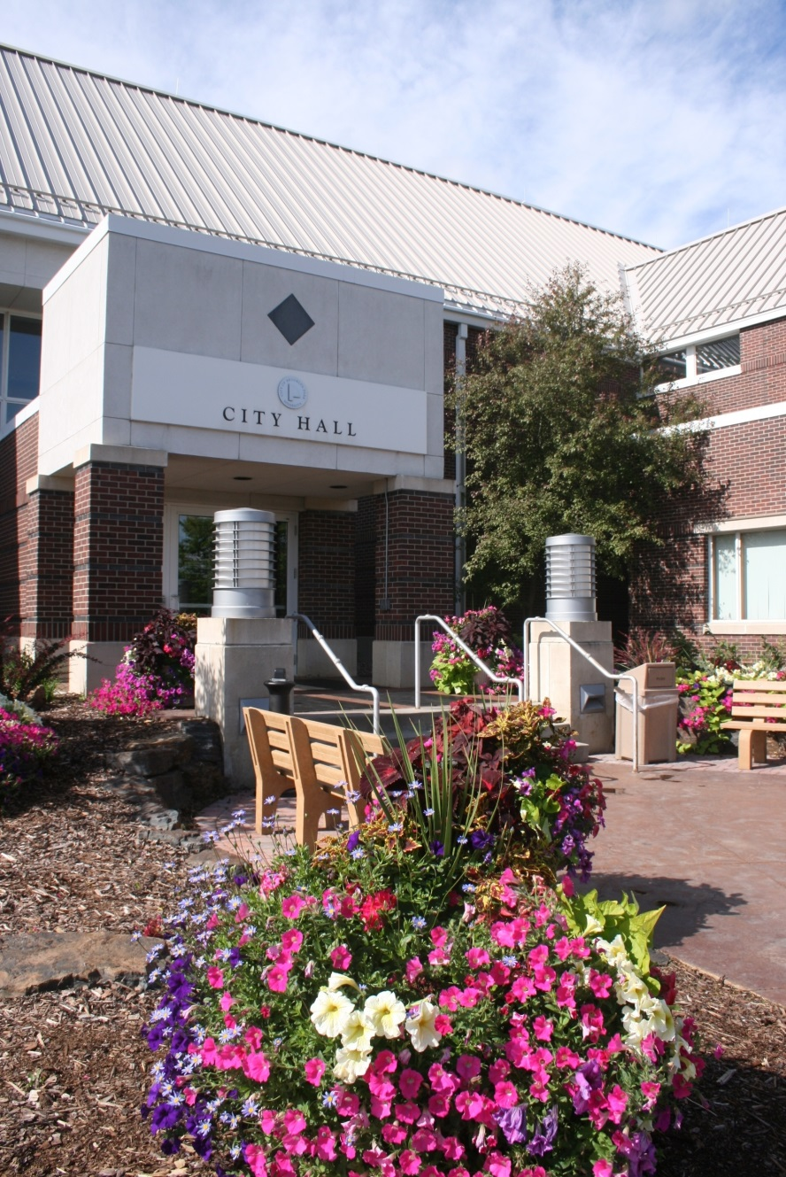
Next Steps
Develop Goals
Make a plan
Review the plan with community
Approve the plan

Slide 13
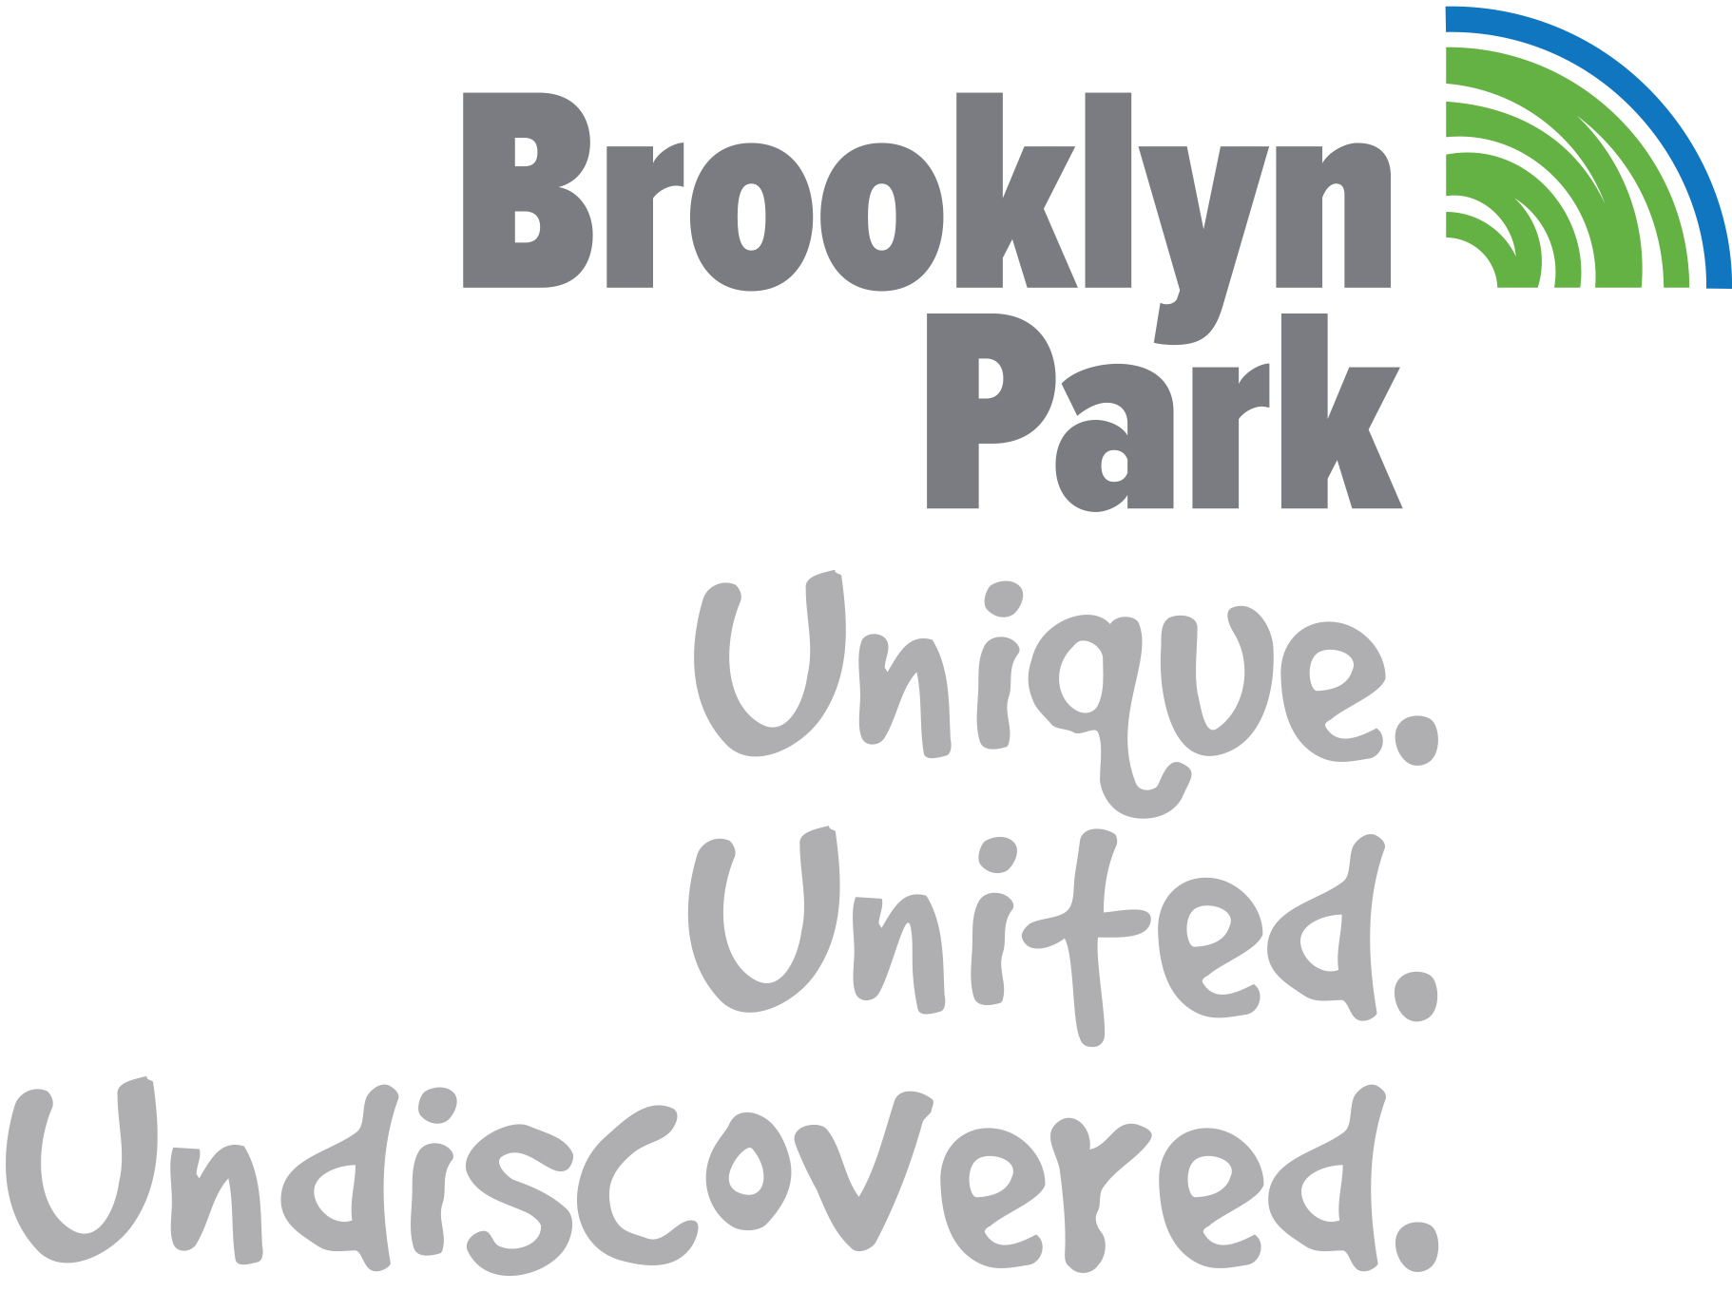
Thank you!

