Slide 1
Racial Equity Within Public Utilities:
Examples and Challenges
Steve Hamai
Environmental Justice and Service Equity Division
July 28, 2017
Metropolitan Council and
Government Alliance for Race and Equity

Slide 2
Presentation Objectives
Improved Understanding of SPU’s Race and Social Justice Framework and Approach
Plan Alignment
Implementation Examples
Challenges
Notes:
Steve
Won’t cover key concepts like Institutional racism, white priv., systems of oppression, equity,
This is a short overview

Slide 3

Vision:
Racial disparities have been eliminated and racial equity achieved.
Notes:
The RSJI vision that unifies this work across City departments and connects us with community goals. RSJI was formally launched in 2005.
This is a big vision, but one that is backed by our nations guiding documents and stated values like, “freedom and justice for all”
The elimination of racial inequity will be an indictor that country has lived into our shared values of fairness and opportunity for people in all circumstances.

Slide 4

Race and Social Justice Initiative Mission
Undo institutional racism
in City government
Promote inclusion
Partner with the community and other institutions
Notes:
In order to have maximum impact we are taking a multi-faceted/City-wide approach.
Translated, this means that City departments are needing to develop their own infrastructure and work plans to support RSJI

Slide 5
SPU Overview
Mission: Providing efficient and forward-looking utility services that keep Seattle the best place to live.
SPU is composed of three major direct-service utilities.
Notes:
1,400 employees
You pay your utility bill every other month
Own our own watershed

Slide 6
SPU Race and Social Justice Competencies
You Understand:
Causes of racial disparities
‘Why’ am I involved – what’s my motivation?
The institutional change process necessary to achieve racial equity
You Are Able To:
Articulate the value and benefit of eliminating institutional racism
Leverage internal expertise to advance the vision of RSJI
Apply RSJI principles and tools to decision making, strategic planning and personnel policies
Self-reflect and challenge our own collective biases
Notes:
Kizz
At the individual level, there is learning and growth
Additional RSJI Competencies for Leadership:
Use your position to influence and direct others to build and utilize RSJI competencies.

Slide 7
Structural Approach
WHAT
HOW
Organizational Learning and Change Management
Understanding our role in unintended negative impacts and disparities
Expanded, pro-active community interface
Staffing & Support
Existing and New Data
Use of Racial Equity Tools and Inclusive Community Engagement
Embedded in decision making processes and performance indicators
Notes:
Also - Includes WMBE analysis, and partnerships and influence across the City and County

Slide 8
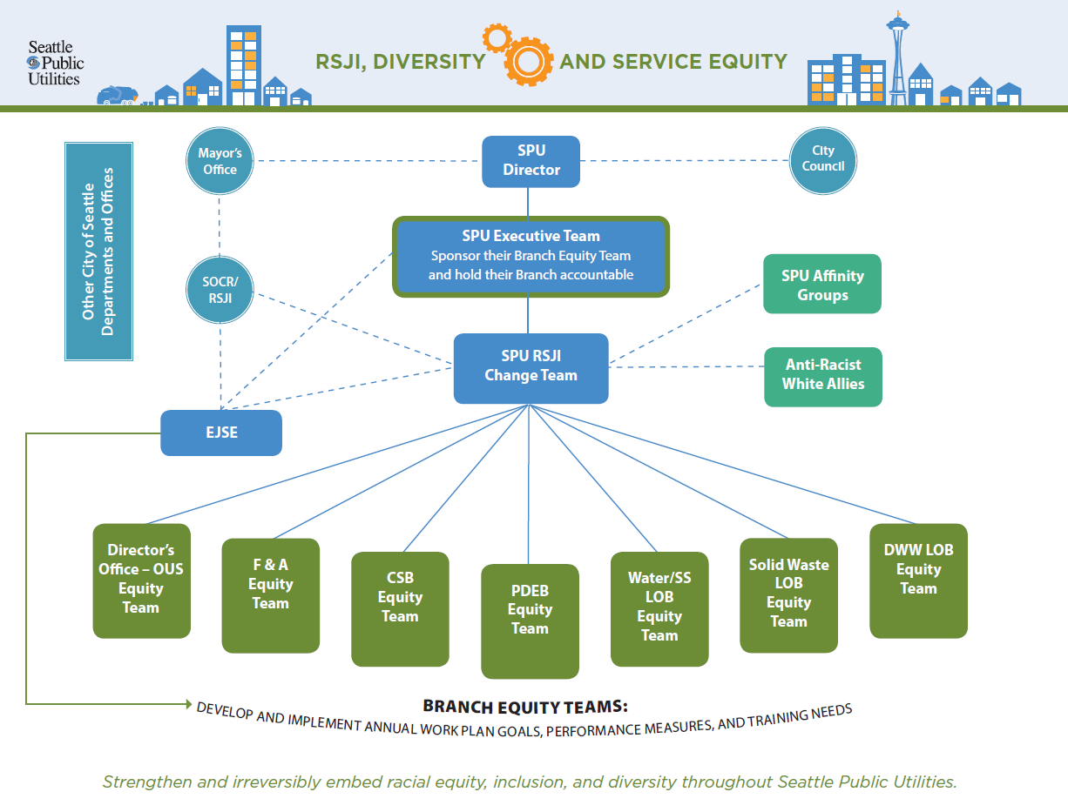
Notes:
In launch mode now
SPU Executive Buy-In and Sponsorship of the new model
Had to create line of sight accountability, AND match the existing organizational structure

Slide 9
External Community Engagement
WHAT
HOW
SPU staff (not consultant firms) take more responsibility for engaging community
Project driven community engagement is ineffective and inefficient
Message is not relevant for community
Funded multi year community partnerships
Coordinated community partnership and engagement that meet broader utility needs
Understand community priorities/needs and connect to message
Notes:
Also - Includes WMBE analysis, and partnerships and influence across the City and County. Turn over to Steve, “Who will focus on our efforts to embed equity internally within the organization.”

Slide 10
Acknowledge Equity as an Issue
Discuss ways our utility may unintentionally create or exacerbate racial or other socio-economic inequities though our policies, procedures, services, programs, or projects.
Discuss the business case for addressing inequity
Notes:
First, must acknowledge the issue AND the connection to what we do as a utility
Second, taking ownership through embedded processes like Asset Management - Stage Gates, Director’s Rule Development, Manager and Division Director annual performance expectations etc.

Slide 11
Creating ‘Line of Sight’
Seattle Comp Plan
SPU Strategic Business Plan
SPU Line of Business Plans

Slide 12
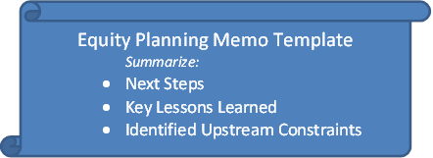
SPU Equity Planning Toolkit Library
Stakeholder Analysis
Inclusive Outreach and Public Engagement Plan Development (optional)
Service, Project, or
Program Development
Master or Comprehensive Plan Development
Policy, Procedure, Director's Rule, or Code Development
Management Discussions and Decision Making
Select one of the following

Slide 13
Some Examples
Planning
  Seattle 2035 Comprehensive Plan – Added language and goals to expand the utility’s commitment to equity
Policies and Procedures
  Sea Level Rise Adaptation – Accountability for inequitable impacts to people
Projects
  Every Other Week Garbage Collection – No-go for Citywide implementation
Programs
  Damage Claims – Expanded customer awareness and access
Notes:
Steve

Slide 14
Seattle 2035 Comprehensive Plan: Utilities Element
Utility Facility Siting and Design
GOAL
Site and design facilities so that they help to efficiently and equitably provide services to all Seattleites and provide value to the communities where they are located.
POLICIES
3.1: Consider and budget for the potential operation and maintenance costs of new facilities when developing them.
3.2: Discourage siting and design alternatives that may increase negative impacts, such as traffic, noise, and pollution, particularly in communities that already bear a disproportionate amount of these impacts.
3.3: Apply consistent and equitable standards for the provision of community and customer amenities when they are needed to offset the impact of construction projects, ongoing operations, and facility maintenance practices.
3.4: Build facilities that are models of environmental stewardship by including high levels of energy, water, and material efficiency, effectively managing stormwater on-site, prioritizing local and environmentally preferable products, and limiting waste.
3.5: Consider opportunities for co-locating facilities, allowing mixed-use development, or creating accessible open space when siting and designing utility facilities, provided doing so would still allow for safe and secure utility operations.
3.6: Consider future climate conditions during siting and design, including changes to temperature, rainfall, and sea level, to help ensure capital facilities function properly as intended over their planned life cycle.
3.7: Consider and address the disproportionate impacts of climate change on communities of color and lower-income communities when prioritizing projects.

Slide 15
Draft Sea Level Rise Adaptation Assessment and Planning
Sensitivity: Performance of the SPU Asset When Flooding Occurs
Adaptive Capacity of the SPU Asset
Risk Assessment: Impacts to People
Account for DAMAGE, DISRUPTION, and COSTS. Include analysis of the racial and socio-economic composition of the area served by the asset, as damage, disruption and costs are not the same for all communities.
Notes:
http://www.seattle.gov/util/EnvironmentConservation/ClimateChangeProgram/ProjectedChanges/Sea-LevelRiseMap/index.htm

Slide 16
Often, lower income racially diverse communities do not have the same level or access to resources and political capital (resiliency factors) as well-to-do neighborhoods.
What is the anticipated level of DAMAGE to the people, impacted area and surrounding neighborhood?
What is the level of DISRUPTION to the people, impacted area and surrounding neighborhood?
What are the COSTS to assets, people and the surrounding neighborhood (to replace/repair or for health & safety)?
Notes:
High, Medium, Low

Slide 17
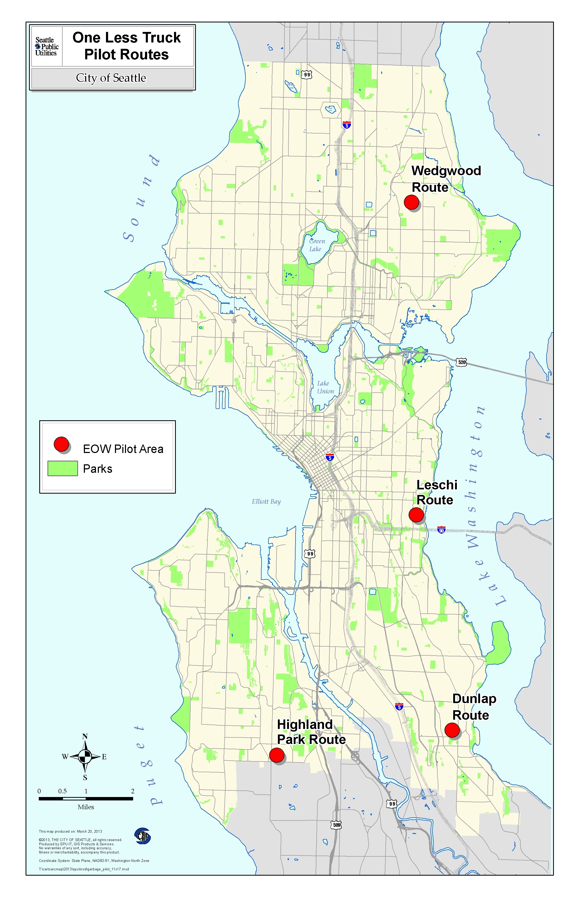
Notes:
Six month pilot conducted July – December 2012

Slide 18
Roughly translated……..
Dunlap (South) = $
Highland Park (Southwest) = $$
Wedgwood (Northeast) = $$$
Leschi (Central) = $$$$

Slide 19
Post Survey
Demographic Data by Neighborhood
Race
 | South | Southwest | Northeast | Central
White only | 50% | 60% | 83% | 70%
Black | 10% | 2% | 0% | 9%
Asian | 22% | 18% | 4% | 12%
Other | 5% | 3% | 0% | 0%
No answer | 13% | 17% | 13% | 9%
Notes:
N = 260 (32%)
In addition, English as Primary Language Spoken in the Home:
South (63%), Southwest (78%), Northeast (94%), Central (96%)

Slide 20
Post Survey
Demographic Data by Neighborhood
Household Income
 | South | Southwest | Northeast | Central
< $50,000 | 40% | 35% | 17% | 7%
$50 - $75,000 | 21% | 14% | 10% | 6%
$75,000 + | 12% | 25% | 41% | 67%
No answer | 27% | 26% | 32% | 20%
Notes:
In addition, # of persons in household:
Five or more: South (15%), Southwest (10%), Northeast (4%), Central (2%)

Slide 21
Before and During Pilot:
Comparison of Neighborhood Appearance
Notes:
When looked at by neighborhood, how people experience these impacts are different. As the chart shows, every problem is perceived bigger in the South and Southwest neighborhoods,
Those respondents living in the Central (60%) and Northeast (49%) neighborhoods were more likely to say they did not notice any differences, as compared to those in the South (31%) and Southwest (22%).
Those respondents living in the South (49%) and Southwest (45%) neighborhoods were more likely to notice overflowing containers, as compared to those in the Northeast (24%) and Central (24%).

Slide 22
Impacts Rated a Major or
Moderate Problem
Notes:
Those least likely to notice that the neighborhood looks messier live in the Northeast (7%) as compared to the Central (16%), Southwest (28%), and South (29%) neighborhoods.
Those living in the South (18%) and Southwest (22%) neighborhoods were more likely to notice litter or illegal dumping, as compared to Northeast (11%) and Central (15%).

Slide 23
Engage in Behavior More Often with
Every-Other-Week Garbage Collection

Slide 24
Preference for City-wide Implementation of
Every-Other-Week Garbage

Slide 25
Seattle Mayor Shelves Every Other Week Garbage Collection
Environmental benefits and the 8% reduction in garbage costs for an average Seattle family (about $3.30 a month) do not outweigh a 50% reduction in service frequency.
Citywide surveys show 45% of customers oppose the program. The rate of opposition is higher in lower income and more ethnically diverse neighborhoods.
Seattle has other immediate opportunities to boost its recycling numbers.

Slide 26
Damage Claims Catalysts
Annual report
Direct staff observations
Anecdotal stories relayed by SPU staff

Slide 27
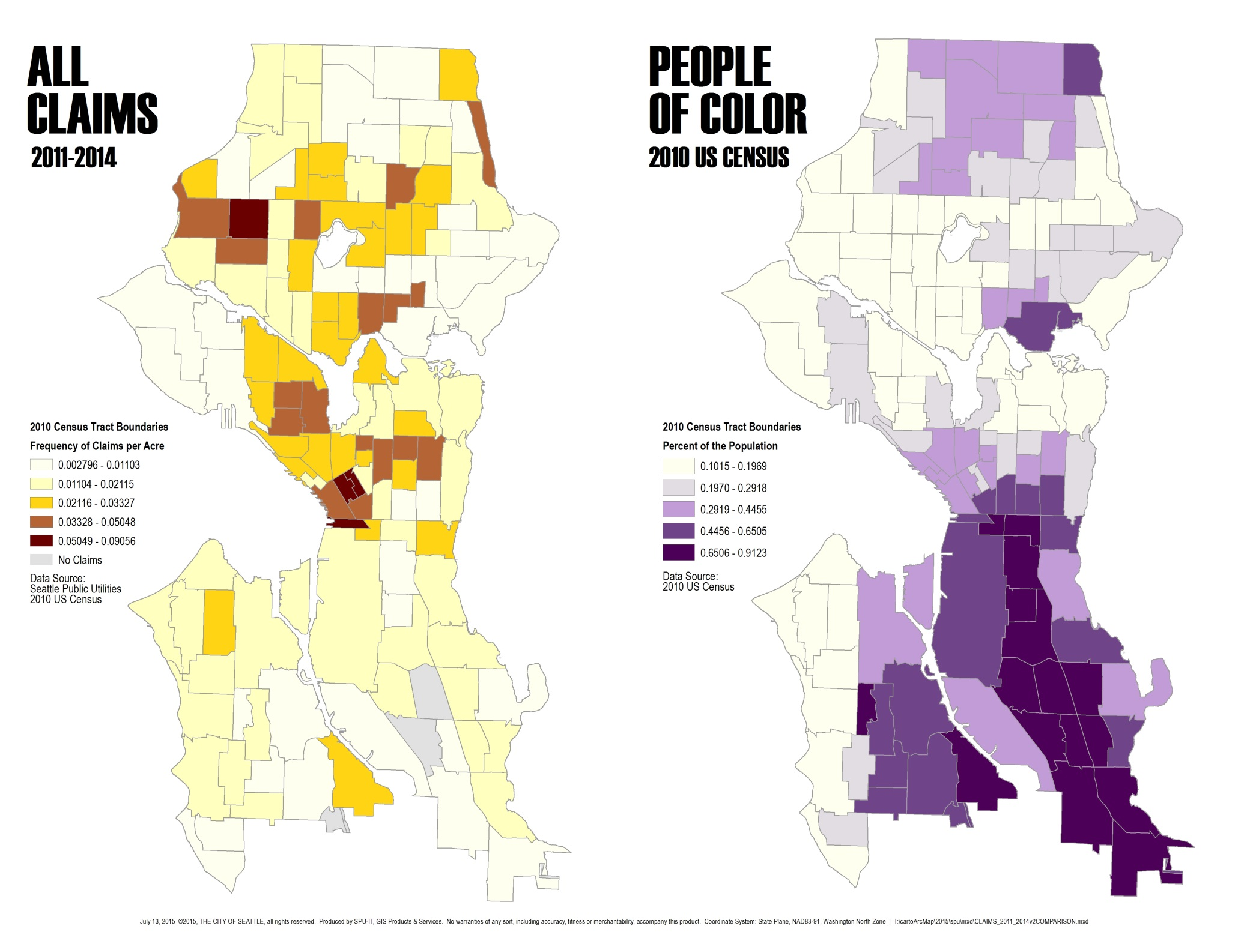
Claims Data + Census Data

Slide 28
Framing the Damage Claims Issue
Opportunity and Access
Who is aware of the right to file a claim?
How do they get the right information?
Support needed to file the claim?
Claims Processing
Prioritizing?
Gathering of additional information?
Bias?

Slide 29
Damage Claims Follow Up Tasks
  Map home addresses of SPU claims for past four years
    Completed
  Add link to claims information on SPU website
    Completed
  Develop messaging platform
    Completed
  Develop and deliver refresher training program for field staff and inspectors
    Completed
  Modify Urban Surface Water Flood Response Plan to include translation services in claims section
    In process
Notes:
Lizzie speaks for first bullet. Rick/Bruce speaks for second bullet.

Slide 30
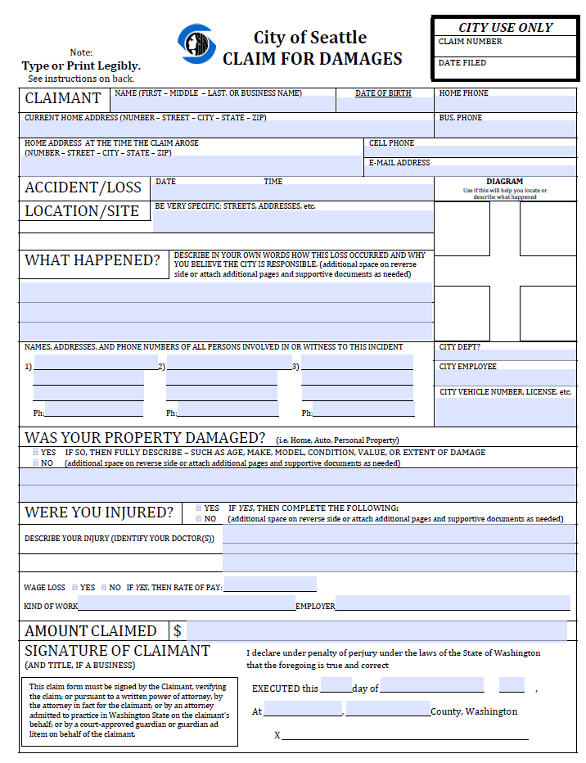
Recommendations for FAS
Shorten URL for Claims website
Review claim form and consider whether it can be simplified
Partner with other City departments to increase claims information in local communities
Consider mapping existing claims data and performing census correlation

Slide 31
Overall Progress Thus Far...
Routine allocation of outreach resources for limited English speaking populations
Grant information sessions now held in community locations with more diverse grant recipients
Stronger adherence to testing for disparities through project design and demographic data collection
Acknowledgement that some Citywide services may inherently be inequitable
Embedded, as a routine business practice

Slide 32
Challenges
Evolving Political Landscape
Staff Turnover
White Privilege of ‘Forgetfulness’
Inter-departmental Coordination
Data Collection
Move from ‘Supplemental’ to ‘Core’ Service, Matching Agency and Customer Values

Slide 33
Lessons Learned
Customized approach to meet organizational culture, and embed within business practices
Take into account the users, and speak to their head and their heart
Create ongoing learning opportunities, and allow for team ownership
Capture ‘and, as a result…….’ accountability

Slide 34
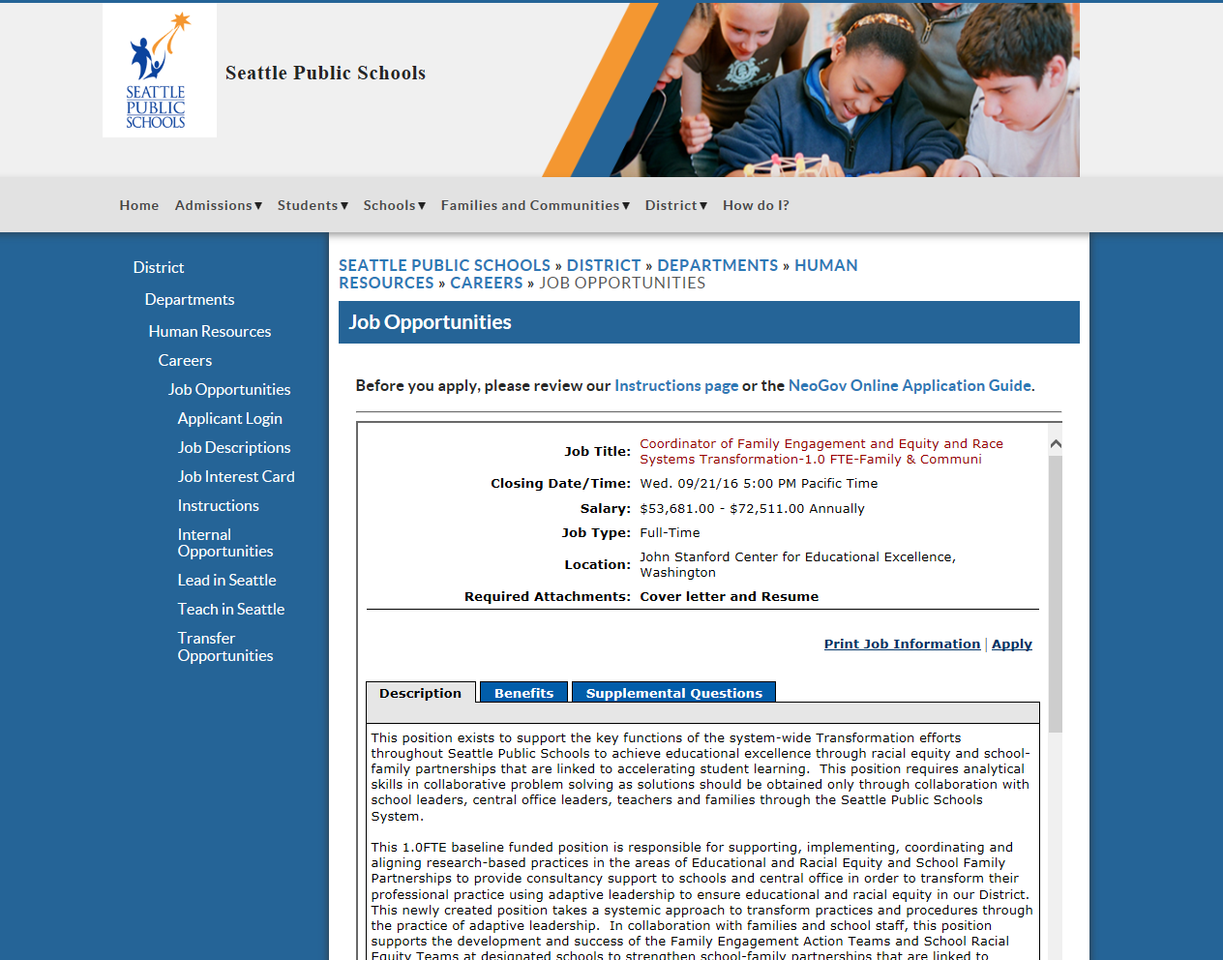
Coordinator of Family Engagement and Equity and Race Systems Transformation-1.0 FTE-Family and Community

Slide 35
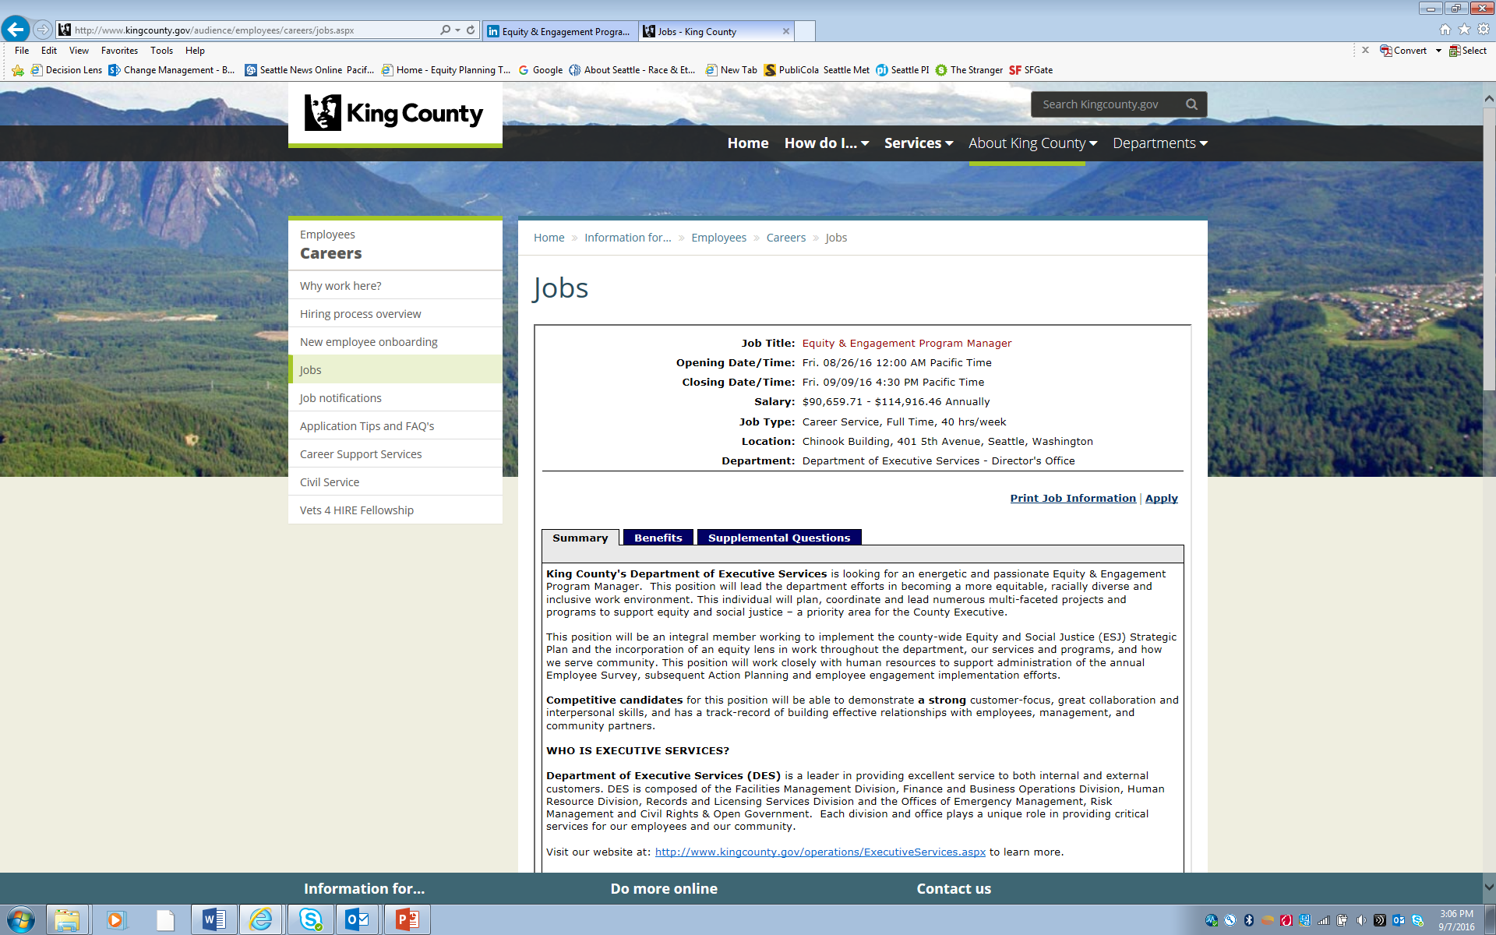
Equity & Engagement Program Manager

Slide 36
Questions and Discussion
1. What is the intersection between institutional racism and professions associated with the College of Built Environments?
2. What can be done now within CBE?
3. In the future, how can I support equity?

Slide 37
Contact Information
Steve.Hamai@seattle.gov
(206) 733-9430
http://www.seattle.gov/util/ “service equity”

