Slide 1
Notes:
2nd Project POP UP MEETING
One of my first jobs at the city was to make a power point for a community meeting. As an artist I made some great images but at the end of the meeting I realized that was not real issue but rather the amount diversity and people attending the community meeting

Slide 2
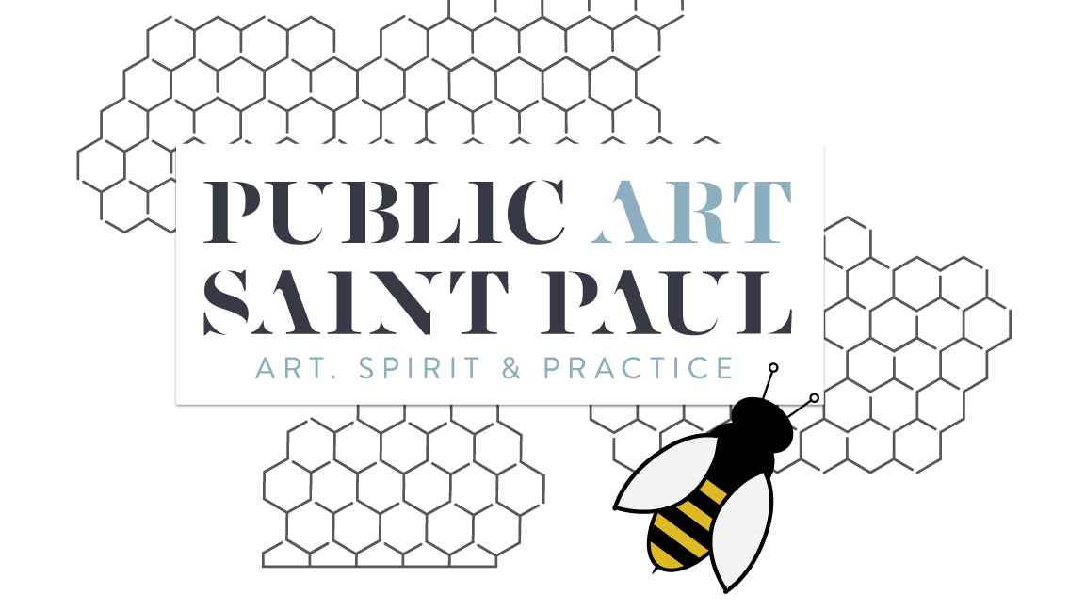
Notes:
The best illustration I’ve come up with for this work at Public Art Saint Paul is the bee and the hive.

Slide 3
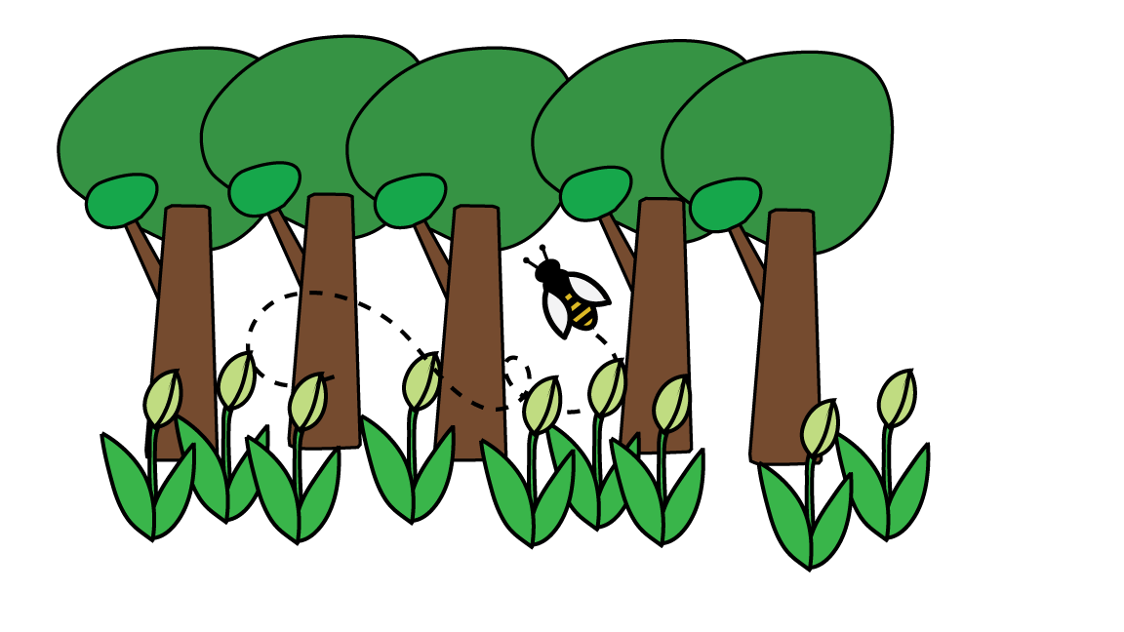
Notes:
The bee circulates through the flowers and trees and collects pollen, which it then spreads to help the flowers and plants to grow.

Slide 4
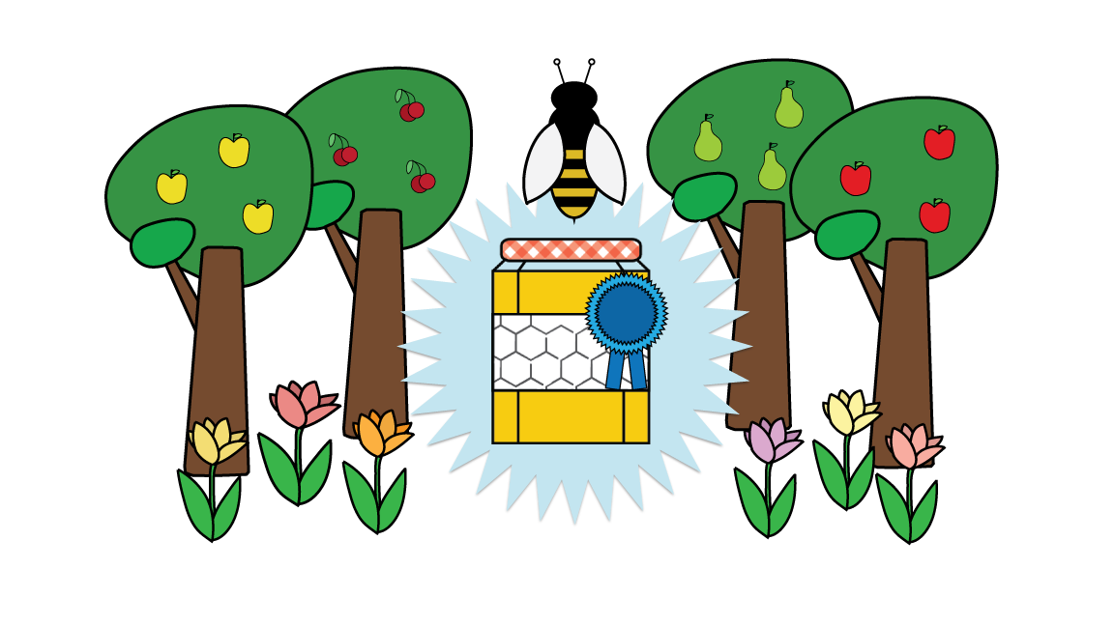
Notes:
They bear fruit!

Slide 5
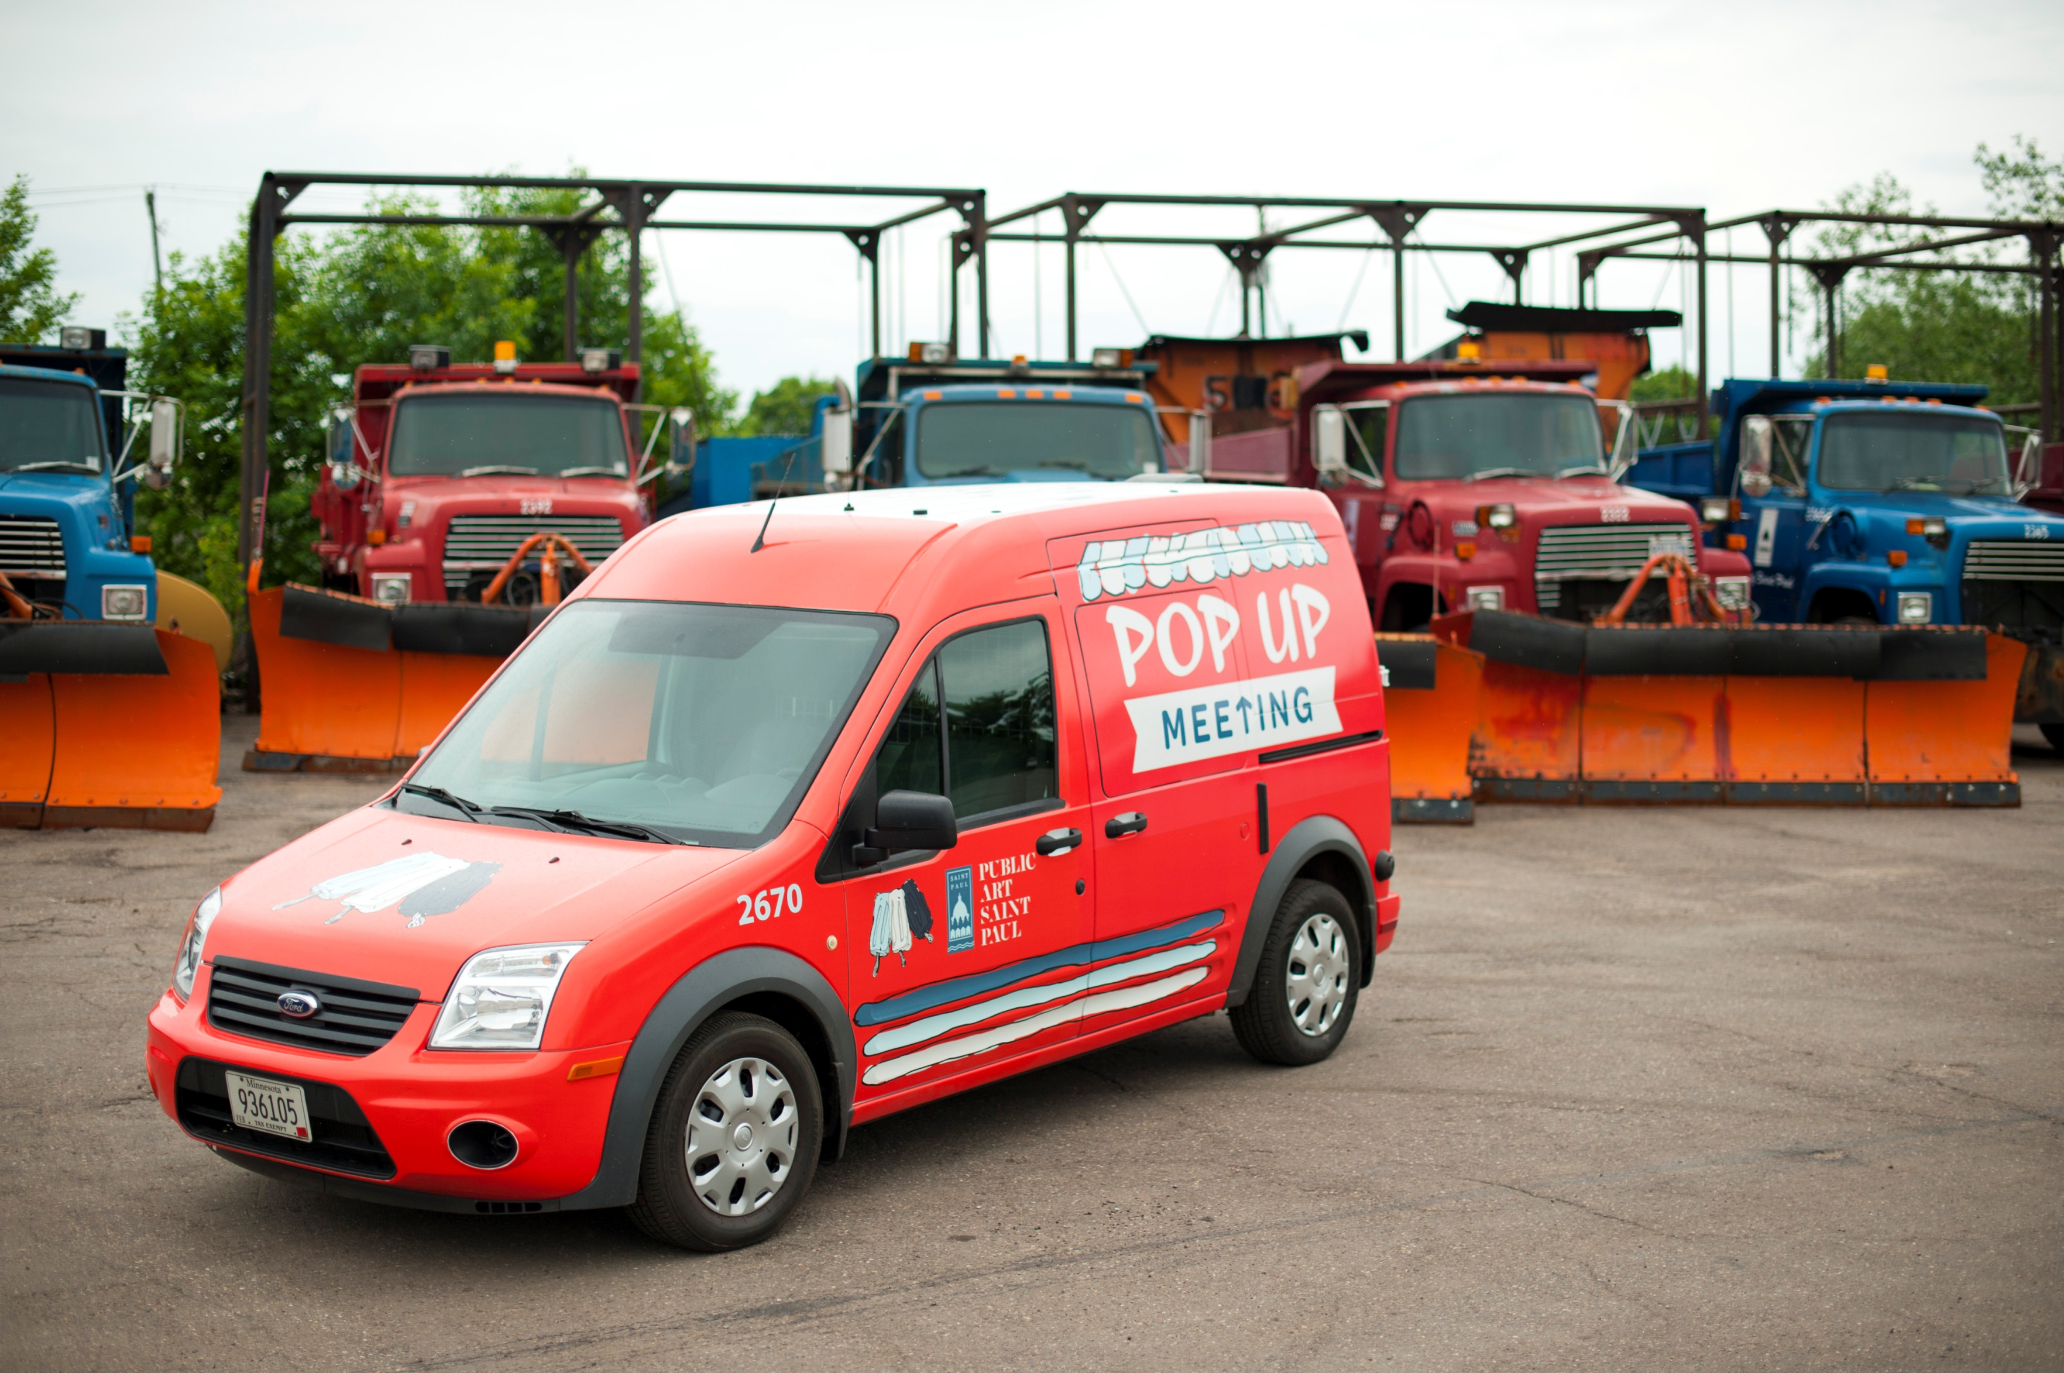
Notes:
So I made a Popsicle truck!
From ideation to implementation took a year
I secured a truck from PW, they tried to give me a snow plow
Worked across departments set up the first summer of meetings

Slide 6
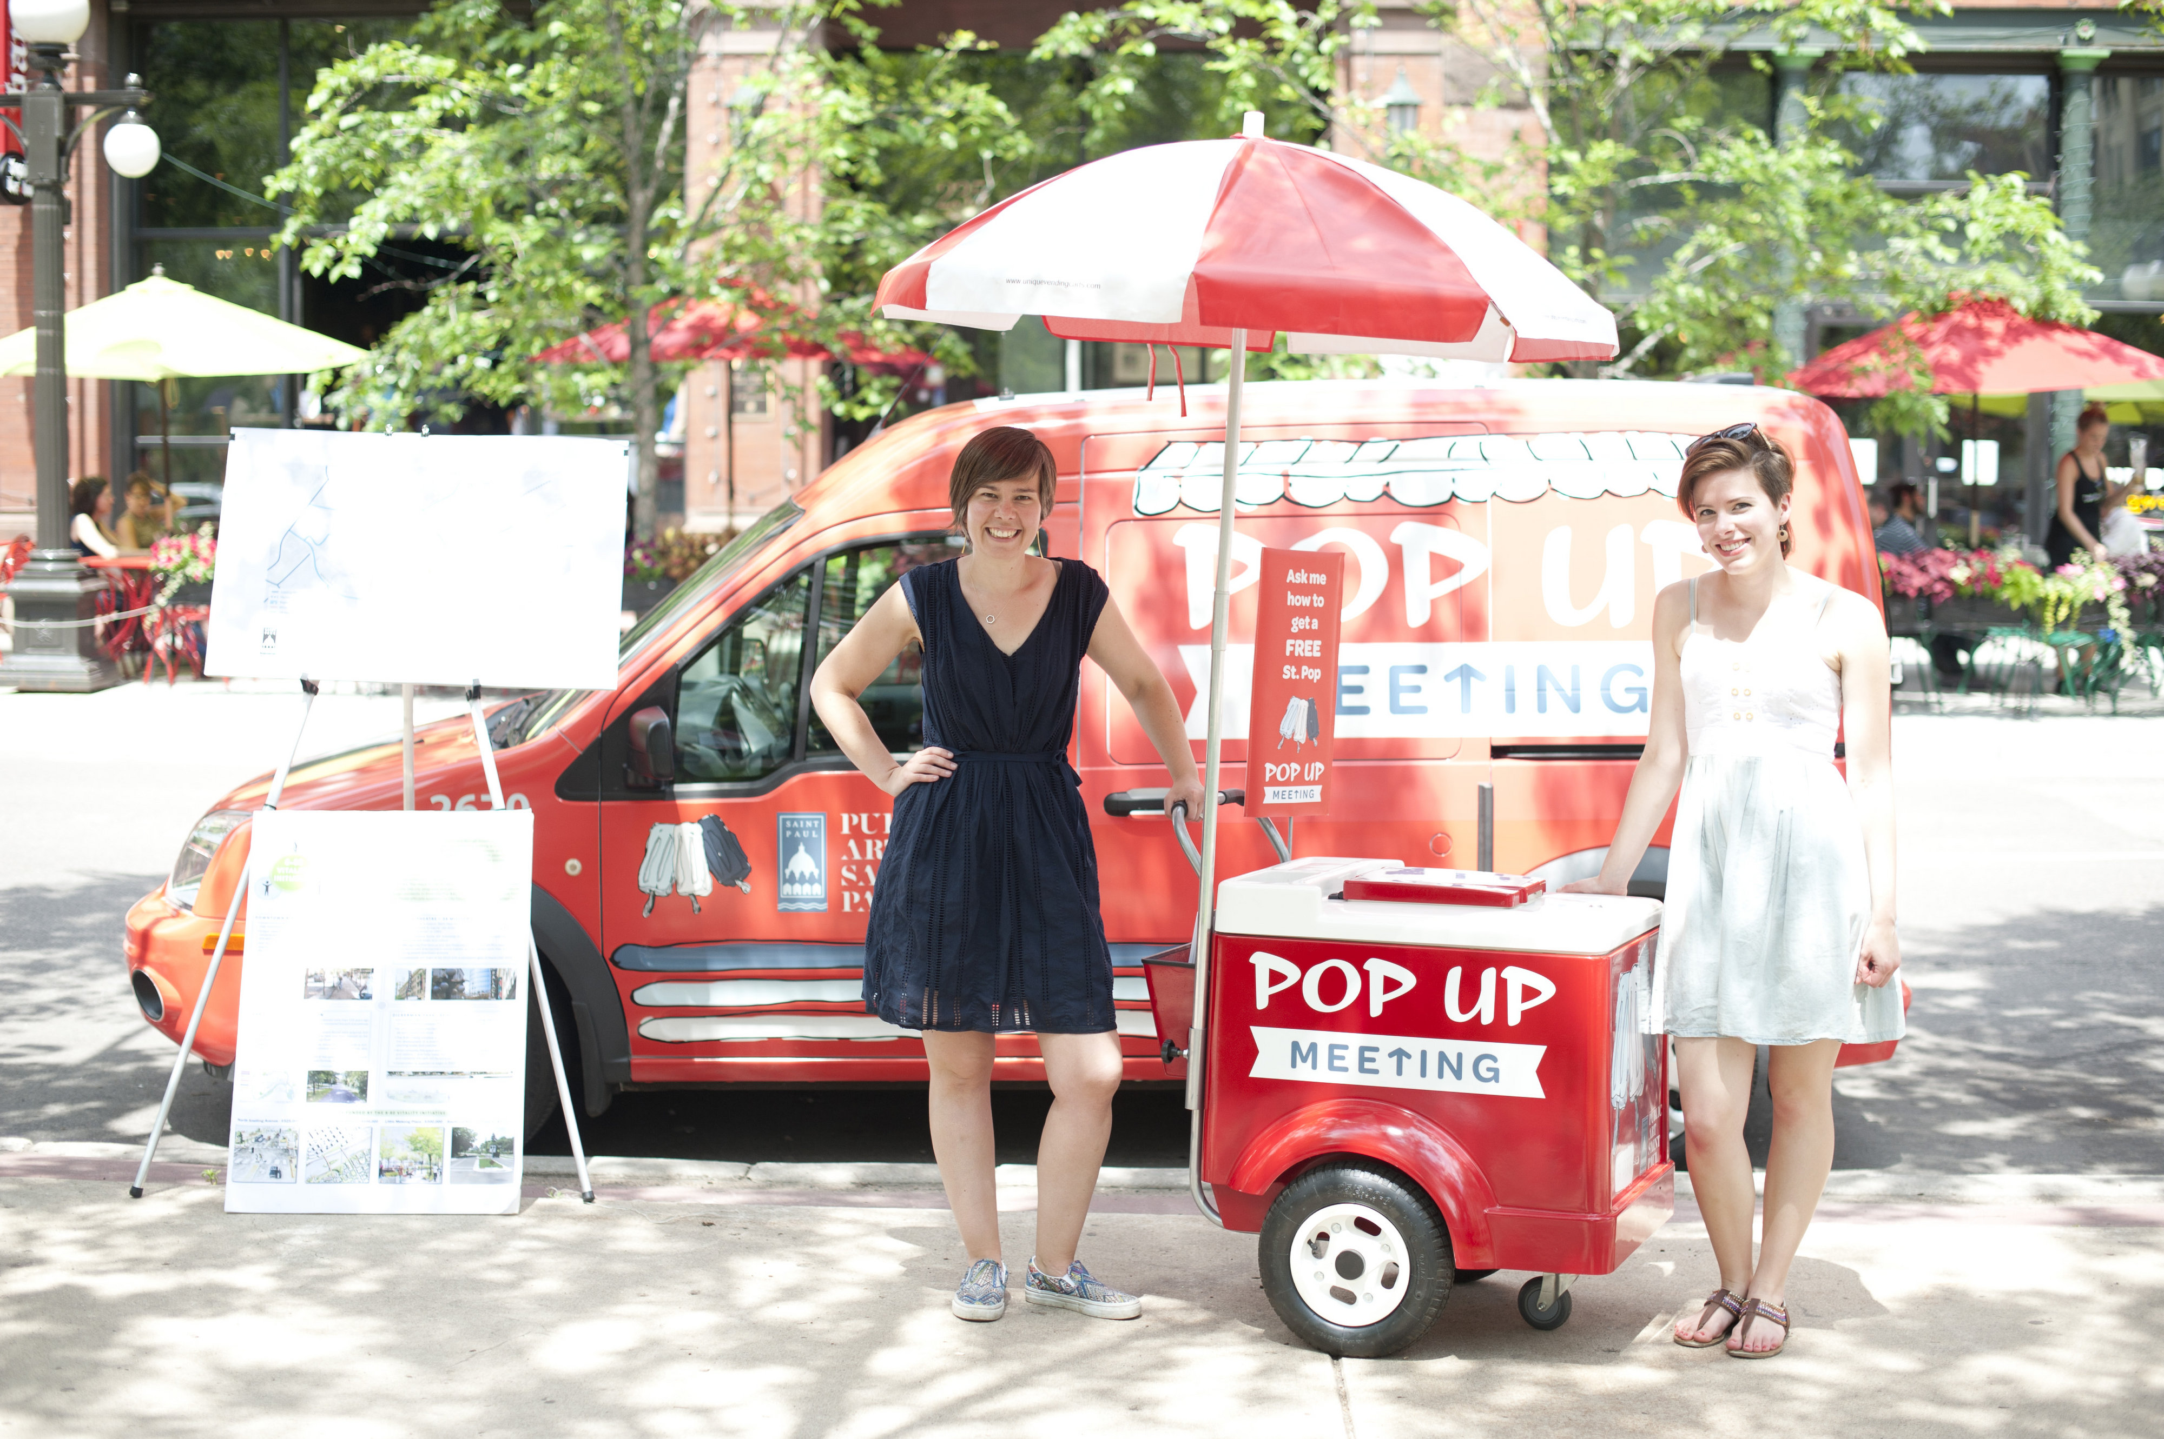
We hosted 17 Pop Up Meetings
Notes:
Photo of outreach staff – they hosted 17 pop-up meetings the first year.

Slide 7
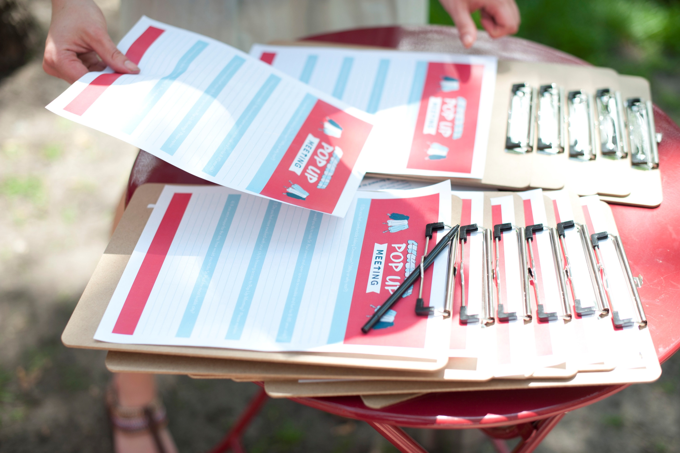
We collected 1,153 surveys
Notes:
Photos of surveys – they collected 1,153 surveys.

Slide 8
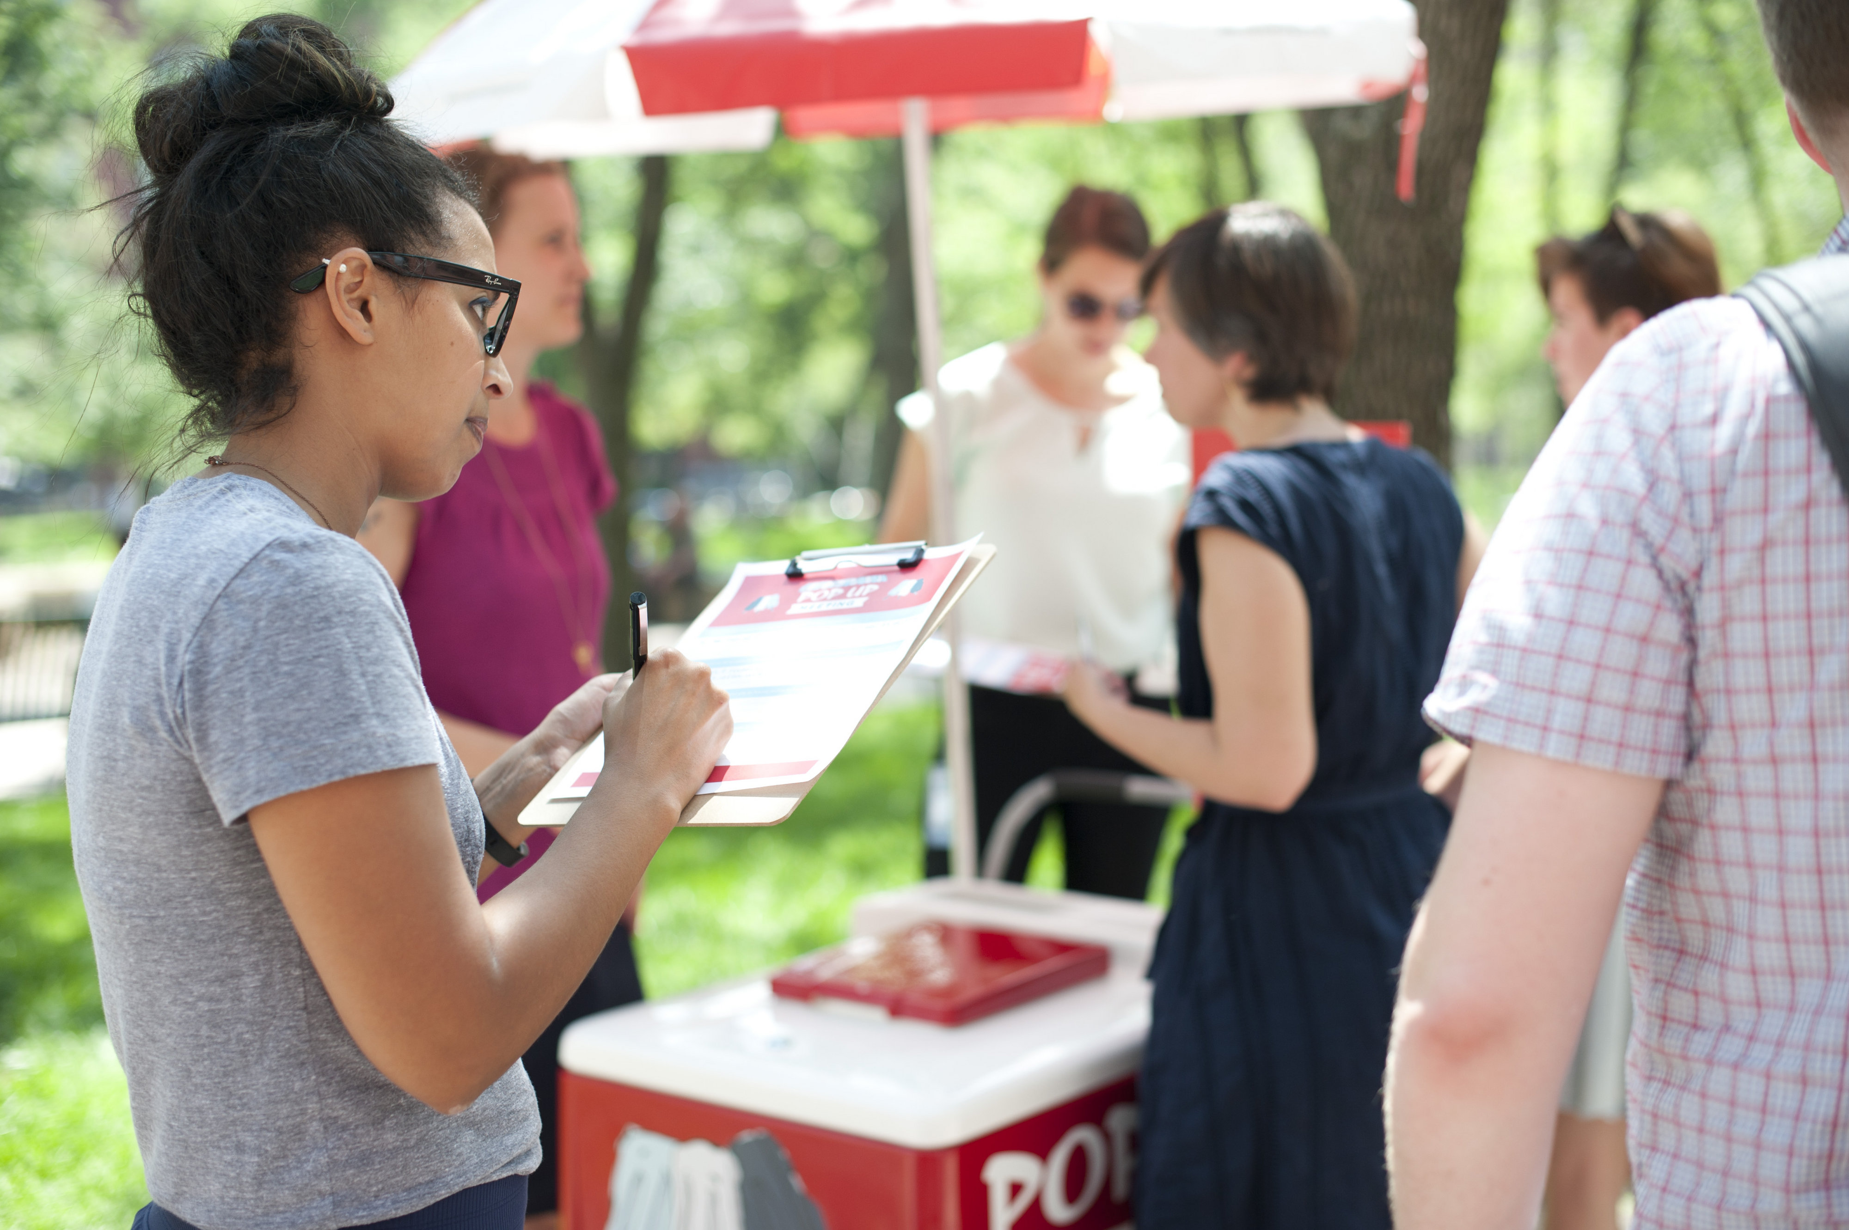
70% of people said
they had not been to
a city meeting before
Notes:
70% of people said they had not been to a city meeting before.

Slide 9
Notes:
Chart of responses – illustrating more responses to questions at the pop-up meetings than traditional meetings.

Slide 10
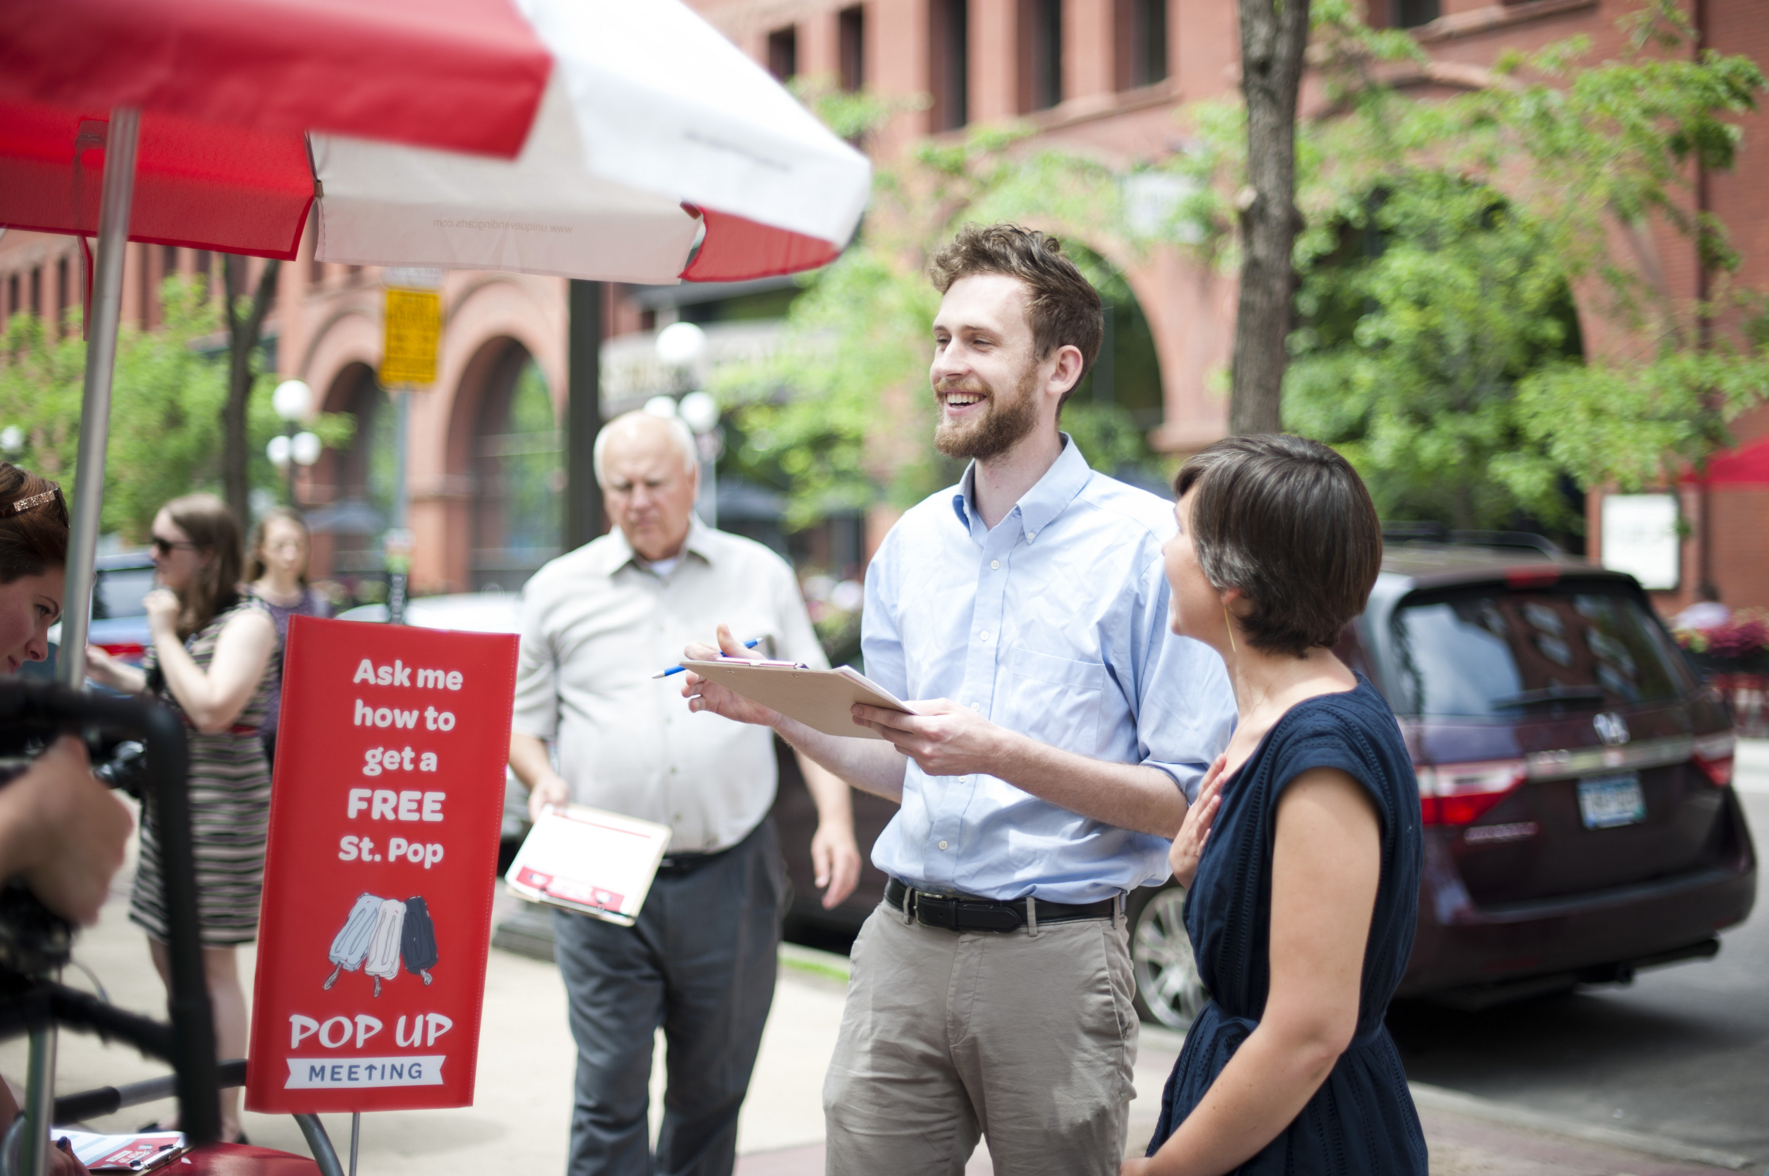
93% of respondents said “Pop Up Meeting was an easy and engaging way to be part of city planning.”
Notes:
93% of respondents said “Pop-up meeting was an easy and engaging way to be part of city planning.”

Slide 11
Notes:
Photo of the survey. Questions listed on next slide.

Slide 12
Sample Survey Questions
What would you do to make St Paul streets and open spaces accessible and fun for 8 to 80 year olds?
If you were mayor for the day, how would you make St. Paul the most livable city?
What are the major biking barriers in your neighborhood?
What should be the opening act for the Palace Theatre?

Slide 13
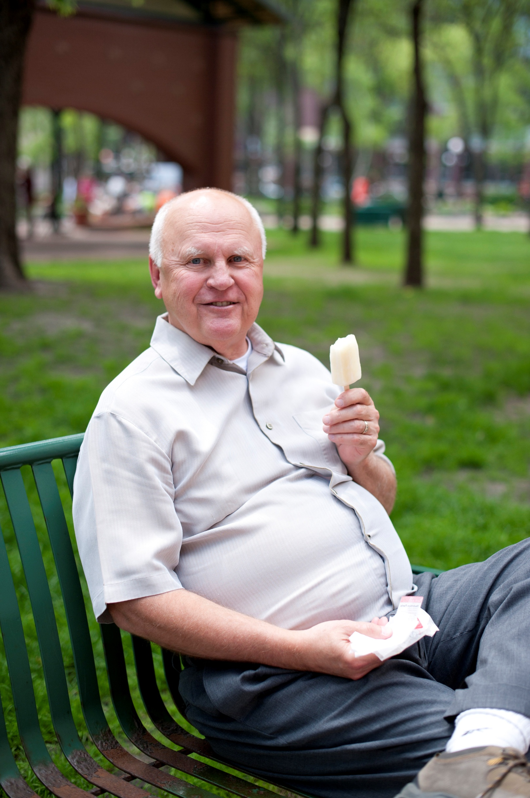
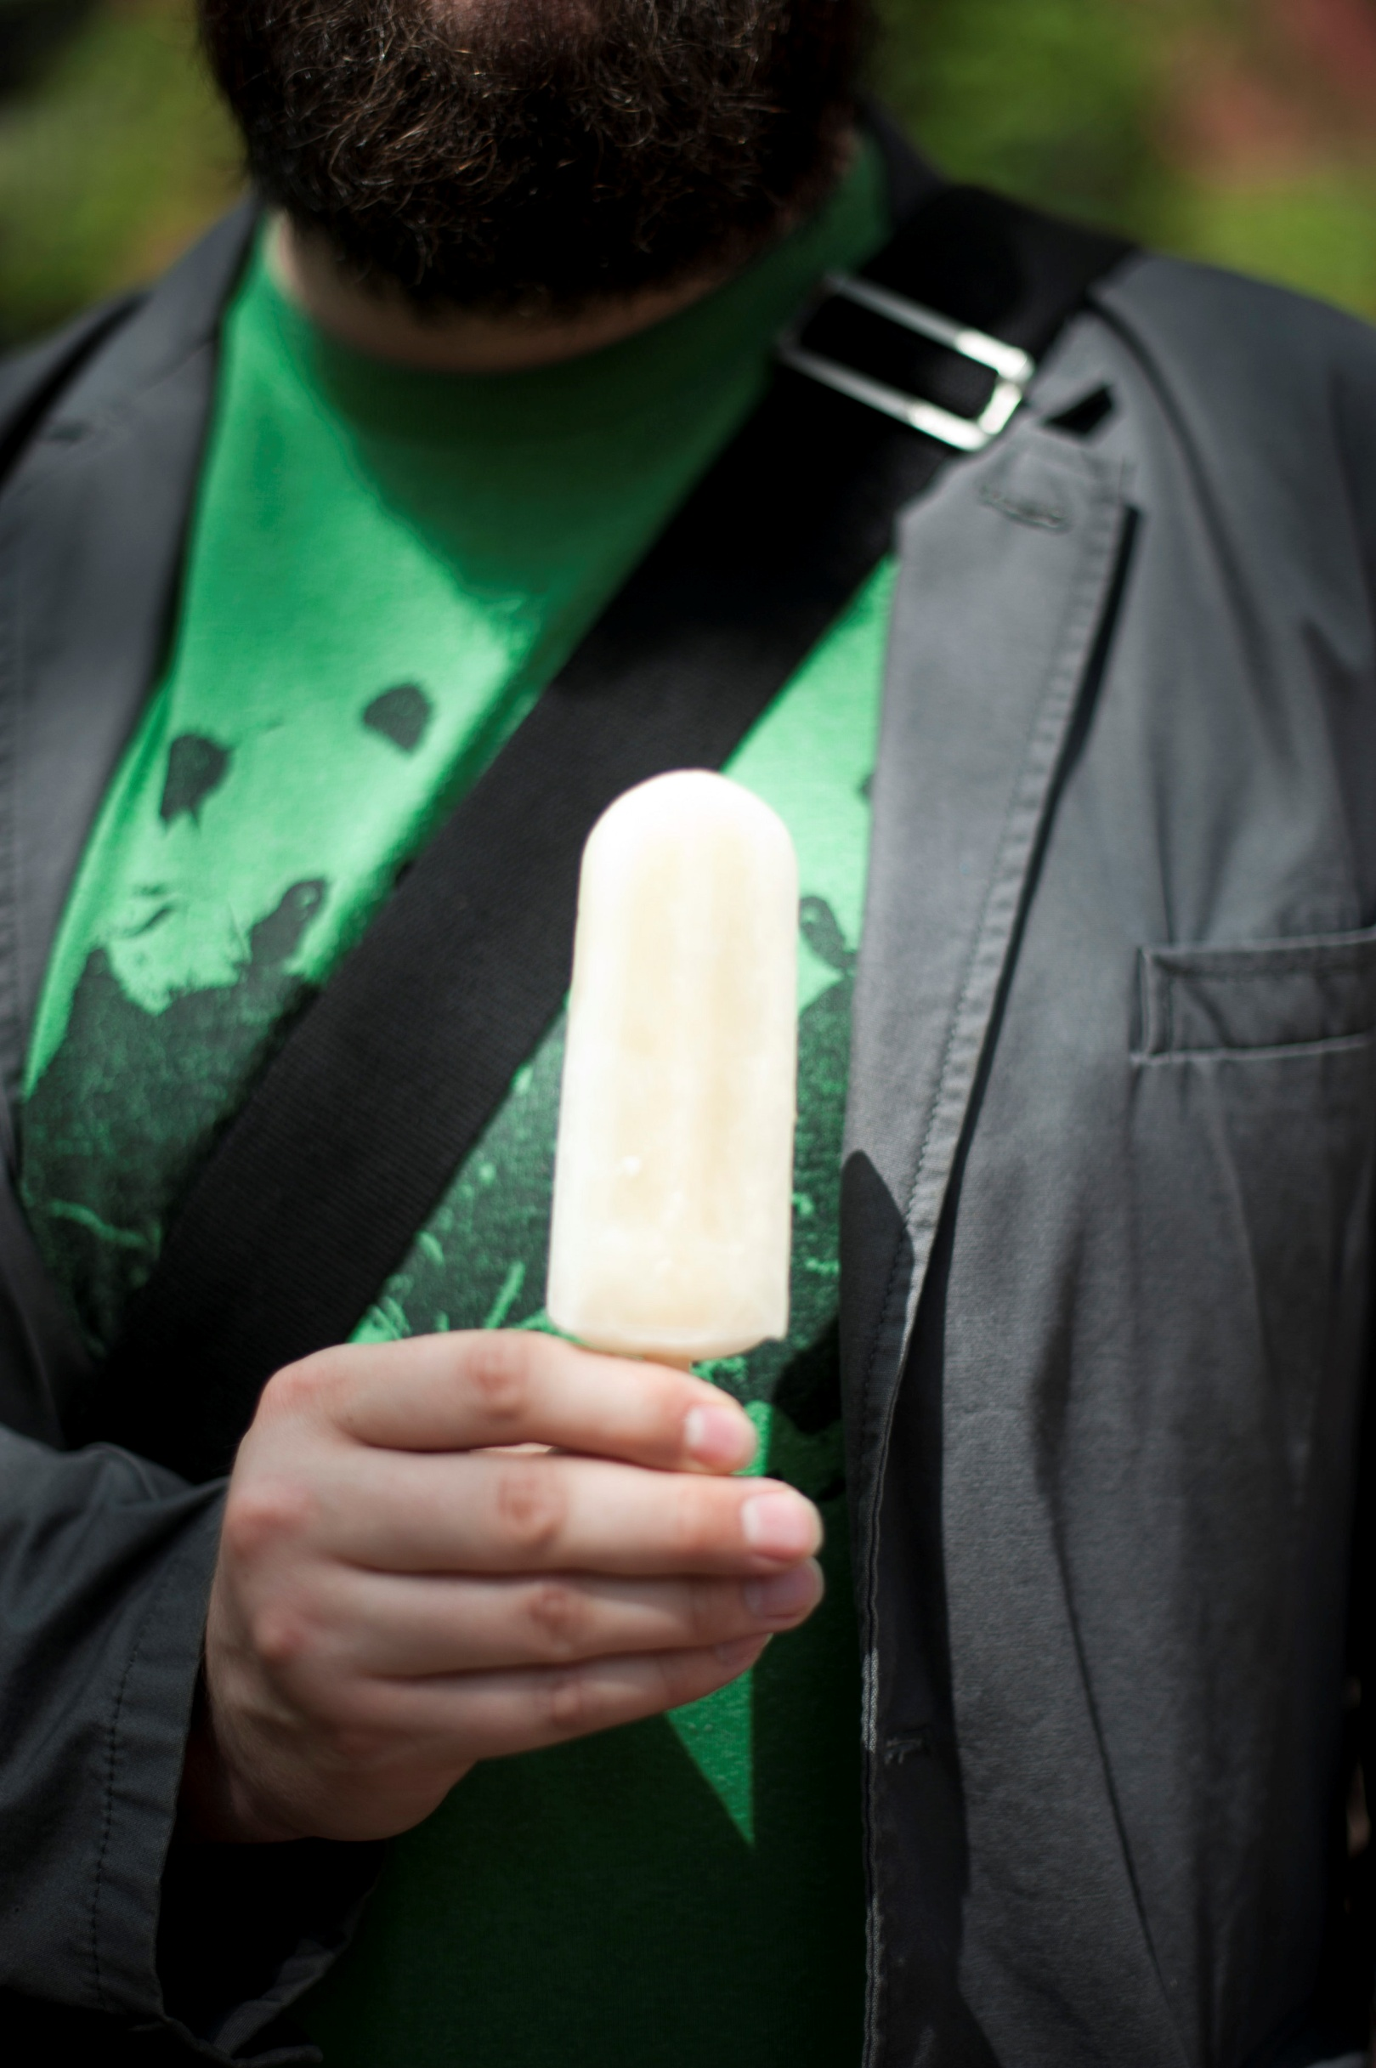
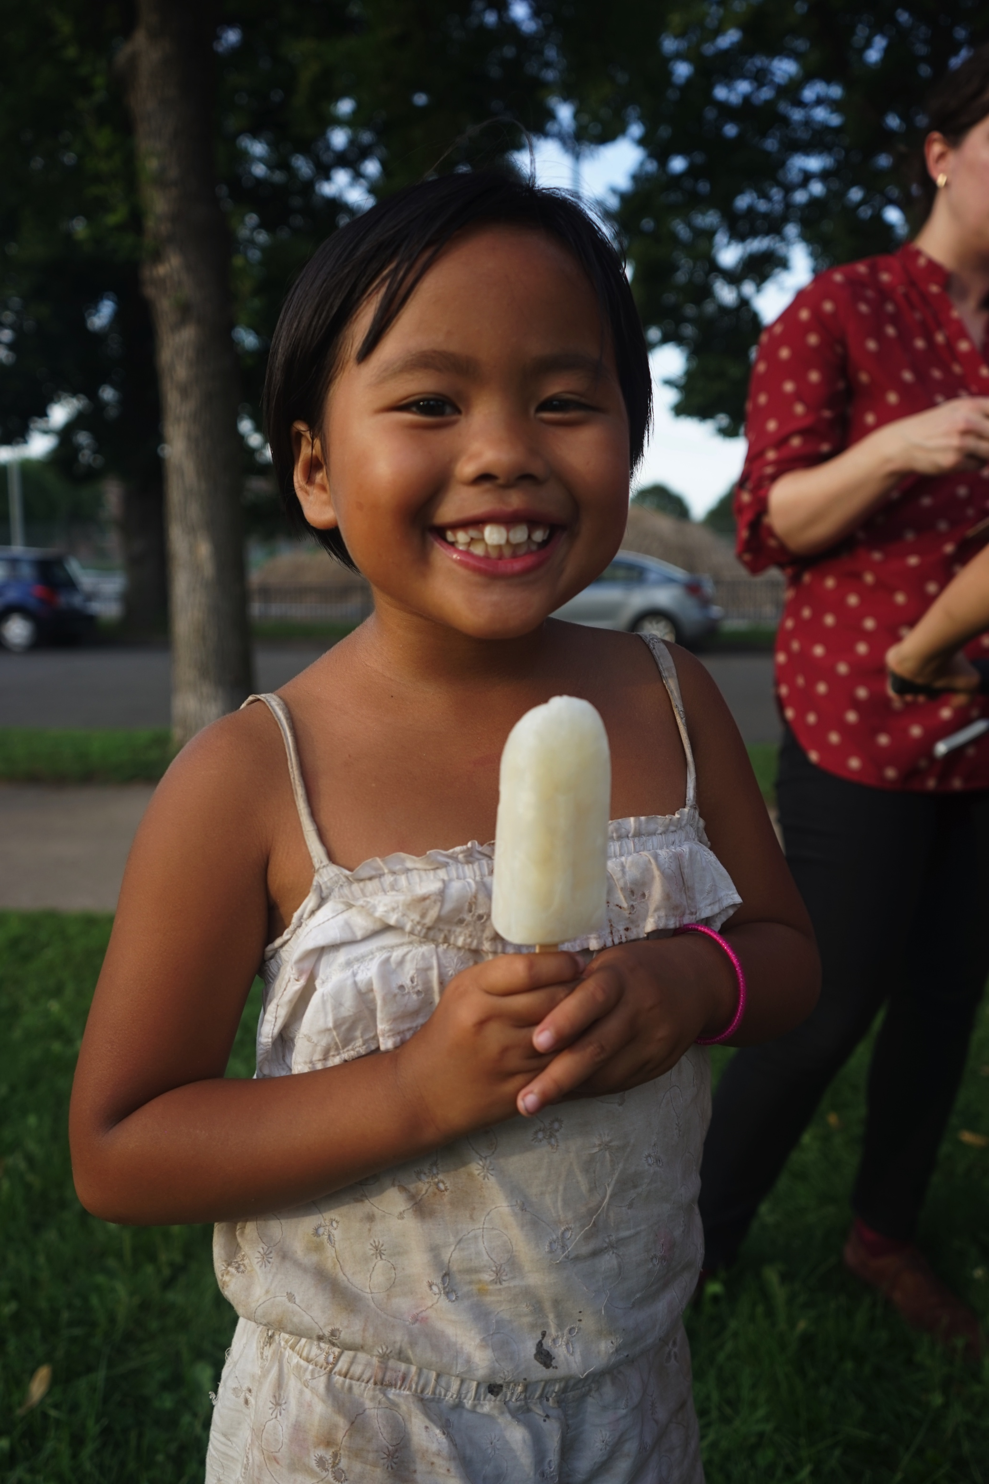
We handed out 1,828 popsicles
Notes:
They handed out 1,828 popsicles

Slide 14
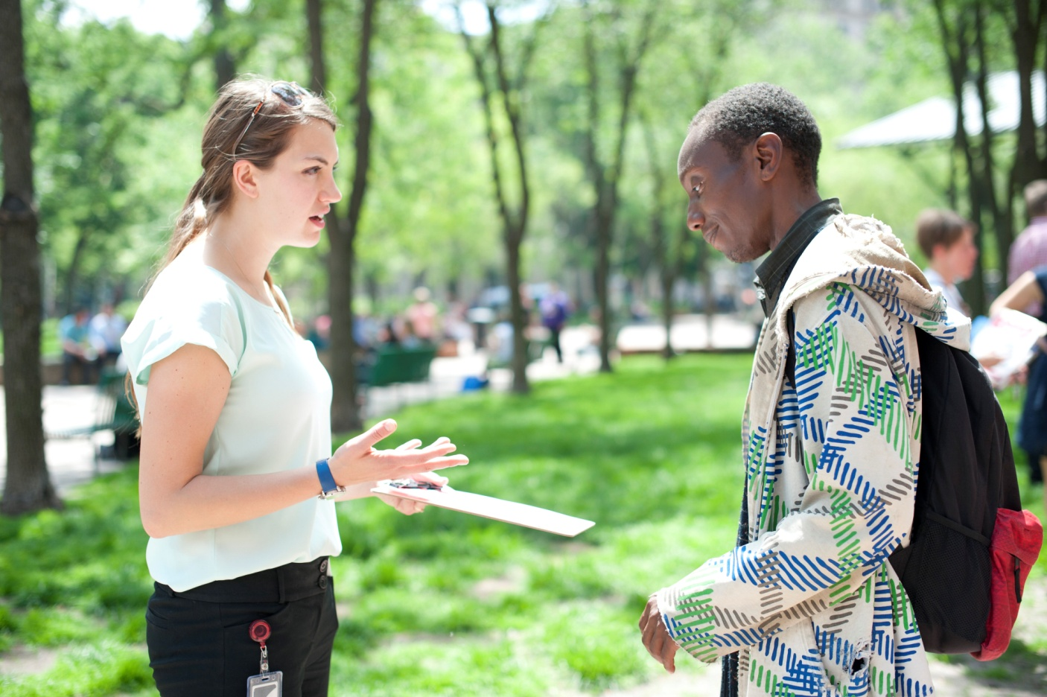
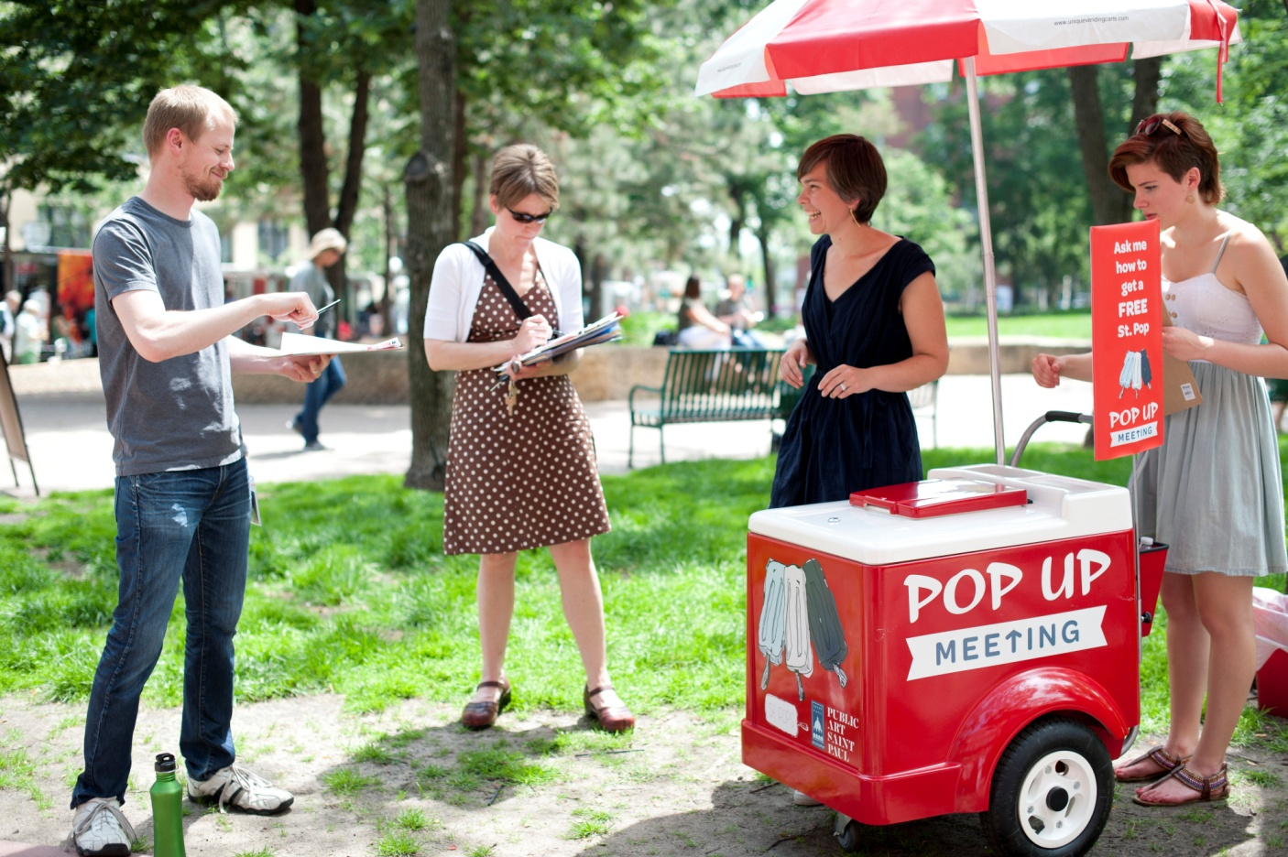
Findings
1. Pop Up meetings engage a more diverse crowd.
2. Pop Up meetings attract new participants to the public input process.
3. Pop Up meetings attract a similar number of participants to typical meetings.
4. Participants find Pop Up meetings to be an easy and engaging way to participate in city planning.
Notes:
Findings
1. Pop Up meetings engage a more diverse crowd.
2. Pop Up meetings attract new participants to the public input process.
3. Pop Up meetings attract a similar number of participants to typical meetings.
4. Participants find Pop Up meetings to be an easy and engaging way to participate in city planning.

Slide 15
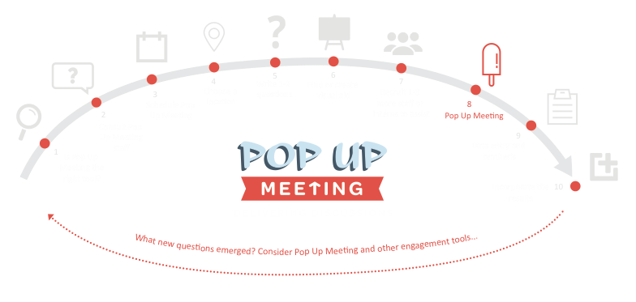
Notes:
Illustration of how they evaluated/planned the pop-up meetings.
Is this the right tool?
Consult with staff
Schedule meeting
Choose location
Write questions
Create visual aids
Recruit other staff/interns
Pop-up meeting happens
Enter data and synthesize information
Incorporate the results – what new questions emerged that should be used in other meetings?

Slide 16
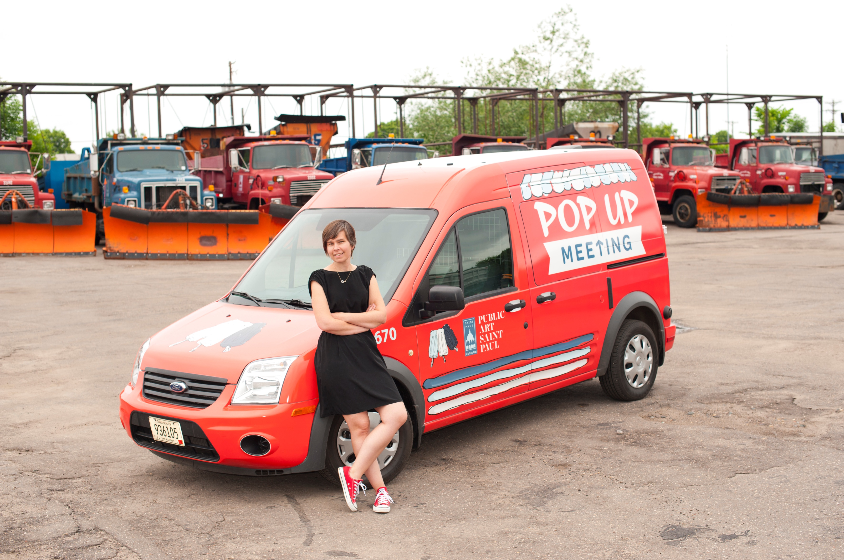
Notes:
Pop Up Meeting was a success.
We showed there was a need for new forms of civic engagement!
It will be paid for this year and years to come by the city using funds across departments!

Slide 17
Notes:
Public Art Saint Paul graphic

