Slide 1
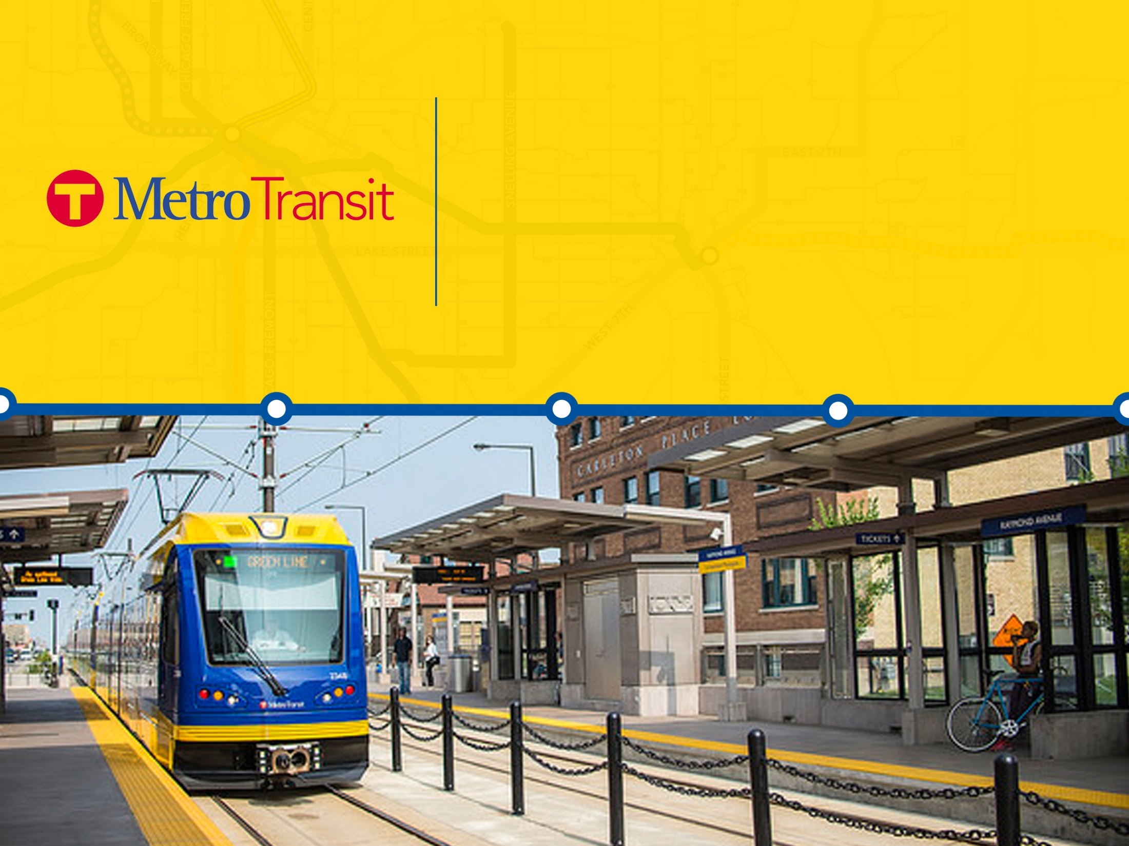
TOD in the Comprehensive Plan
TOD in New/Small Starts Applications
TOD Office Resources
Kathryn Hansen
Senior Project Manager, TOD
TOD Office
January 26, 2017

Slide 2
TOD IN NEW AND SMALL STARTS APPLICATIONS

Slide 3

Peer “New Starts” PD and Engineering
September 2016 Status
Seattle, WA
Minneapolis – St. Paul, MN
NJ - NY
New York, NY
Hudson, NJ
Suburban Maryland
San Jose, CA
Denver, CO
Los Angeles, CA
Durham, NC
Santa Ana, CA
Phoenix, AZ
Fort Worth, TX
Houston, TX
Fort Lauderdale, FL
Project Development (PD) Engineering

Slide 4
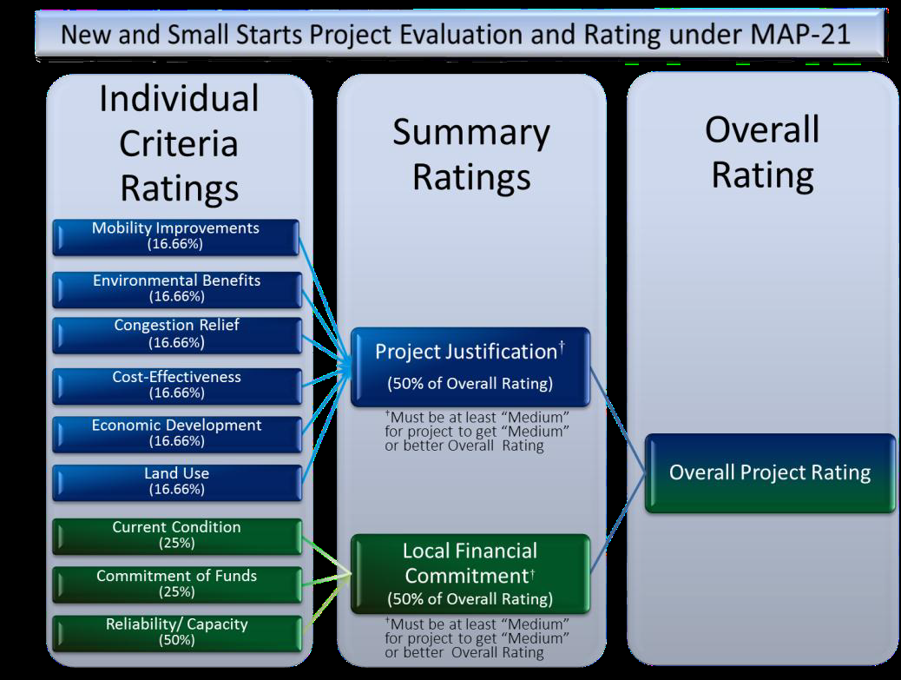
Evaluation Criteria

Slide 5
Land Use
Existing corridor and station area development
  How many people, housing units, and jobs surround proposed stations today?
  How much parking is in the CBD and what does it cost?
  How much affordable housing is located within the station areas?
  What development surrounds proposed stations today?
  Does the station area have good pedestrian and bike access?

Slide 6
Economic Development
Transit-supportive plans and policies
  Growth Management
  Transit-supportive corridor policies
  Supportive zoning regulations near transit stations
  Tools to implement transit-supportive policies
Performance and impacts of policies
  Performance of transit-supportive plans and policies
  Potential impact of transit investment on regional land use
Tools to maintain or increase share of affordable housing

Slide 7
TOD Offices Resources

Slide 8
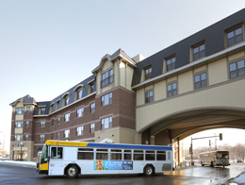
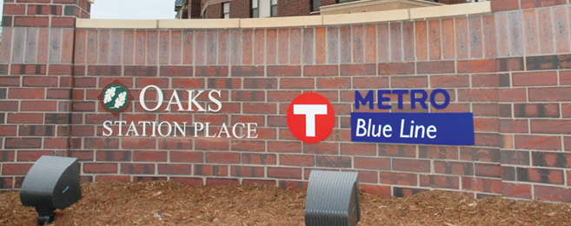
TOD Policy Goals
Maximize the development impact of transit investments
  Community building
Support regional economic competitiveness
  More customers & employees connected to employment centers
Advance equity
  Housing affordability & good jobs accessible by transit
Support a 21st century transportation system
  Ridership & revenue
Blue Line TOD at 46th Street
Notes:
Just to review the TOD Policy goals that guide our work.

Slide 9
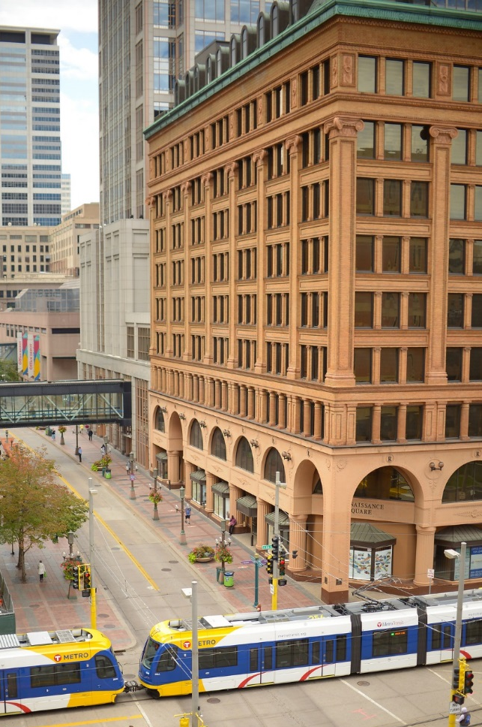
TOD Policy – Five Strategies
Prioritize Resources
Focus on Implementation
Effective Communication
Collaborate with Partners
Coordinate Internally
1
2
3
4
5

Slide 10
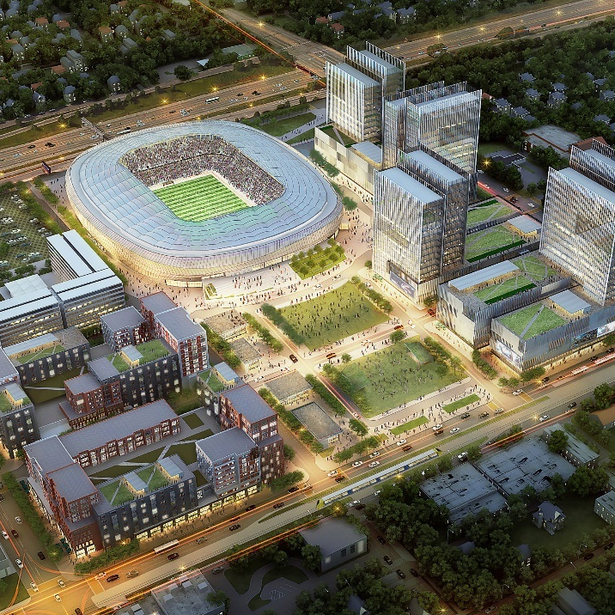
TOD Policy – Five Strategies
Prioritize Resources
1
Development of Met Council Property
  The TOD Office works to develop council owned land within a half mile of light rail, commuter rail, and Bus Rapid Transit stations.
  Emphasis is on mixed use development and pedestrian/bicycle access to support vibrant station areas.
  Projects in Progress: MN United FC Soccer Stadium, 38th Street Station
S9 Architecture and Populous

Slide 11
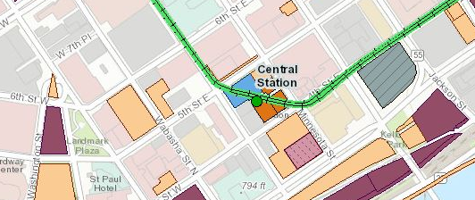
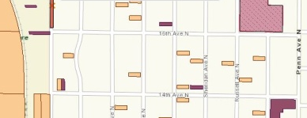
TOD Policy – Five Strategies
Focus on Implementation
2
  Public Property Database
The database can be accessed through ArcGIS online as well as a layer in the Met Council’s Make-a-Map application.
All features are available to the public on the Metro Transit TOD website.
ArcGIS free mapping
Met Councils Make-a-Map

Slide 12
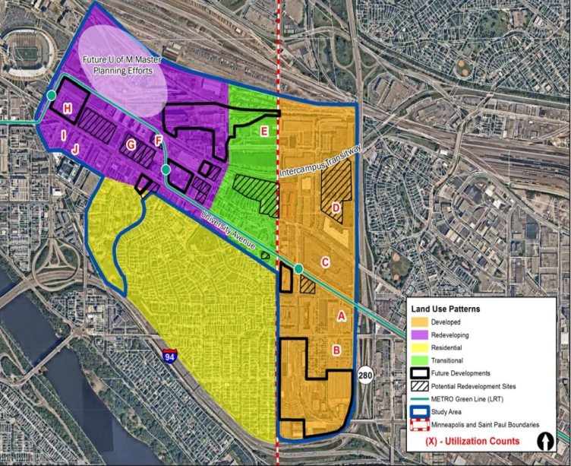
TOD Policy – Five Strategies
Focus on Implementation
2
  Parking District Study
Identified 6 Key Parking District Models for Parking Districts in the Twin Cities:
  Enterprise Funds
  Development Authorities
  Improvement Districts
  Transportation Management Associations
  Public‐Private Partnerships

Slide 13
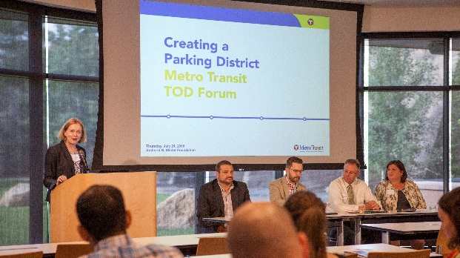
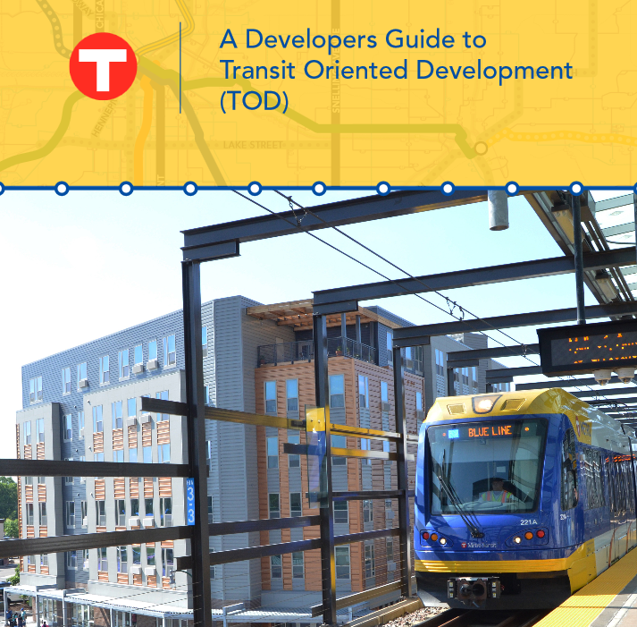
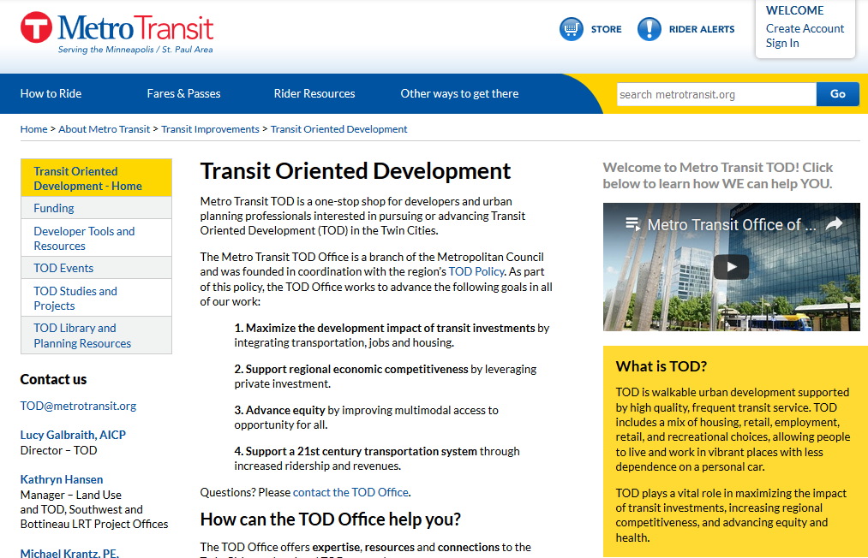
TOD Policy – Five Strategies
Effective Communication
3
      TOD Topic Forums
      Website Resources
      Newsletter Updates
Collaborate with Partners
4
  Regional TOD Staff Meetings
  Gold Line TOD Pilot Planning Grant
  Blue Line Extension TOD Pilot Planning Grant
Coordinate Internally
5
  Monthly council staff working group
  Regular meetings with project offices

Slide 14
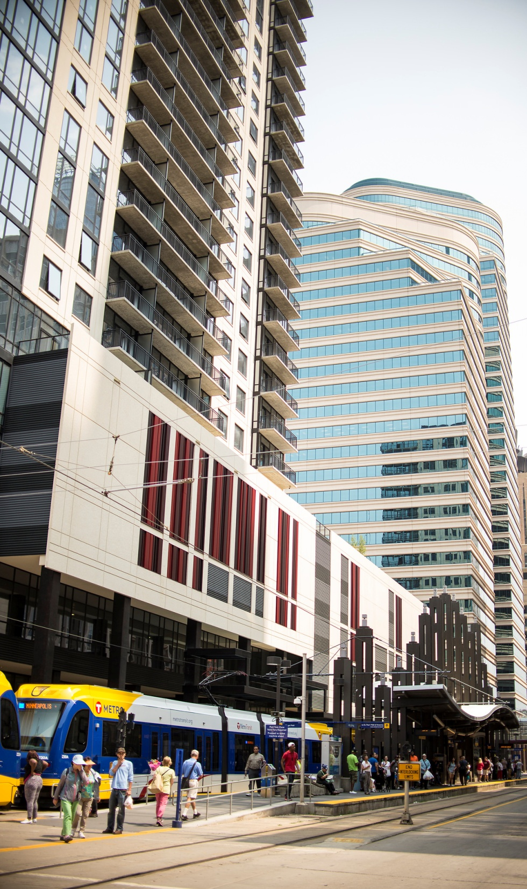
Let us know how we can help YOU
Metro Transit TOD office serves the region to create walkable, livable, thriving communities supported by transit.
Questions? Comments?
Ideas for future Forums?
Contact us anytime at:
tod@metrotransit.org
Thank you!
Metrotransit.org/TOD

