Slide 1
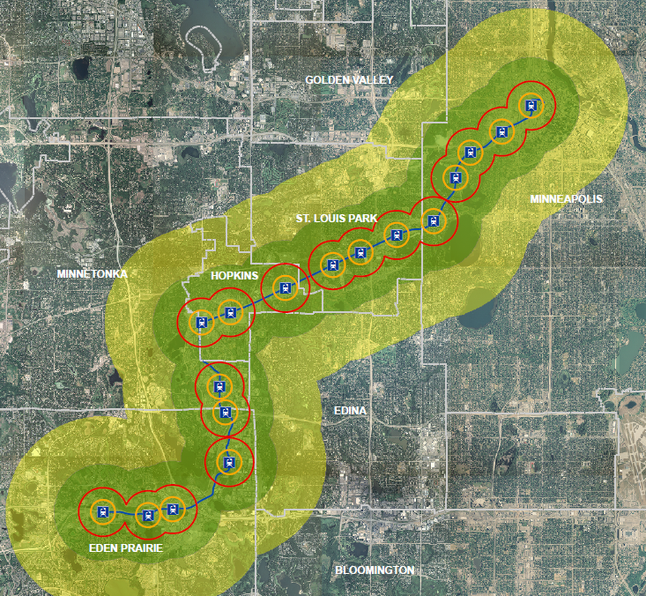
SWLRT – Green Line Extension

Slide 2
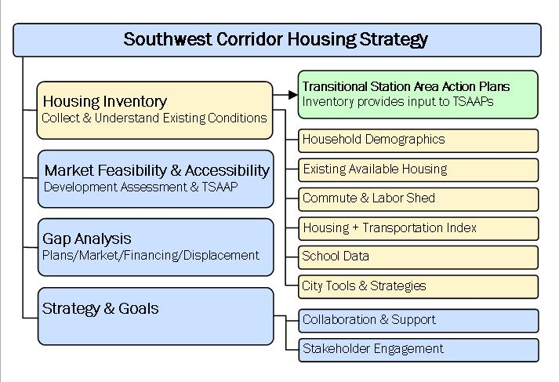
Housing Plan

Slide 3
Economic Development Strategy
Analysis of all tools and authorities that exist along the line.
Understanding complexities of development preparation (infrastructure and phasing)
Understanding from other regions: TransAct, Denver, and Dallas
Case Study – Shady Oak Station
  Providing development examples and gap analysis

Slide 4
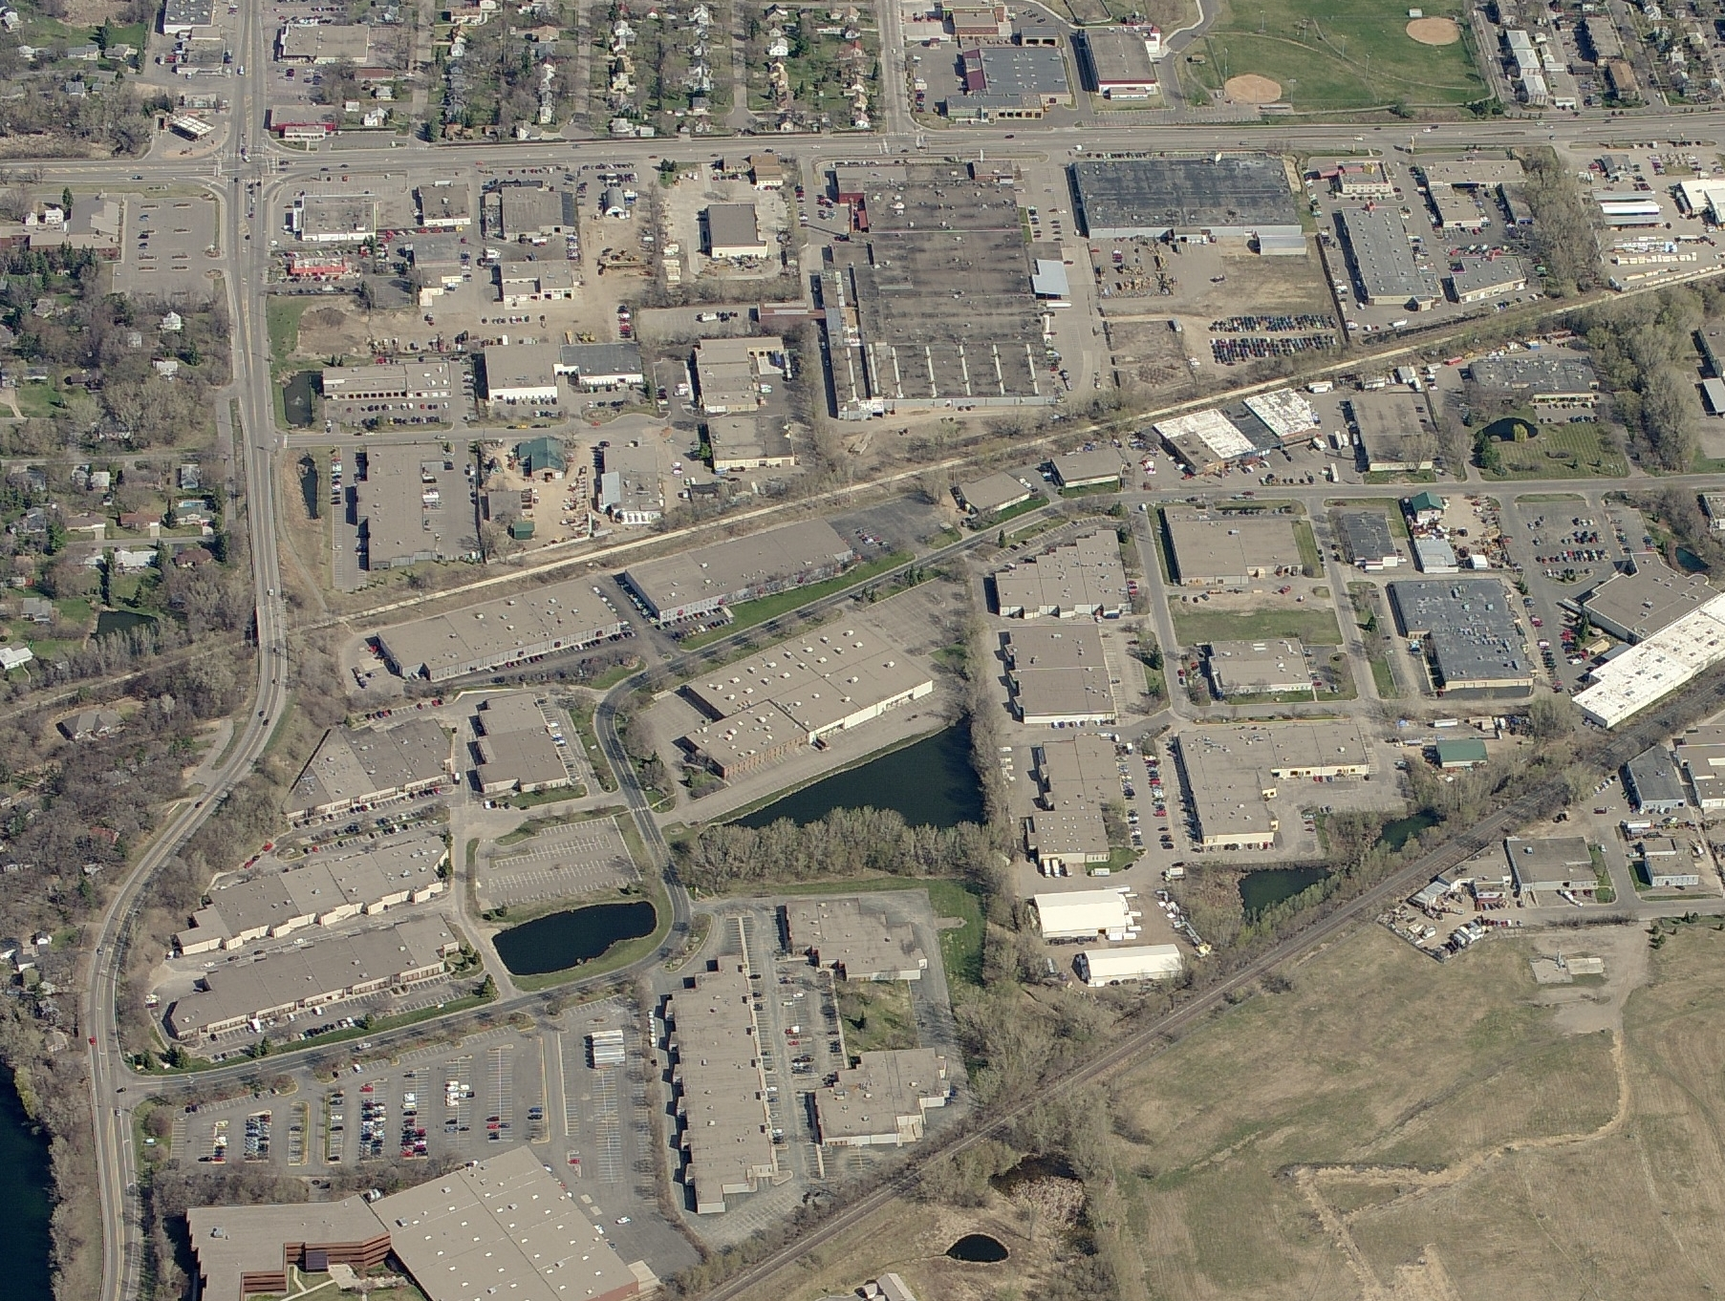

Slide 5
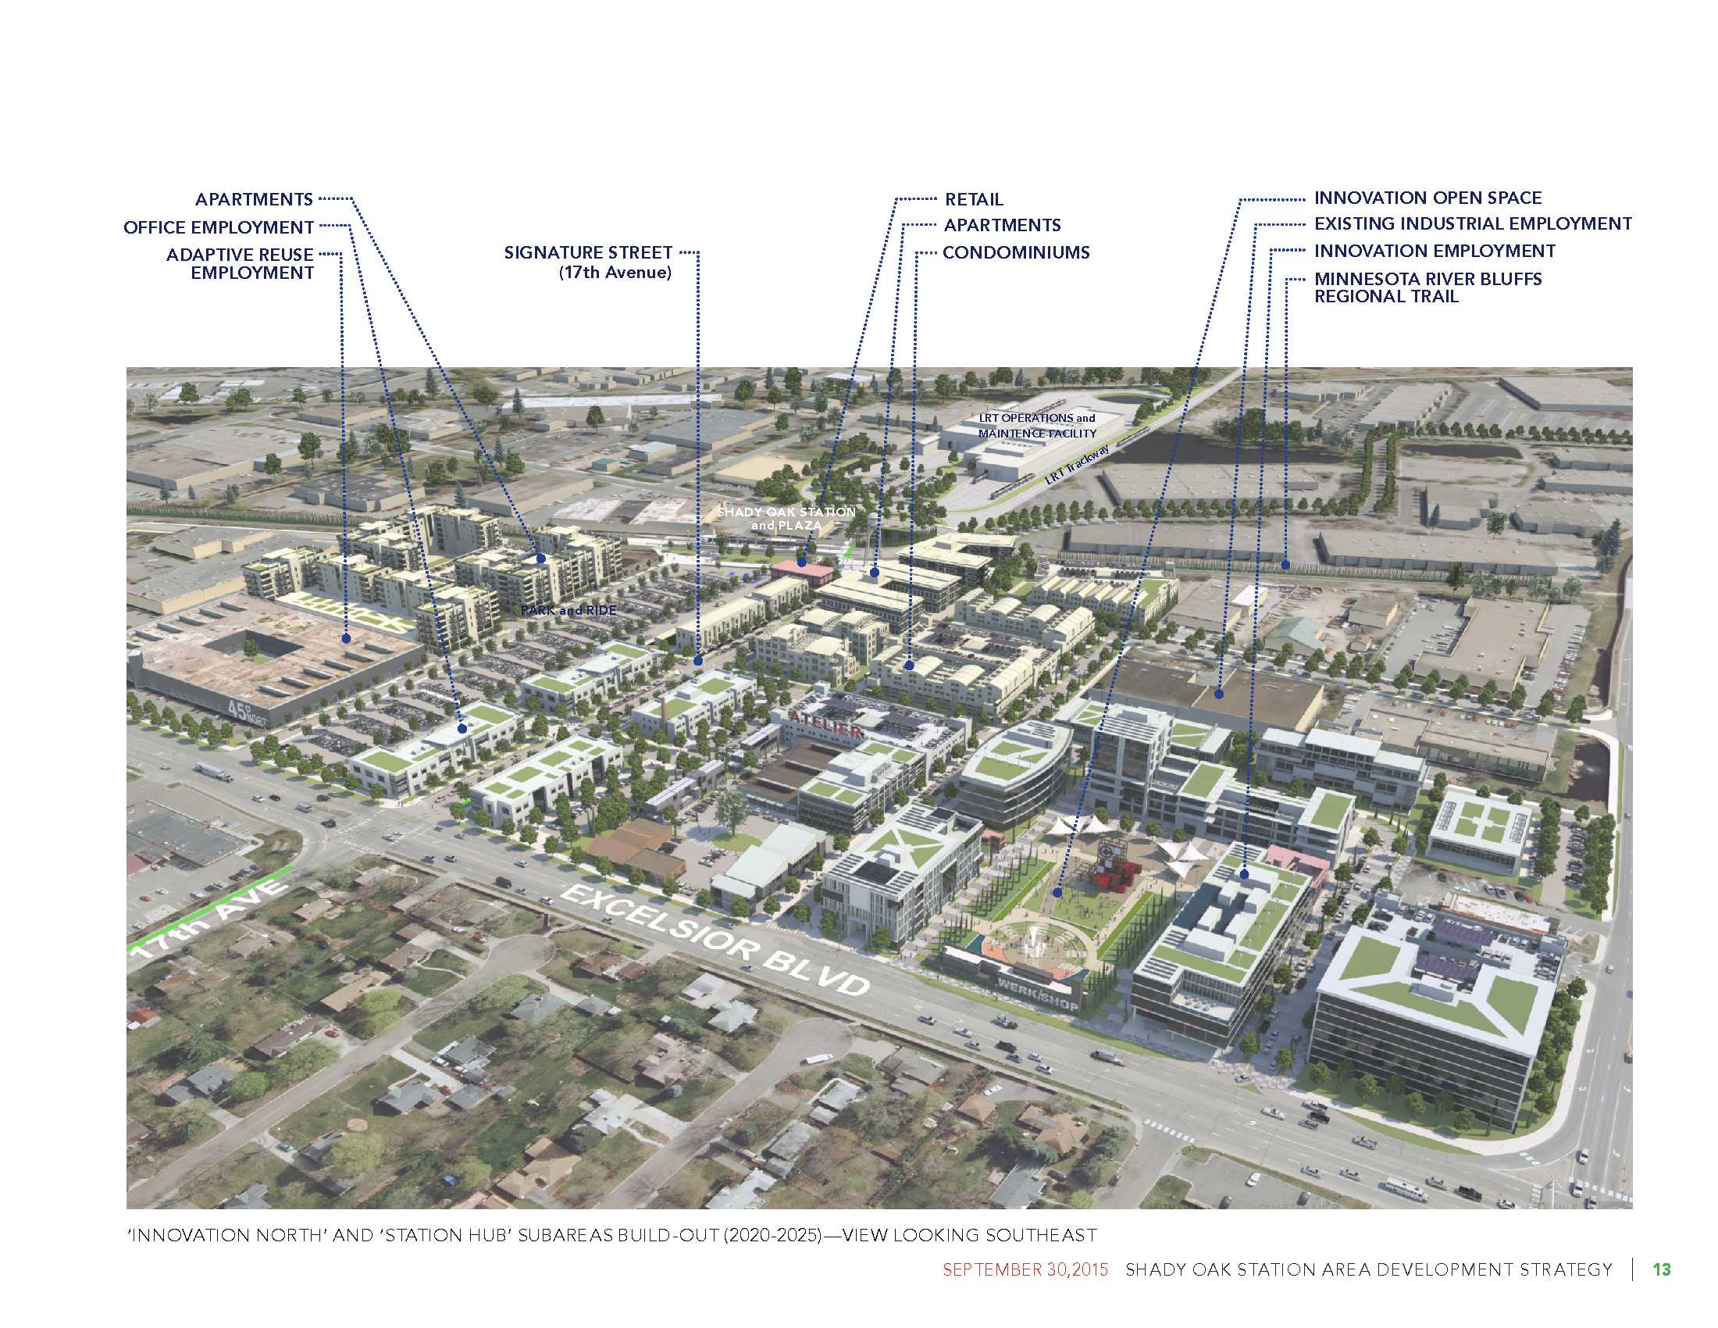

Shady Oak Station Area Development Strategy
Station Platform
Hopkins
Municipal Boundary
Minnetonka

Slide 6
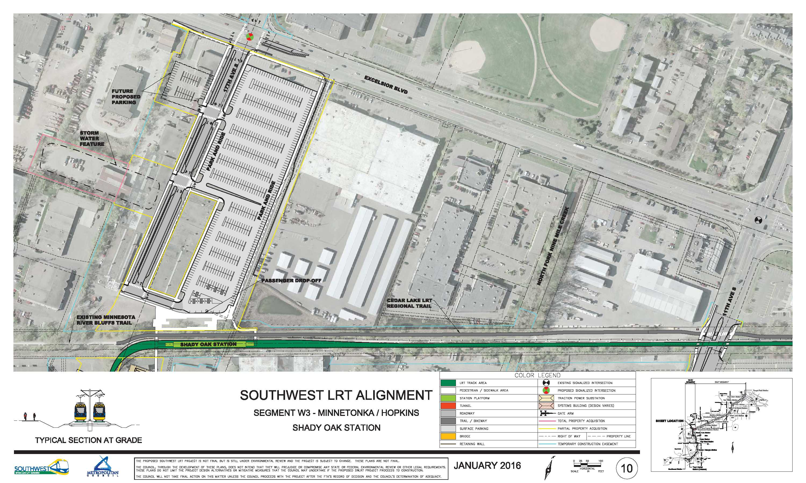
Shady Oak Station Area Development Strategy

Slide 7
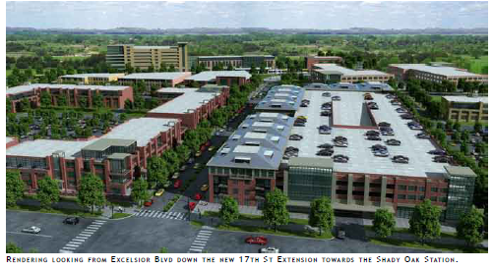
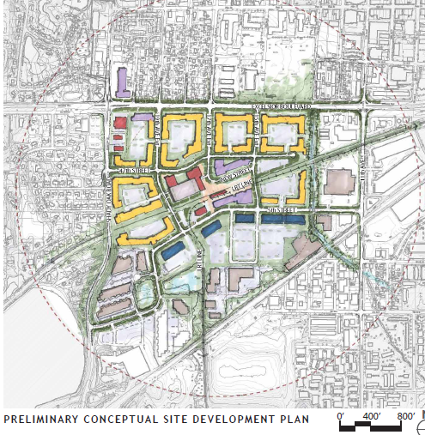
SHADY OAK STATION – Hopkins/Minnetonka

Slide 8
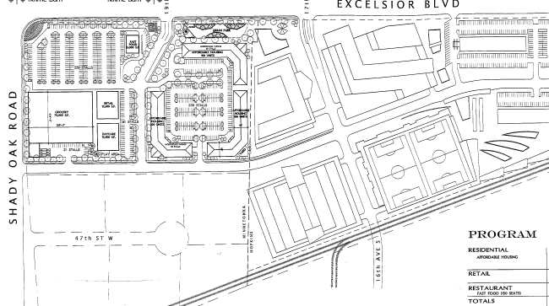

Slide 9
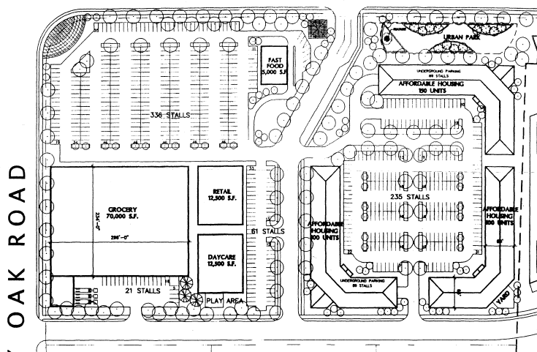

Slide 10
Shady Oak Station Area Development Strategy
Uses – types & detail vs general
Development phasing
General support for a joint board to review.
More clearly defines character and vision
Design standards to articulate the desired architecture and aesthetics of the area.
What is the appropriate amount of parking in this transit oriented district?
How can we best balance the needs of pedestrians, bicyclists, transit riders and vehicles?
What is the right amount of required landscaping?
Match up the open space standards with building code/city expectations.
Are we were over-planning for bicyclists, especially given the Minnesota climate?
Bike-sharing is well used where it has been established from the beginning which would support building ample bike facilities.
How will bus activity be coordinated with light rail service? Staff should work with Metro Transit to review and coordinate bus and light rail service.
How will park dedication be allocated? It was discussed that park dedication should be shared between the two communities and used to focus on planned greenspace.

Slide 11
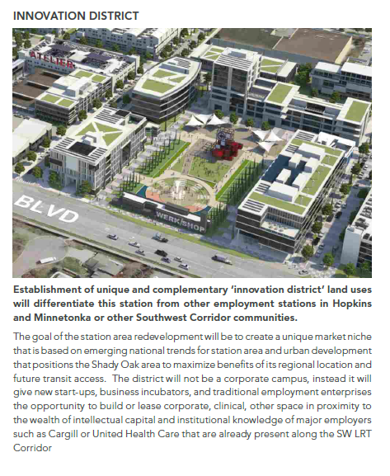
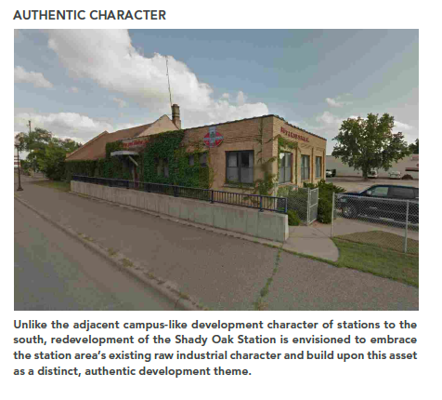

Slide 13
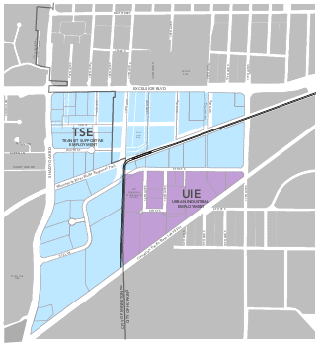
Shady Oak Station Area Development Strategy
Zoning Districts
Innovation District
  Start-ups business & incubators
Transit Supportive Employment (TSE) District
  Office
  Limited Retail
  Service development
  High density residential
  Existing industrial, warehousing and manufacturing functions
The Urban Industrial Employment (UIE) District
  Maintains existing industrial use
  Redevelopment over time of transit supportive, high density residential, office, and a limited amount of retail and service uses.

Slide 14
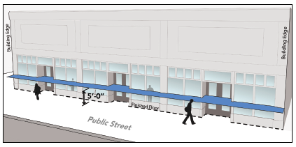
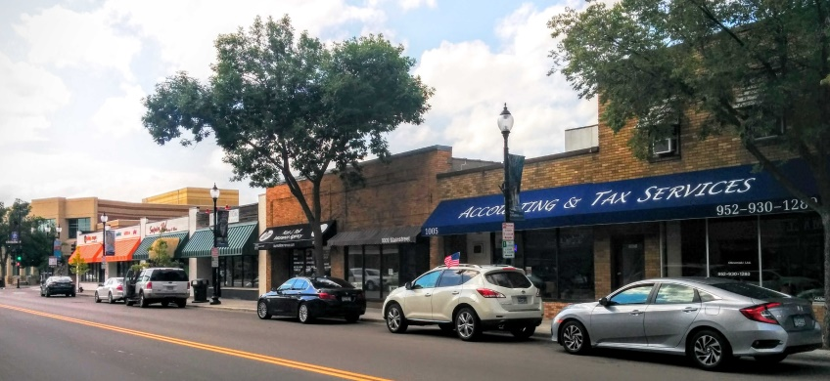
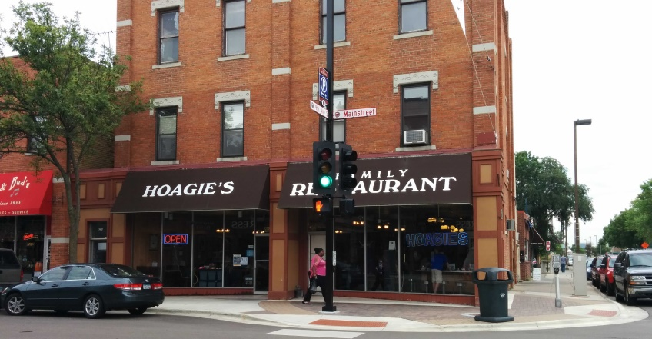
Shady Oak Station Area Development Strategy
Development Standards – Required Active Edge
Increase visual and physical interaction between people inside and outside of buildings
Characterized as building frontages with direct public street entries and a high degree of ground floor facade transparency.
Residents and visitors enter and exit the from the public street, activating and animating the public realm.
Required in specific areas and optional in others
Fronting parking lots, service bays/loading bays, and parking garage entrances prohibited

Slide 15
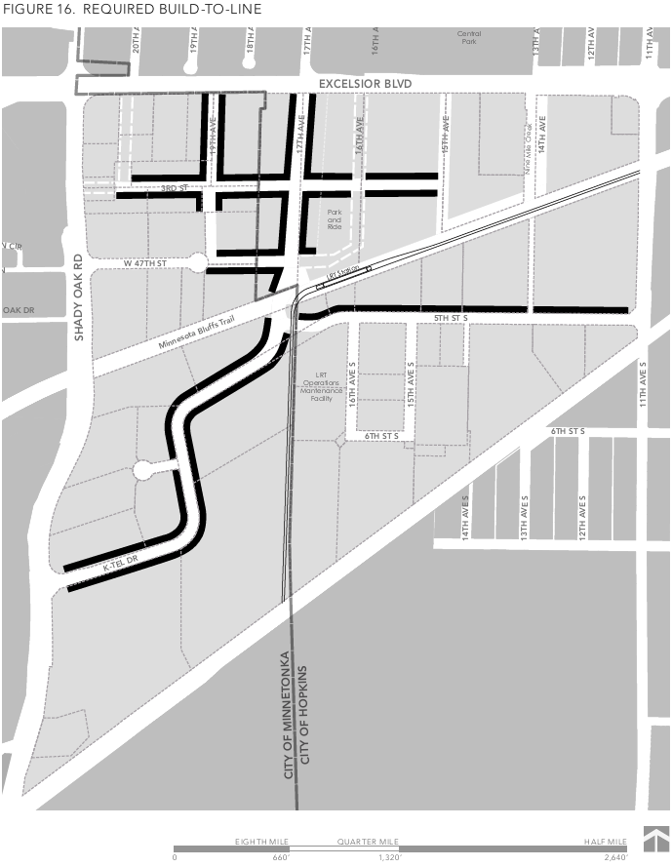
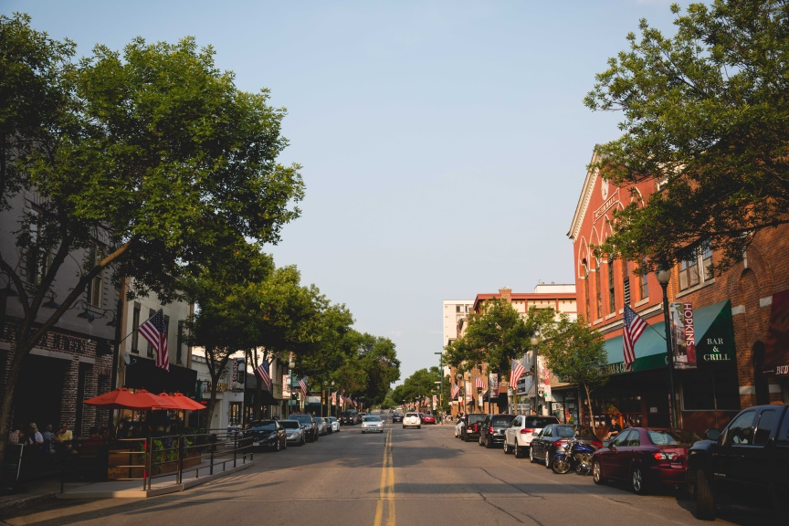
Shady Oak Station Area Development Strategy
Development Standards - Build-to-Line
Establish a continuous street wall
Provides for:
  Pedestrian interest
  Improved safety
  Orient building to the street
Applies to ground floor in specific areas
Exceptions for:
  Privacy for residential
  Landscaping
  Outdoor seating or display
  Architectural elements or entry features

Slide 16
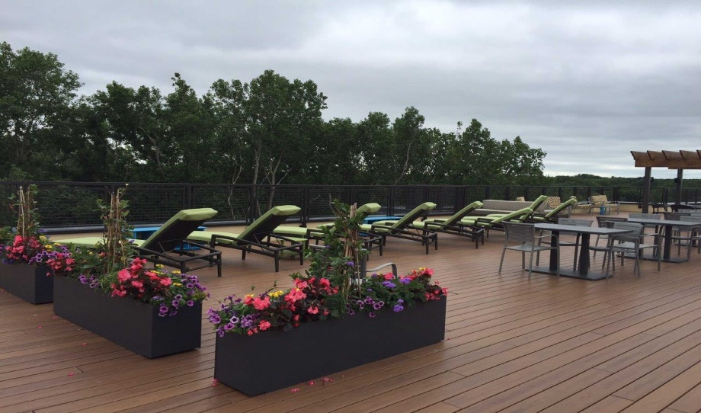
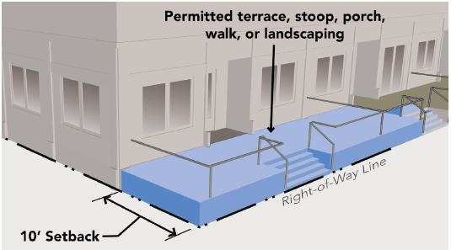
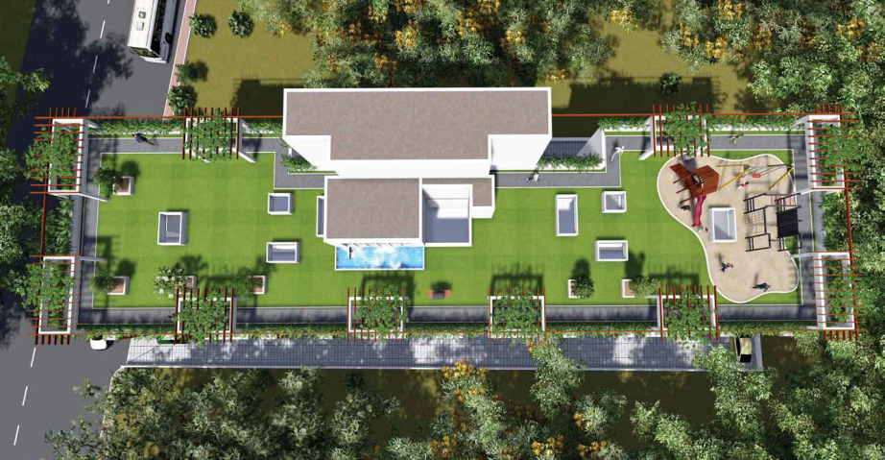
Shady Oak Station Area Development Strategy
Development Standards – Useable Open Space
Provide for outdoor living & recreational activity
Roofs, balconies, terraces, porches, decks or required setback areas
Minimum 100 square feet per unit
Relationship to park dedication

Slide 17
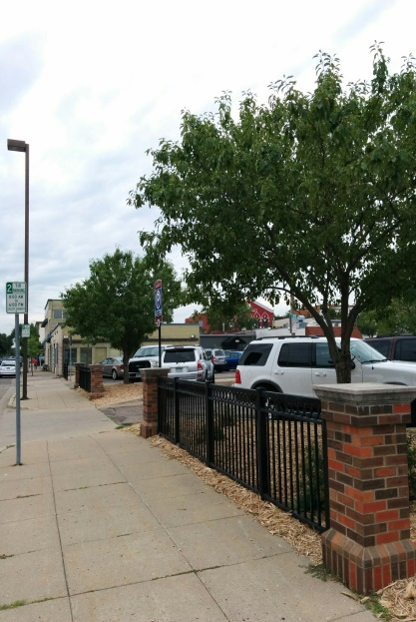
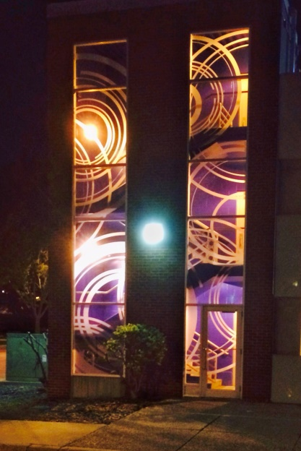
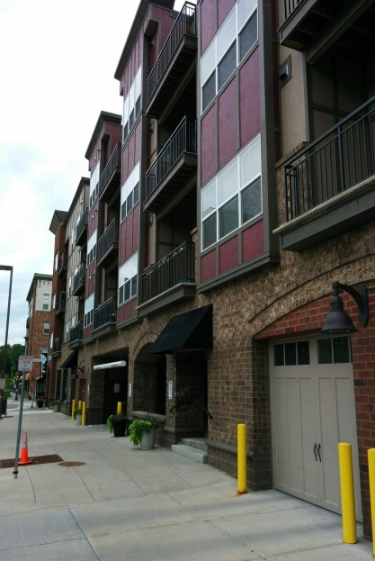
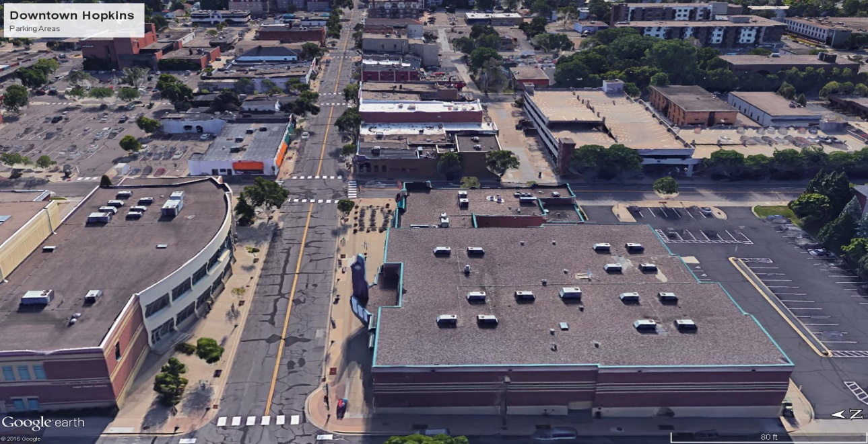
Shady Oak Station Area Development Strategy
Development Standards – Auto Parking
Minimum & maximum based on use and size
Standards for:
  Mixed use buildings
  Joint use parking
  Carpool parking
  Distance from use
Exceptions to minimum requires for:
  bicycle sharing facility
  Bicycle
  Motorcycle
  car sharing parking.
Exceptions to maximum requirements:
  Below grade parking

Slide 18
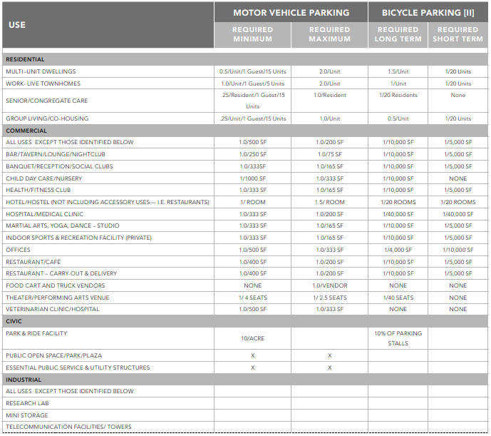
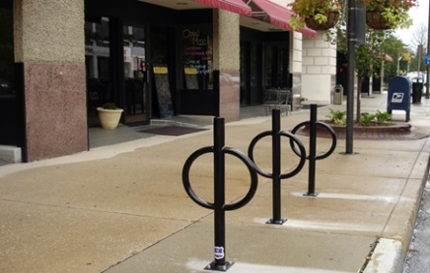
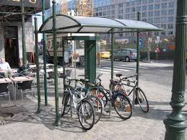

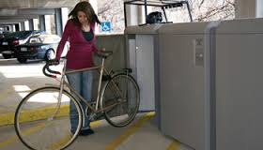
Shady Oak Station Area Development Strategy
Development Standards – Bicycle Parking
Ensure adequate short-term & long term bicycle parking
Based on use and size
Standards for:
  Racks
  Lockers
  Maneuvering areas
  Signs
  Covered parking

Slide 19
Shady Oak Station Area Development Strategy
Development Standards – Minimum Building Height
Purpose - encourage transit supportive housing, office and commercial development in close proximity to the Shady Oak Station platform
No maximum height limit
The minimum building heights elsewhere in the Shady Oak Station Area zoning Districts shall be 20 feet.

Slide 21
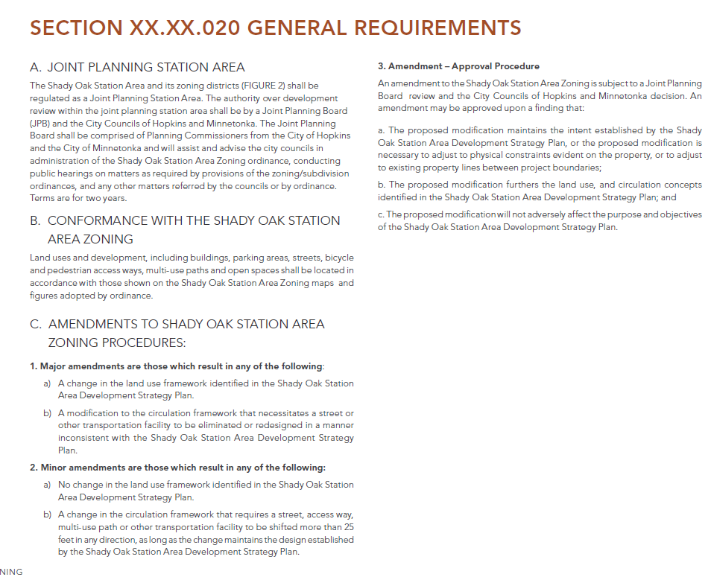

Slide 22
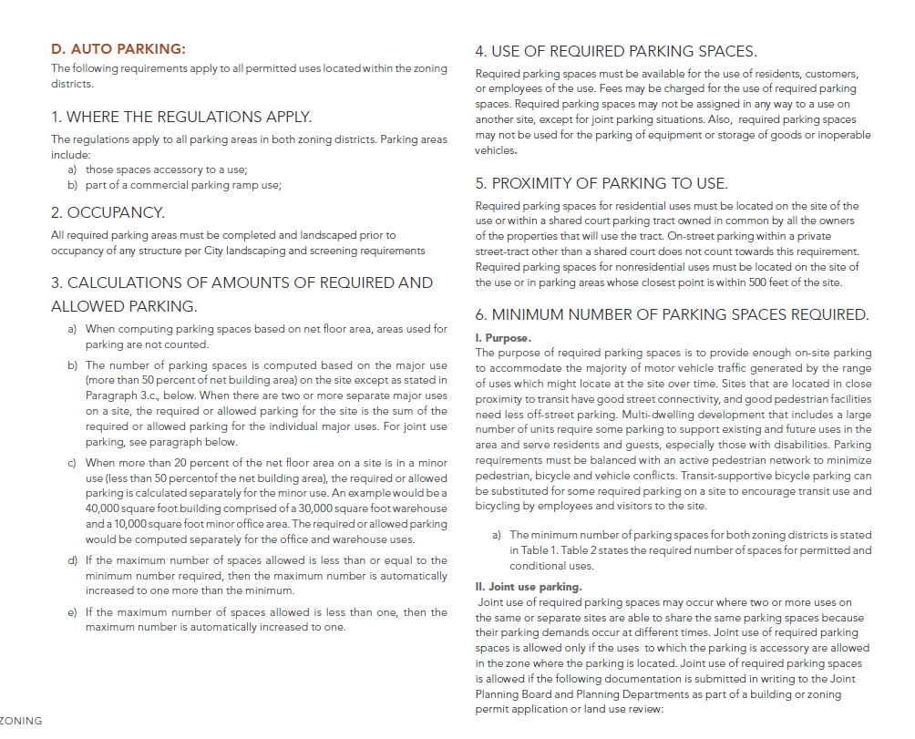

Slide 23
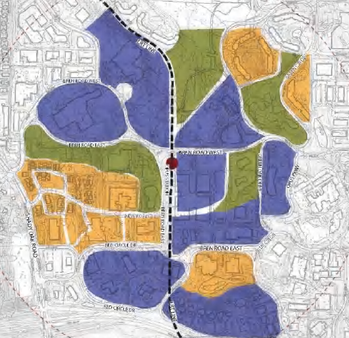
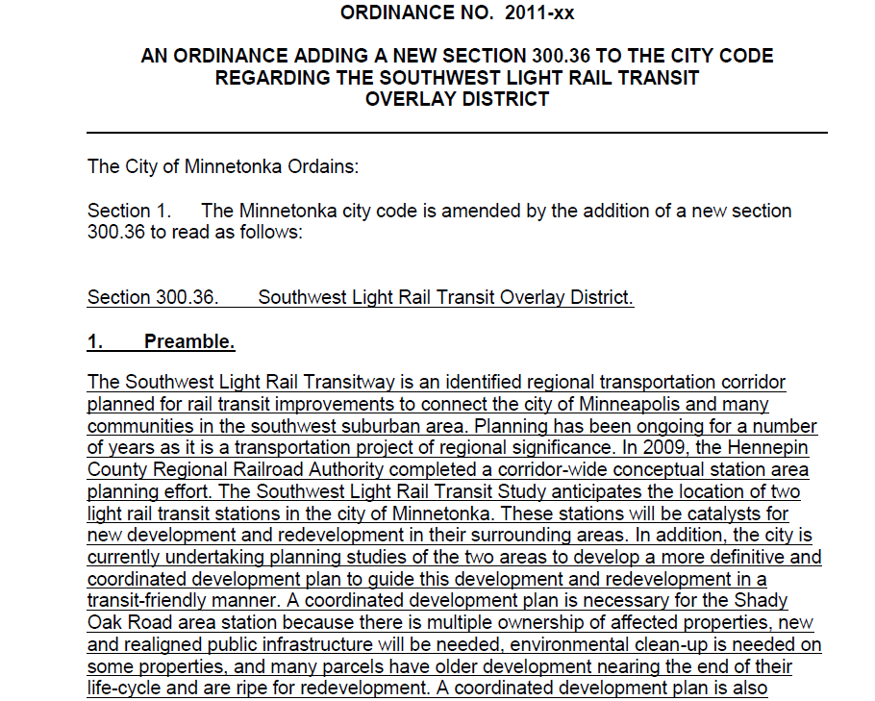
Future Considerations
http://tinyurl.com/hrr9jpy

Slide 24
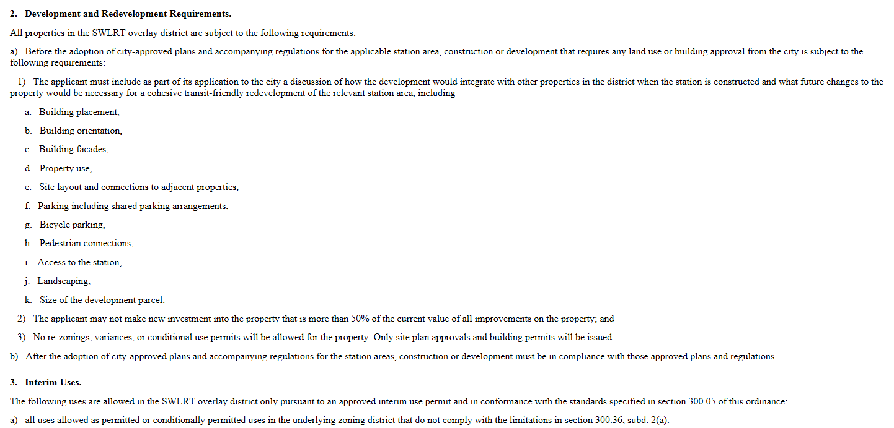

Slide 25
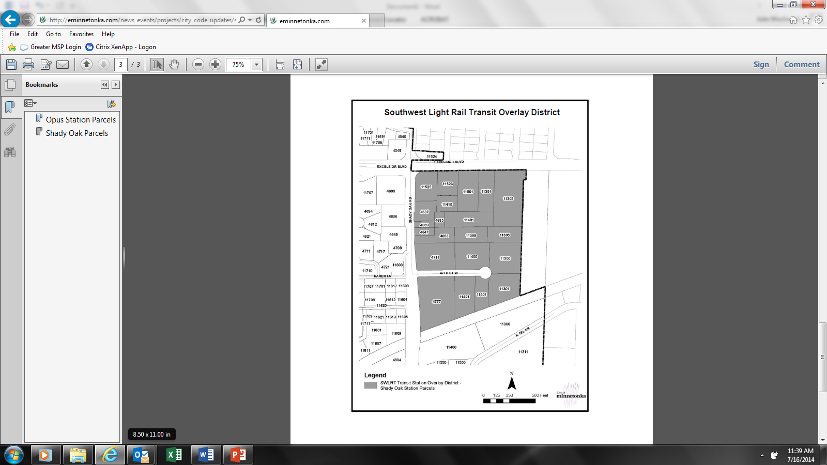
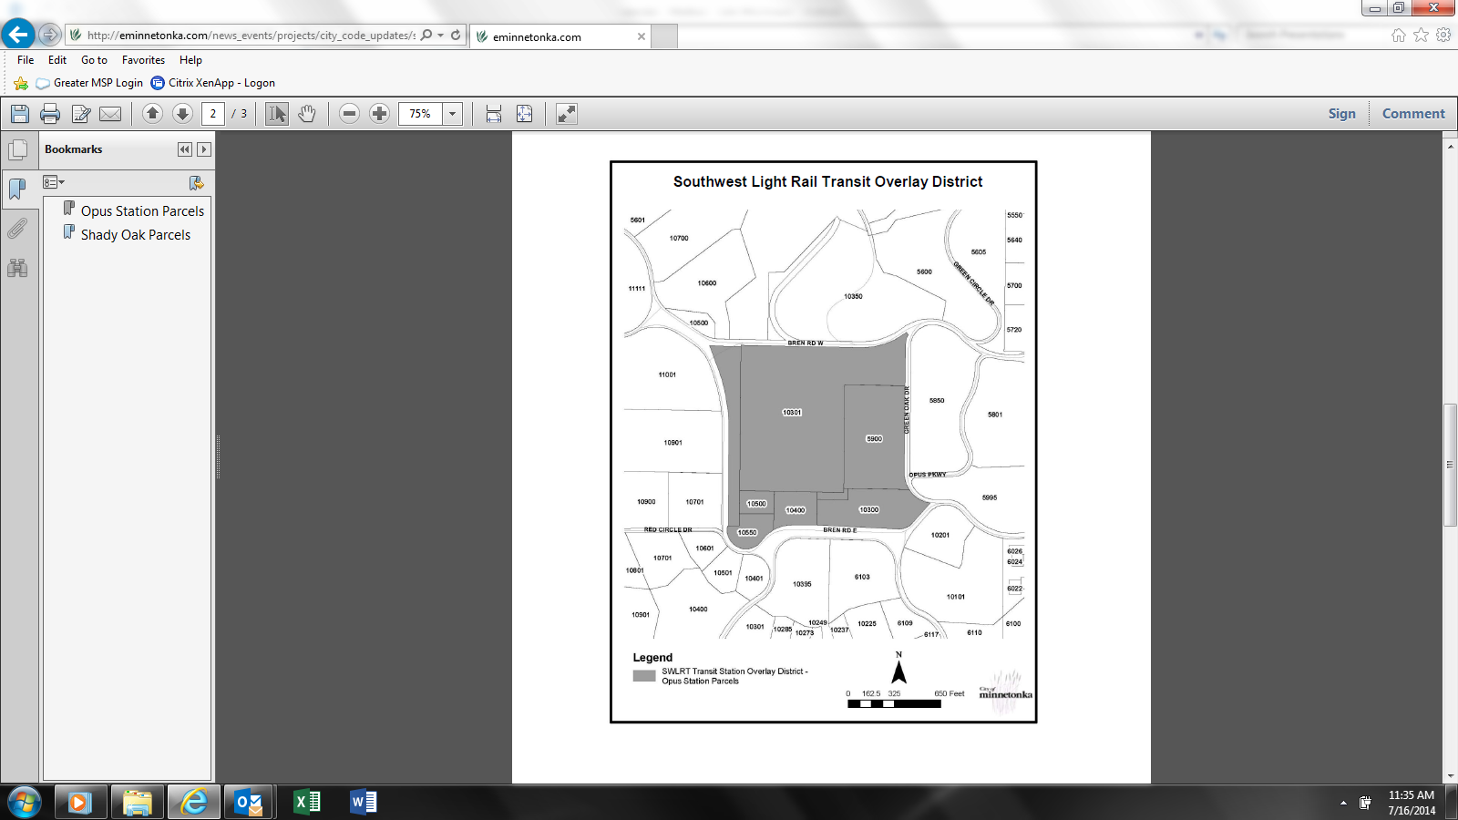
Overlay District – current – adopted 2011

Slide 26
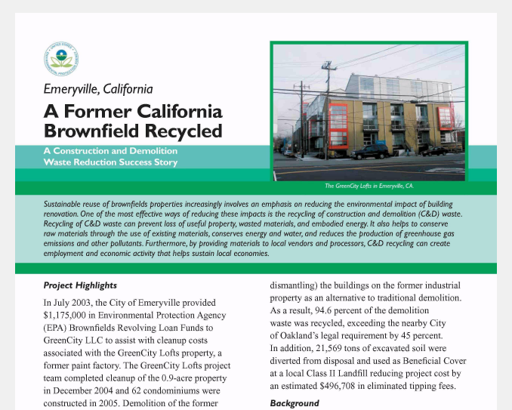
Railvolution 2016

Slide 27
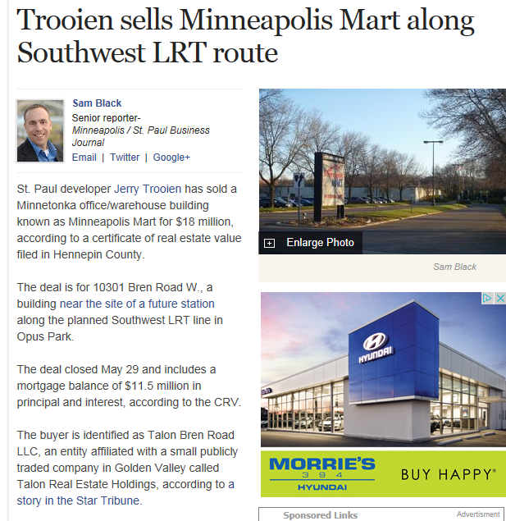
Property at Opus Station
Valued at $8 million in 2014
One sale for $12 million
Most recent sale for $18 million
Recent sale pending at
$26 million

Slide 28
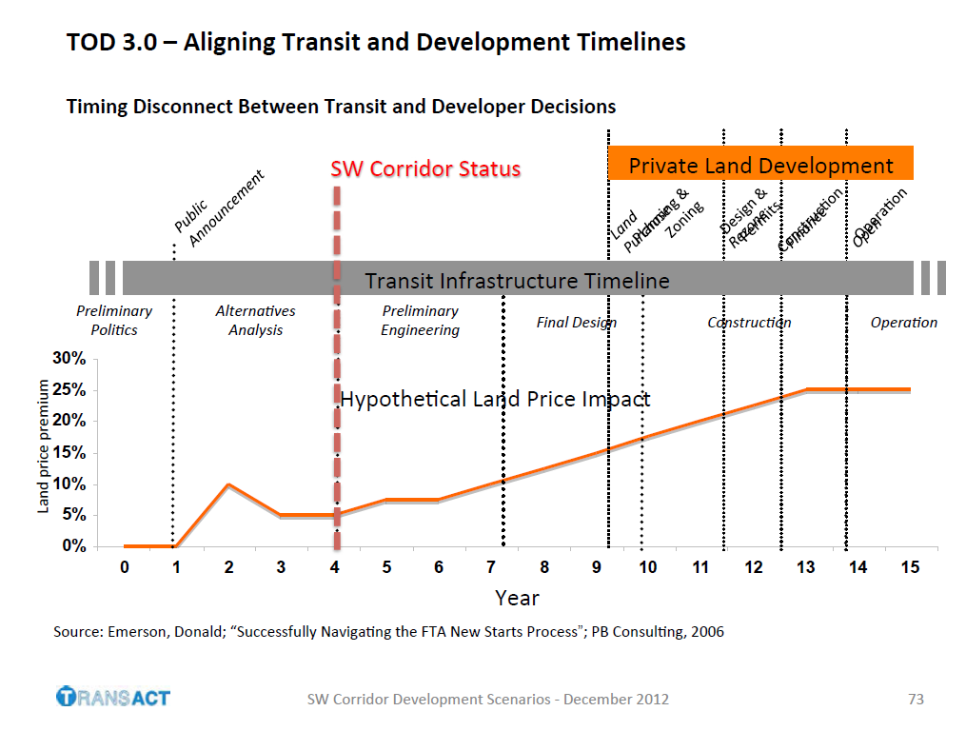

Slide 29
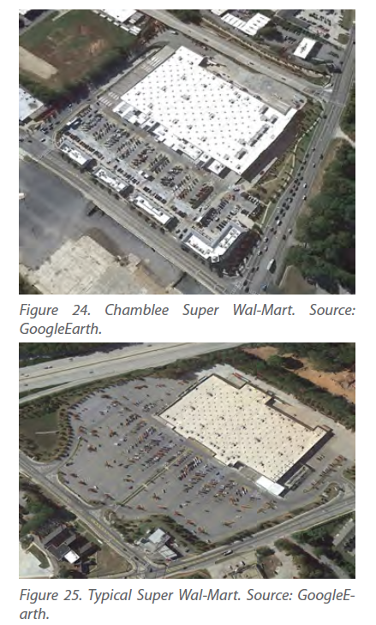
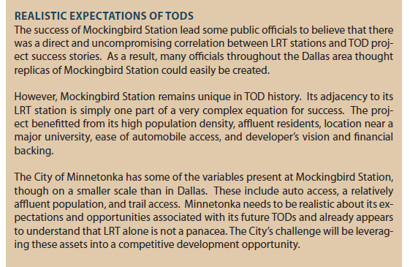
http://rcp.umn.edu/wp-content/uploads/2015/07/PA8081_TOD_Report.pdf

