Slide 1
Corridor Management Committee
June 5, 2019

Slide 2
Today’s Topics
Welcome
Approval of Minutes
Chair’s Update
Project Update
SWLRT Construction
Staffing/Meeting Structure
2019 Look Ahead
Communications & Outreach
DBE and Workforce Advisory Committee Update

Slide 3
Chair’s Update

Slide 4
Project Update

Slide 5
Overall Project Schedule
 | 2011-2015 | 2016 | 2017 | 2018 | 2019 | 2020 | 2021 | 2022 | 2023
Project Development
Engineering |  | ROD |  | AROD
Construction |  |  |  | LONP | FFGA
LRV Design, Production & Testing
Fare Collection Production & Testing
Integration Testing
Revenue Operations

Slide 6
Construction Update

Slide 8
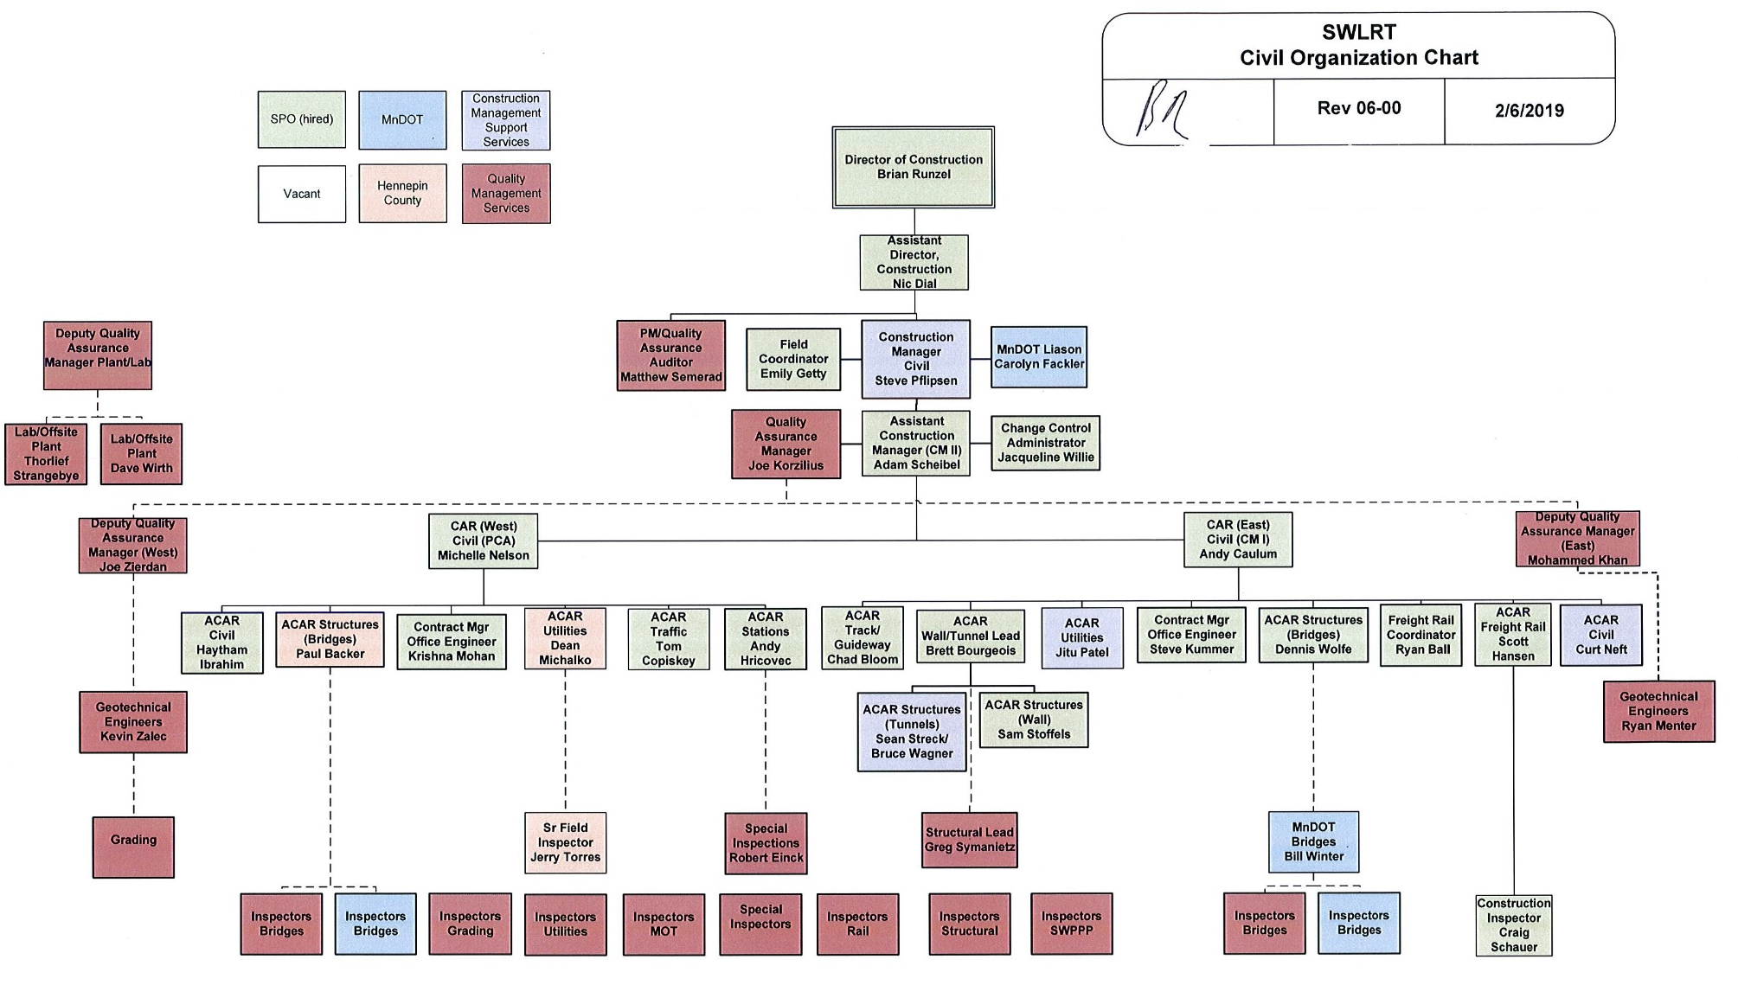
Construction Organizational Chart

Slide 9
Construction Meetings: Project Partners
Project partners (city/county/agencies) attend:
Pre-construction meetings
Weekly Progress meetings
Weekly Management of Traffic meetings
Weekly Utility Coordination meetings

Slide 10
Construction Activities: LMJV Activities
Preparing and submitting early required submittals
Field work
30-day background vibration monitoring at CICA
Freight rail delivery
Clearing & grubbing at many locations
Trail closures:
Kenilworth Trail 3 years
Cedar Lake Trail 2 years

Slide 11
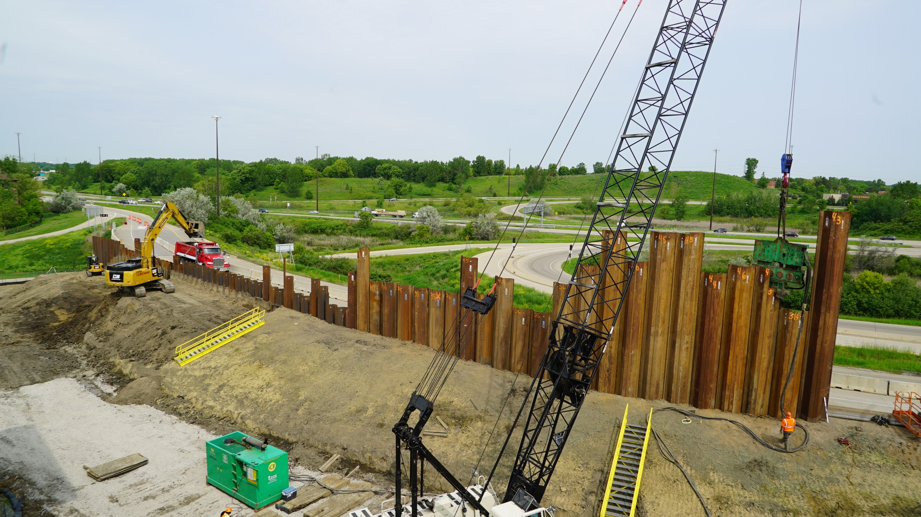
Construction Activities: Sheet Piling at SouthWest Station

Slide 12
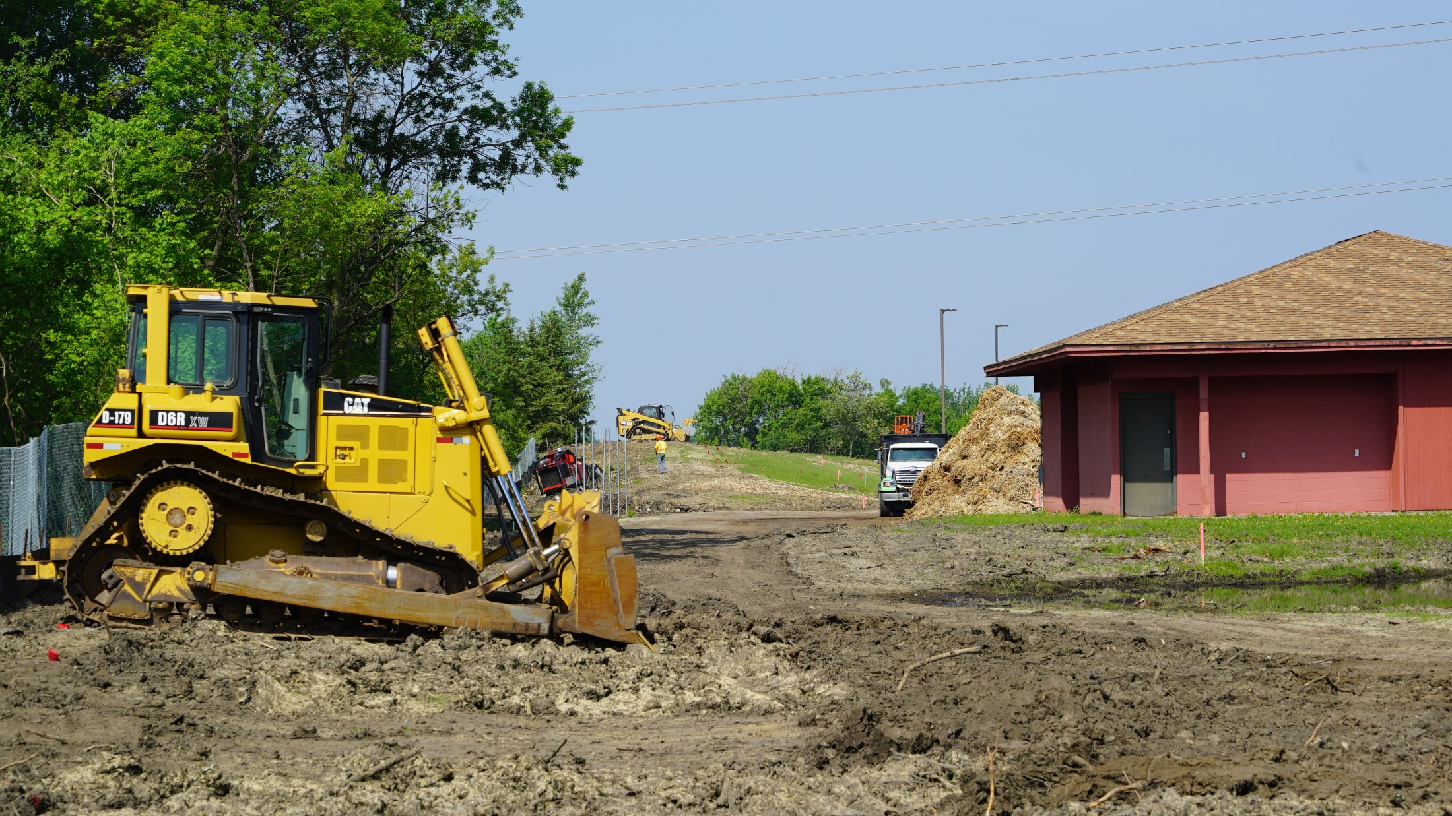
Construction Activities: Clearing Near EPTC

Slide 13
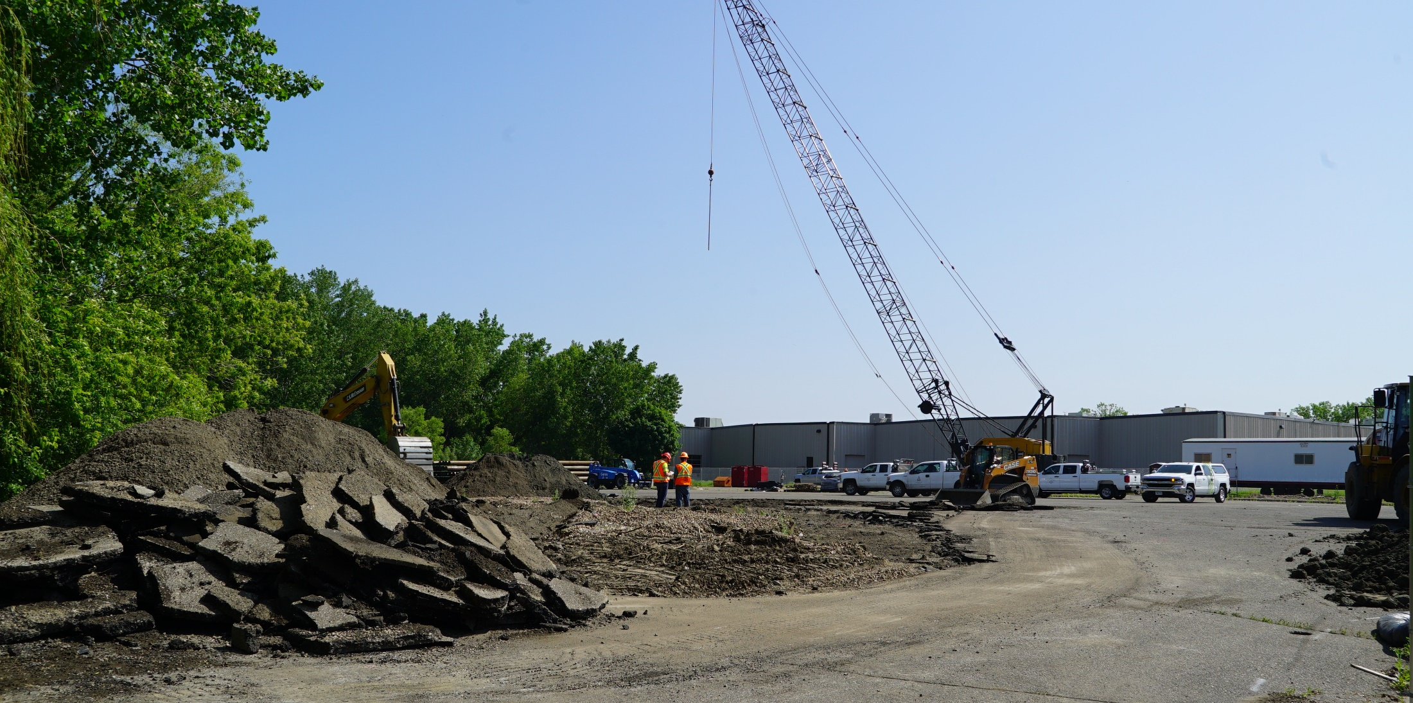
Construction Activities: Golden Triangle Station

Slide 14
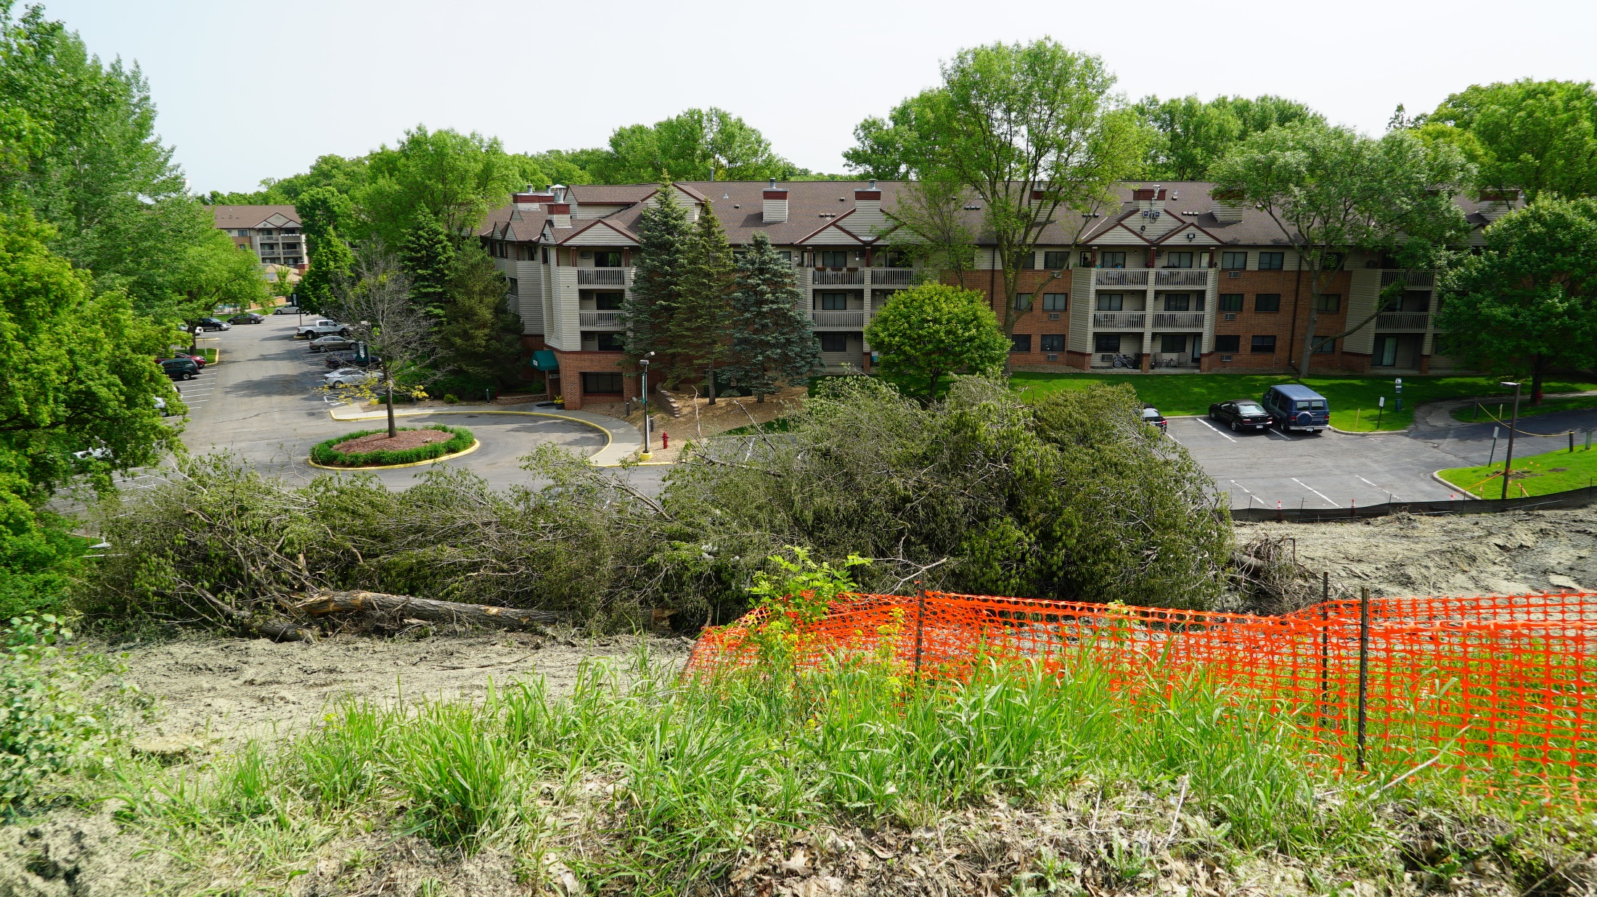
Construction Activities: Clearing & Grubbing
Near Smetana and Feltl roads in Minnetonka

Slide 15
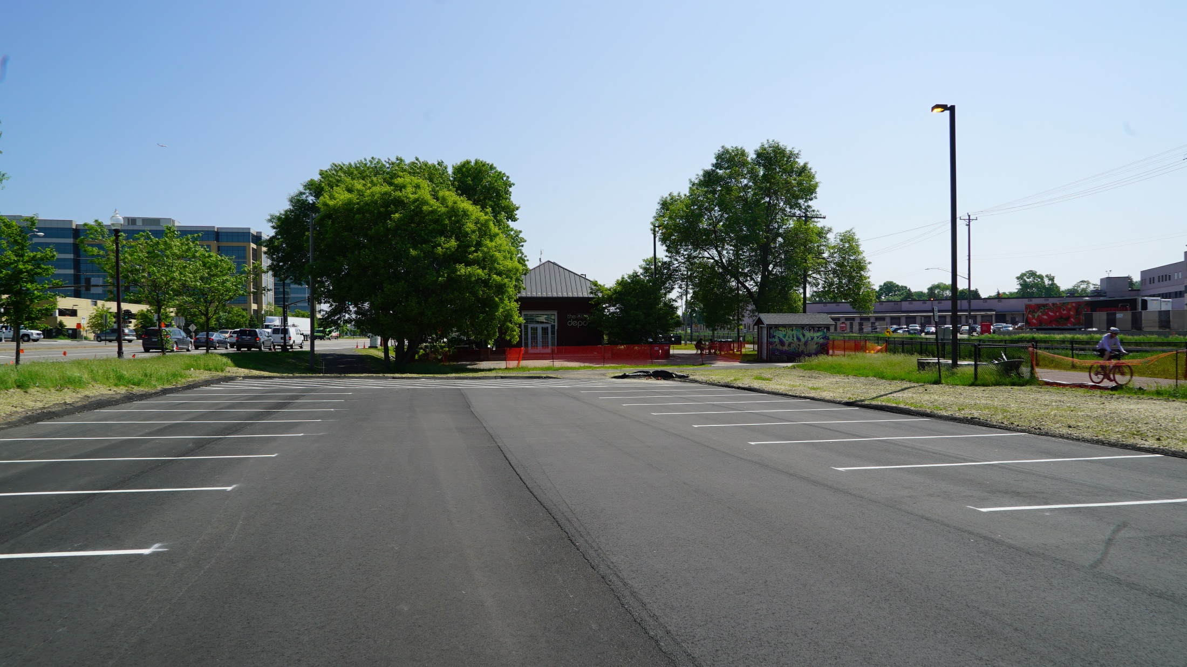
Construction Activities: Hopkins Depot

Slide 16
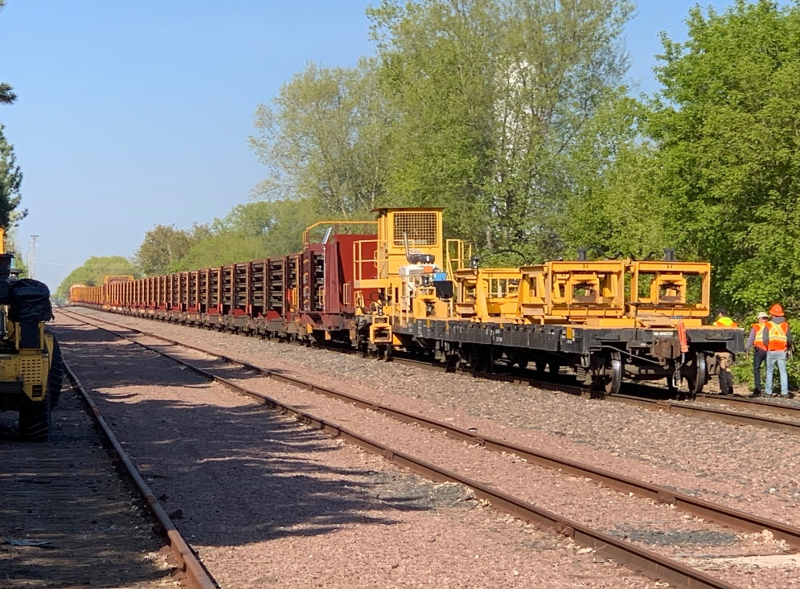
Construction Activities: First Rails Delivered

Slide 17
Construction Activities: Bird Nest Survey

Slide 18
2019 Look Ahead
Heavy construction throughout the alignment focused on:
Bridges
Tunnels
Retaining walls
Utility relocations

Slide 19
Communications & Outreach Update

Slide 20
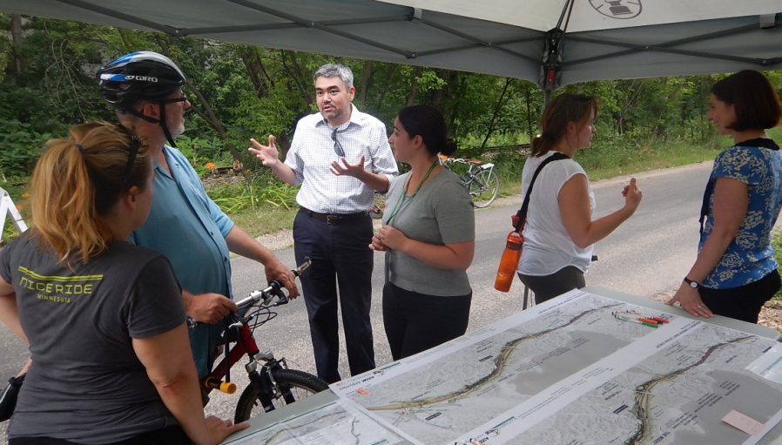
Construction Communications
Sign-up for the weekly project construction updates at swlrt.org; sent out every Friday to your email and/or phone
Follow us on
Twitter: @SouthwestLRT
Facebook: @MetropolitanCouncil
Instagram: @southwest_lrt
Learn more about the project: swlrt.org
Videos
Station renderings
Committee information

Slide 21
Digital Metrics: GovDelivery
April 26:
Sent: 8,256, Open: 2,931 (35%)
May 3:
Sent: 15,159, Open: 8,548 (56%)
May 10:
Sent: 14,963, Open: 9,376 (62%)
May 17:
Sent: 15,312, Open: 7,079 (46%)
May 24:
Sent: 15,368, Open: 6,969 (45%)
May 31:
Sent: 15,402, Open: 6,328 (41%)

Slide 22
Digital Metrics: SWLRT.ORG
January: 14,432
February: 27,013
March: 35,310
April: 37,933
May: 60,445

Slide 23
Digital Metrics: Twitter
Month | # of Tweets | Followers | Retweets | Likes | Mentions
January | 1 | 842 | 0 | 0 | 0
Feburary | 0 | 846 | 0 | 0 | 1
March | 2 | 859 | 3 | 20 | 5
April | 18 | 925 | 22 | 98 | 19
May | 26 | 1,100 | 88 | 196 | 29

Slide 24
Construction 24-Hour Hotline
May 15: Construction hotline active
Mostly questions about construction timing and comments about trail signage

Slide 25
Community Outreach
Reaching out to property owners/neighborhoods to discuss access during construction
Flyering impacted areas about upcoming construction activity

Slide 26
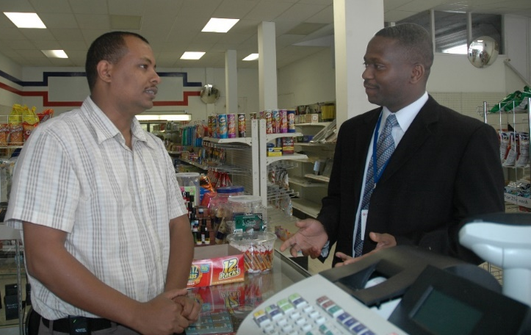
Business Outreach
Meeting with business owners to discuss access during construction
Developing content for customers, employees, suppliers
Special signage

Slide 27
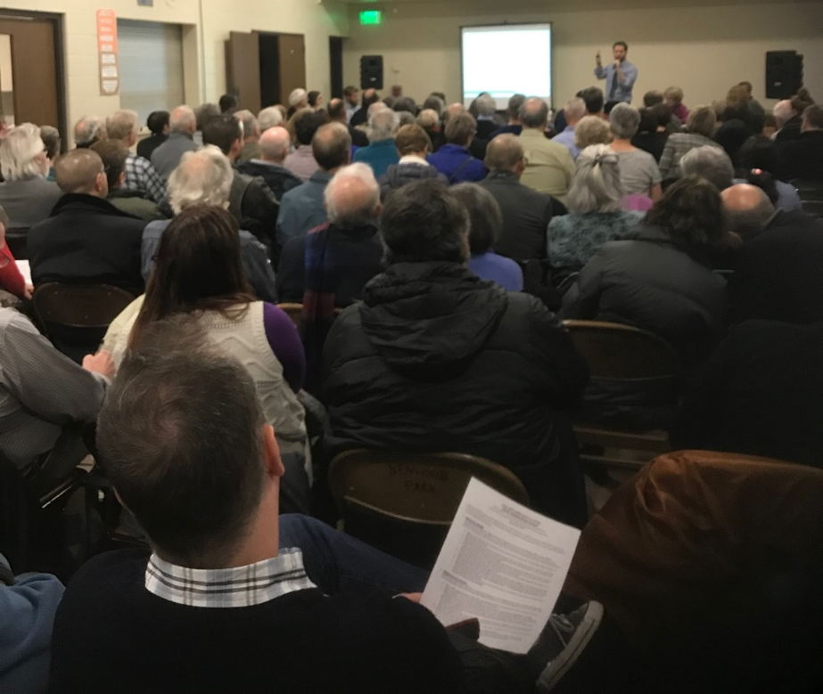
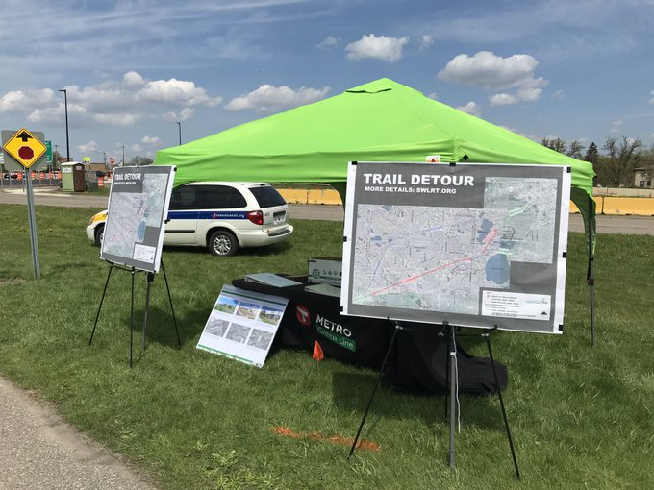
Spring Outreach Events
March 20: Kenwood/CIDNA Neighborhood Meeting
May 11: Cedar Lake Trail Pop-Up

Slide 28
Upcoming Outreach Activities
Construction open houses anticipated in July
Pop-up events along corridor
Trails
SouthWest Transit Station
Participate in summer community events
Neighborhood meetings

Slide 29
DBE & Workforce Advisory Committee Update

Slide 30
DBE & Workforce Advisory Committee
An opportunity for the Council to utilize community experts and resources to identify potential solutions for concerns raised by stakeholders
15 member committee
Co-chaired by MN Dept. of Human Rights and the Council
Made up of experts from community based organizations, agencies, unions

Slide 31
DBE & Workforce Advisory Committee Membership
Met Council Office of Equal Opportunity
MN Dept. of Human Rights
Minneapolis Building & Construction Trades Council
Hennepin County Purchasing and Contracts
Association of Women Contractors
National Association of Minority Contractors
Goodwill Easter Seals
HIRED
Summit OIC
Metropolitan Economic Development Association (MEDA)
Twin Cities R!SE
City of Mpls. Contract Compliance
Hire MN
Ramsey County Solutions
MN Department of Transportation

Slide 32
DBE Program Compliance
Federal program for increasing the participation of women and minority owned businesses in the award of federally assisted contracts
Council’s Office of Equal Opportunity is responsible for DBE monitoring and compliance on SWLRT
DBE goals on SWLRT construction contracts:
Rail Support Facility demolition: 17%
Civil construction: 16%
Systems: 12%

Slide 33
Workforce Compliance
Construction contracts with a value over $100K have Workforce Participation Goals
MN Department of Human Rights’ Office of Equity and Inclusion for Minnesota Businesses is responsible for monitoring and compliance
Workforce goals for Hennepin and Ramsey County :
20% Women
32% People of Color

Slide 34
DBE vs. Workforce Difference
DBE participation is measured by the dollars paid to disadvantaged small business
Workforce participation is measured by the hours worked on the project by skilled workers
They work together to support the Council’s equity commitments to the region

Slide 35
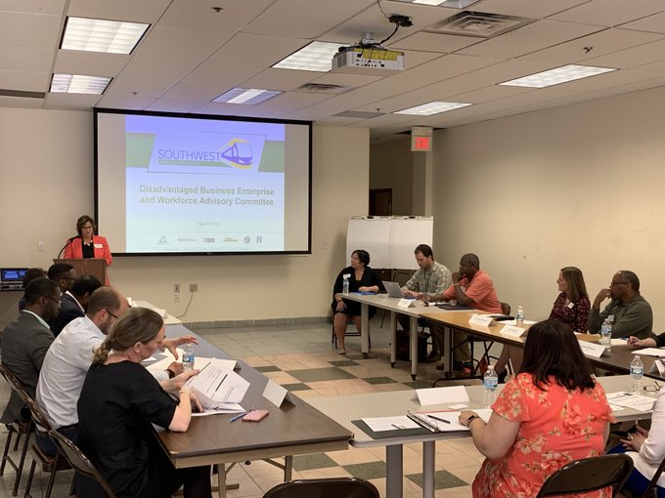
May 16 DBE & Workforce Kick-off

Slide 36
Summary of Meeting
Identifying challenges and opportunities
Barriers to training and workers
Long subcontractor payment cycles
Lack of working capital
Need to break away from doing business as usual
Discussed what success looks like
Exceeding the DBE and Workforce Goals
Long term career pathways beyond this project
No DBEs going out of business

Slide 37
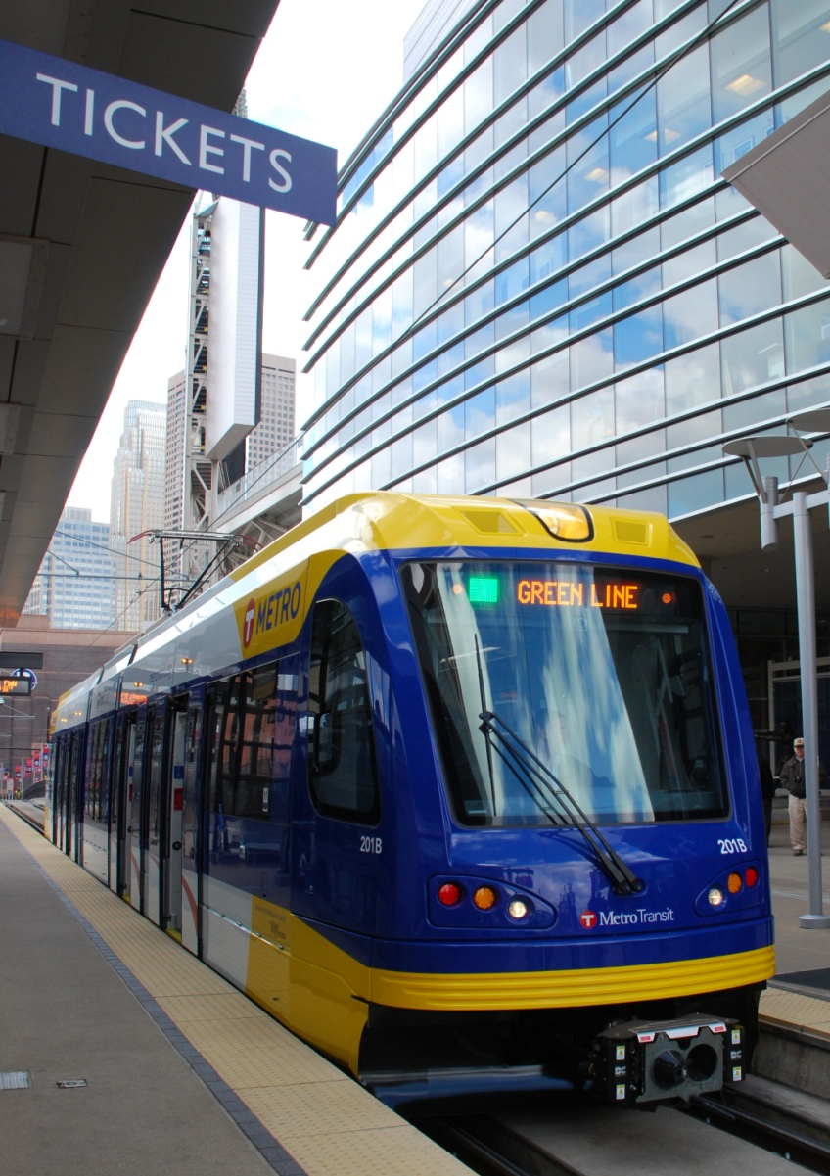
Stay Updated!
Online:
SWLRT.org
Twitter:
@SouthwestLRT
Facebook:
@MetropolitanCouncil
Instagram:
@southwest_lrt

